Slide 1
4
Completing the Accounting Cycle
Learning Objectives
After studying this chapter, you should be able to:
[1] Prepare a worksheet.
[2] Explain the process of closing the books.
[3] Describe the content and purpose of a post-closing trial balance.
[4] State the required steps in the accounting cycle.
[5] Explain the approaches to preparing correcting entries.
[6] Identify the sections of a classified balance sheet.

Slide 2
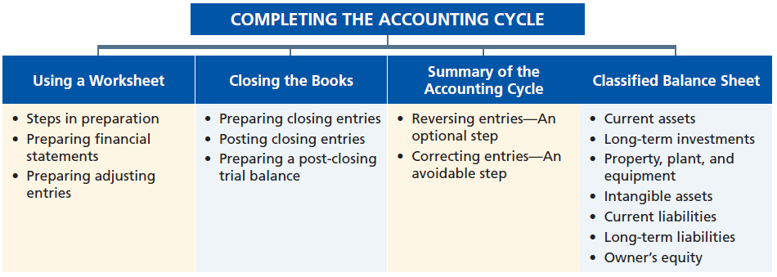
Preview of Chapter 4
Accounting Principles
Eleventh Edition
Weygandt Kimmel Kieso

Slide 3
Using a Worksheet
Steps in Preparing a Worksheet
Multiple-column form used in preparing financial statements.
Not a permanent accounting record.
Five step process.
Use of worksheet is optional.
LO 1 Prepare a worksheet.

Slide 4
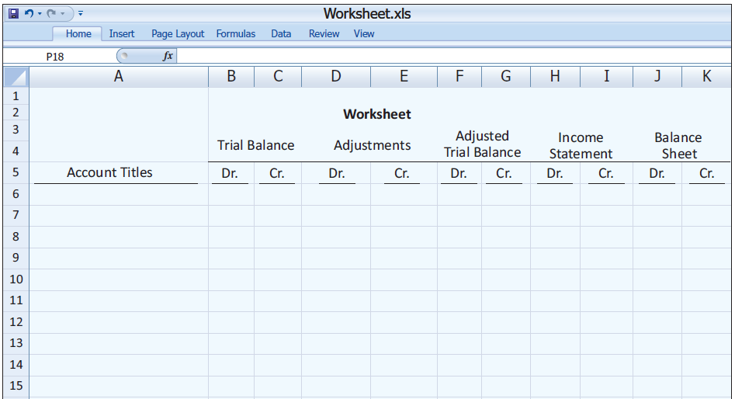
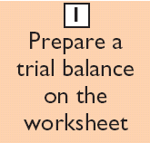
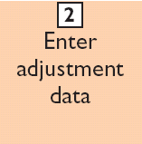
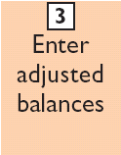
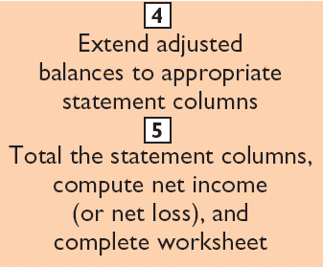
Steps in Preparing a Worksheet
Illustration 4-1
LO 1 Prepare a worksheet.

Slide 5
Steps in Preparing a Worksheet
1. Prepare a Trial Balance on the Worksheet
Illustration 4-2
Trial balance amounts come directly from ledger accounts.
Include all accounts with balances.
LO 1 Prepare a worksheet.

Slide 6
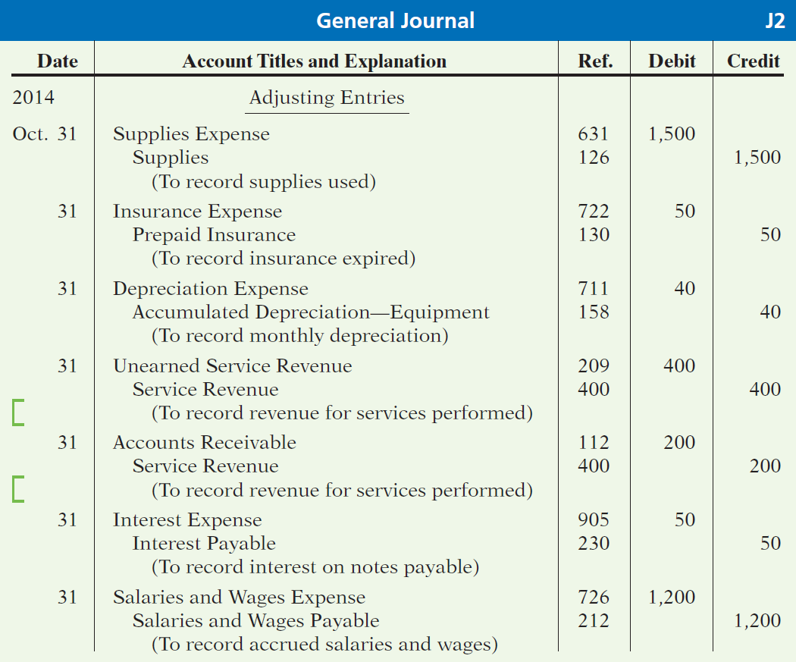
Steps in Preparing a Worksheet
Illustration 3-23
General journal showing adjusting entries
Adjusting Journal Entries
(Chapter 3)
LO 1 Prepare a worksheet.

Slide 7
Steps in Preparing a Worksheet
2. Enter the Adjustments in the Adjustments Columns
(a)
(b)
Adjustments Key:
(a) Supplies Used.
(b) Insurance Expired.
(c) Depreciation Expensed.
(d) Service Revenue Earned.
(e) Service Revenue Accrued.
(f) Interest Accrued.
(g) Salaries Accrued.
(d)
(d)
(g)
(e)
(a)
(b)
(c)
(c)
(e)
Enter adjustment amounts, total adjustments columns,
and check for equality.
(f)
(f)
(g)
Add additional accounts as needed.
LO 1 Prepare a worksheet.

Slide 8
Steps in Preparing a Worksheet
3. Complete the Adjusted Trial Balance Columns
(a)
(b)
(d)
(d)
(g)
(e)
(a)
(b)
(c)
(c)
(e)
(f)
(f)
(g)
Total the adjusted trial balance columns and check for equality.
LO 1 Prepare a worksheet.

Slide 9
Steps in Preparing a Worksheet
4. Extend Amounts to Financial Statement Columns
(a)
(b)
(d)
(d)
(g)
(e)
(a)
(b)
(c)
(c)
(e)
(f)
(f)
(g)
Extend all revenue and expense account balances to the income statement columns.
LO 1 Prepare a worksheet.

Slide 10
Steps in Preparing a Worksheet
5. Total Columns, Compute Net Income (Loss)
(a)
(b)
(d)
(d)
(g)
(e)
(a)
(b)
(c)
(c)
(e)
(f)
(f)
(g)
Compute Net Income or Net Loss.
LO 1 Prepare a worksheet.

Slide 11
Steps in Preparing a Worksheet
Review Question
Net income is shown on a worksheet in the:
income statement debit column only.
balance sheet debit column only.
income statement credit column and balance sheet debit column.
income statement debit column and balance sheet credit column.
LO 1 Prepare a worksheet.

Slide 12
Using a Worksheet
Preparing Statements from a Worksheet
Income statement is prepared from the income statement columns.
Balance sheet and owner’s equity statement are prepared from the balance sheet columns.
Companies journalize and post adjusting entries.
LO 1 Prepare a worksheet.

Slide 13
Preparing Statements from a Worksheet
Illustration 4-4
LO 1 Prepare a worksheet.

Slide 14
Preparing Statements from a Worksheet
Illustration 4-4
LO 1 Prepare a worksheet.

Slide 15
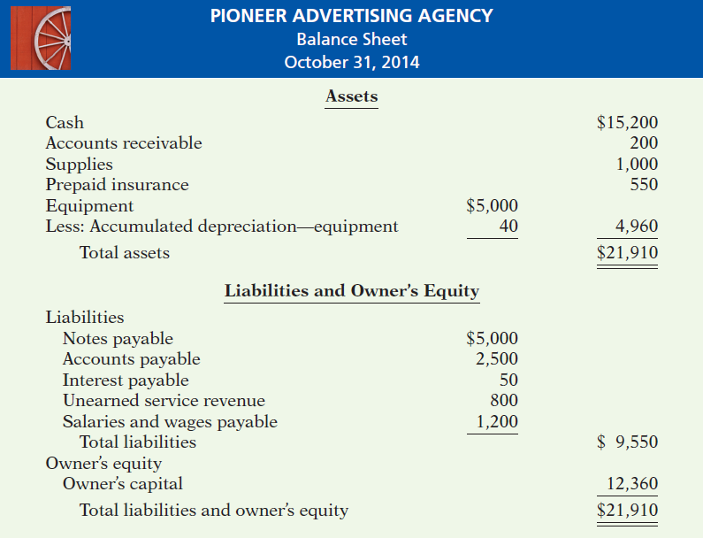
Preparing Statements from a Worksheet
Illustration 4-4
LO 1

Slide 16
Using a Worksheet
Preparing Adjusting Entries from a Worksheet
Adjusting entries are prepared from the adjustments columns of the worksheet.
Journalizing and posting of adjusting entries follows the preparation of financial statements when a worksheet is used.
LO 1 Prepare a worksheet.

Slide 17
>
DO IT!
Susan Elbe is preparing a worksheet. Explain to Susan how she should extend the following adjusted trial balance accounts to the financial statement columns of the worksheet.
Cash
Balance sheet (debit column)
Accumulated Depreciation
Balance Sheet (credit column)
Accounts Payable
Balance Sheet (credit column)
Owner’s Drawings
Balance sheet (debit column)
Service Revenue
Income statement (credit column)
Salaries and Wages Expense
Income statement (debit column)
LO 1 Prepare a worksheet.

Slide 18
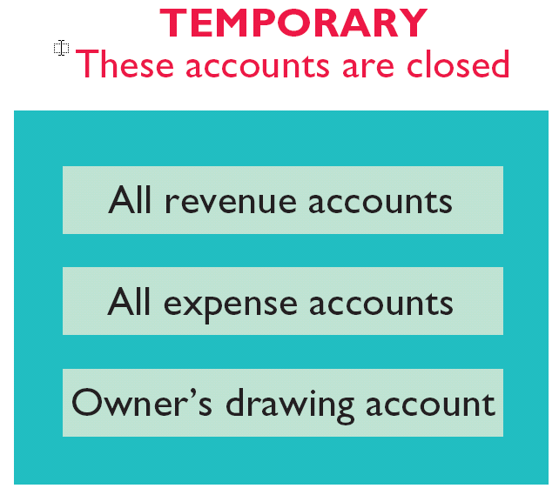
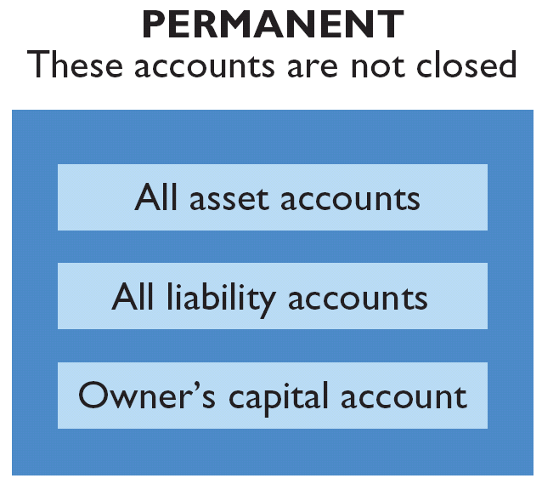
Closing the Books
At the end of the accounting period, the company makes the accounts ready for the next period.
Illustration 4-5
LO 2 Explain the process of closing the books.

Slide 19
Closing the Books
Preparing Closing Entries
Closing entries formally recognize, in the general ledger, the transfer of
net income (or net loss) and
owner’s drawing
to owner’s capital.
Closing entries are only made at the end of the annual accounting period.
LO 2 Explain the process of closing the books.

Slide 20
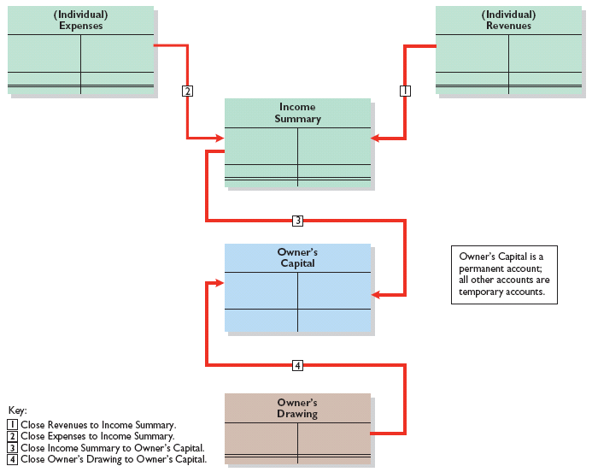
Closing the Books
Note:
Owner’s Drawing is closed directly to Capital and not to Income Summary because Owner’s Drawing is not an expense.
Illustration 4-6
Owner’s Capital is a permanent account; all other accounts are temporary accounts.
LO 2 Explain the process of closing the books.

Slide 21
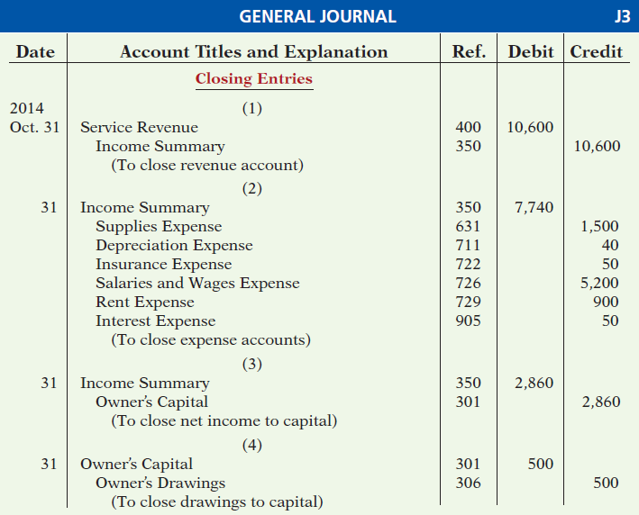
Closing the Books
Closing Entries Illustrated
Illustration 4-7
Closing entries journalized

Slide 22
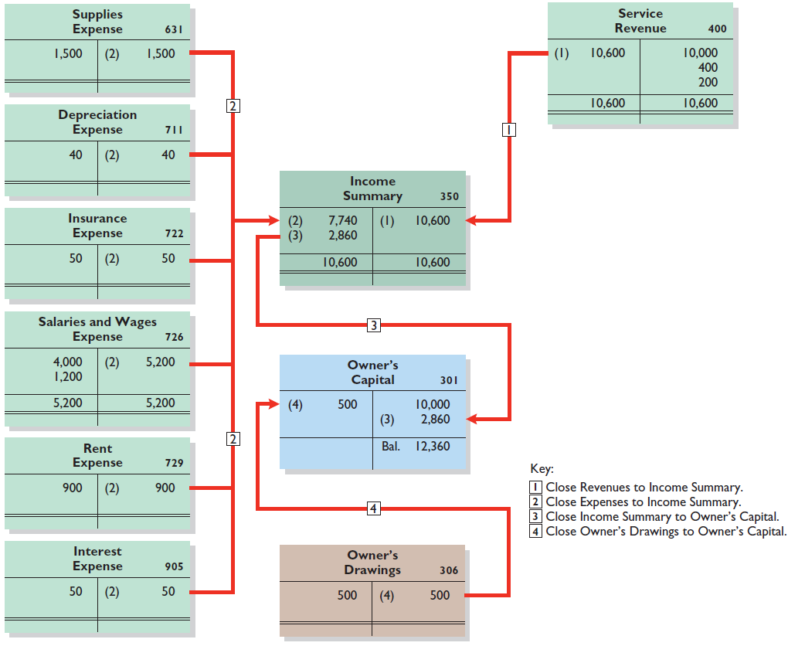
Closing the Books
Posting Closing Entries
Illustration 4-8
LO 2

Slide 23
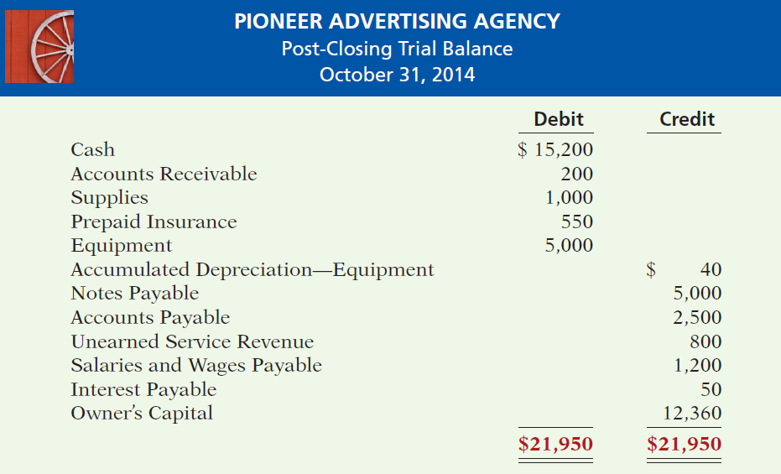
Preparing a Post-Closing Trial Balance
Purpose is to prove the equality of the permanent account balances after journalizing and posting of closing entries.
Illustration 4-9
LO 3

Slide 24
Summary of the Accounting Cycle
Illustration 4-12
1. Analyze business transactions
9. Prepare a post-closing trial balance
2. Journalize the transactions
8. Journalize and post closing entries
3. Post to ledger accounts
7. Prepare financial statements
4. Prepare a trial balance
6. Prepare an adjusted trial balance
5. Journalize and post adjusting entries
LO 4 State the required steps in the accounting cycle.

Slide 25
Summary of the Accounting Cycle
Correcting Entries—An Avoidable Step
Unnecessary if the records are error-free.
Made whenever an error is discovered.
Must be posted before closing entries.
Instead of preparing a correcting entry, it is possible to reverse the incorrect entry and then prepare the correct entry.
LO 5 Explain the approaches to preparing correcting entries.

Slide 26
Correcting Entries—An Avoidable Step
Illustration (Case 1): On May 10, Mercato Co. journalized and posted a $50 cash collection on account from a customer as a debit to Cash $50 and a credit to Service Revenue $50. The company discovered the error on May 20, when the customer paid the remaining balance in full.
Incorrect entry
Cash 50
Service Revenue 50
Correct entry
Cash 50
Accounts Receivable 50
Correcting entry
Service Revenue 50
Accounts Receivable 50
LO 5 Explain the approaches to preparing correcting entries.

Slide 27
Correcting Entries—An Avoidable Step
Illustration (Case 2): On May 18, Mercato purchased on account equipment costing $450. The transaction was journalized and posted as a debit to Equipment $45 and a credit to Accounts Payable $45. The error was discovered on June 3,
Incorrect entry
Equipment 45
Accounts Payable 45
Correct entry
Equipment 450
Accounts Payable 450
Correcting entry
Equipment 405
Accounts Payable 405
LO 5 Explain the approaches to preparing correcting entries.

Slide 28
The Classified Balance Sheet
Presents a snapshot at a point in time.
To improve understanding, companies group similar assets and similar liabilities together.
Standard Classifications
Illustration 4-17
Assets Liabilities and Owner’s Equity
Current assets Current liabilities
Long-term investments Long-term liabilities
Property, plant, and equipment Owner’s (Stockholders’) equity
Intangible assets
LO 6 Identify the sections of a classified balance sheet.

Slide 29
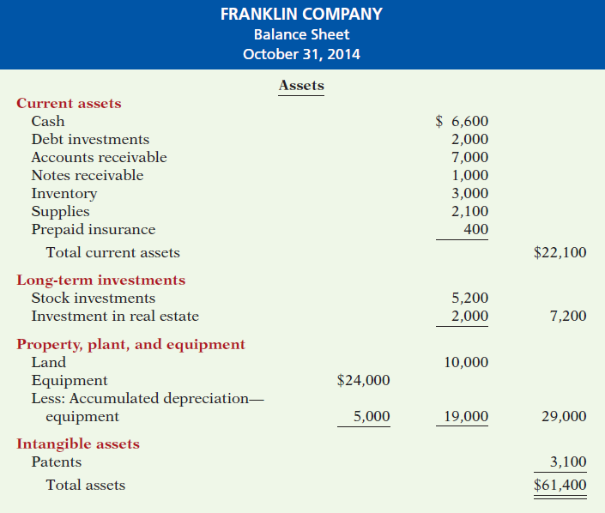
The Classified Balance Sheet
Illustration 4-18
LO 6

Slide 30
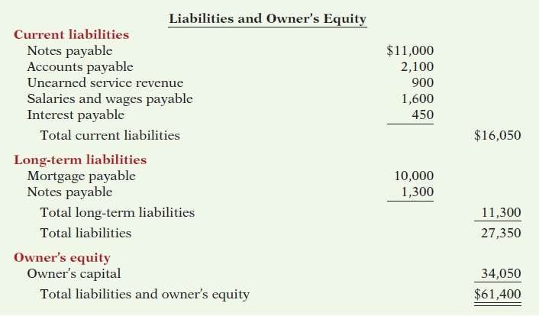
The Classified Balance Sheet
Illustration 4-18
LO 6

Slide 31
The Classified Balance Sheet
Current Assets
Assets that a company expects to convert to cash or use up within one year or the operating cycle, whichever is longer.
Operating cycle is the average time it takes from the purchase of inventory to the collection of cash from customers.
LO 6 Identify the sections of a classified balance sheet.

Slide 32
The Classified Balance Sheet
Current Assets
Illustration 4-19
Usually listed in the order they expect to convert them into cash.
LO 6 Identify the sections of a classified balance sheet.

Slide 33
The Classified Balance Sheet
Question
Cash, and other resources that are reasonably expected to be realized in cash or sold or consumed in the business within one year or the operating cycle, are called:
Current assets.
Intangible assets.
Long-term investments.
Property, plant, and equipment.
LO 6 Identify the sections of a classified balance sheet.

Slide 34
The Classified Balance Sheet
Long-Term Investments
Investments in stocks and bonds of other companies.
Investments in long-term assets such as land or buildings that a company is not currently using in its operating activities.
Illustration 4-20
LO 6 Identify the sections of a classified balance sheet.

Slide 35
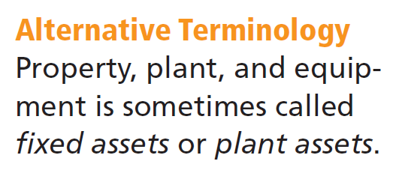
The Classified Balance Sheet
Property, Plant, and Equipment
Long useful lives.
Currently used in operations.
Depreciation - allocating the cost of assets to a number of years.
Accumulated depreciation - total amount of depreciation expensed thus far in the asset’s life.
LO 6 Identify the sections of a classified balance sheet.

Slide 36
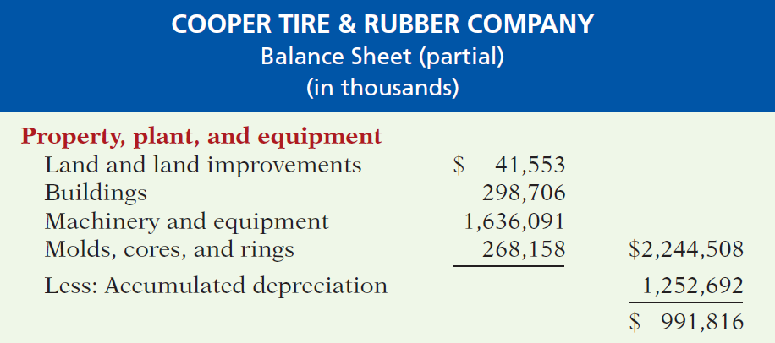
The Classified Balance Sheet
Property, Plant, and Equipment
Illustration 4-21
LO 6 Identify the sections of a classified balance sheet.

Slide 37
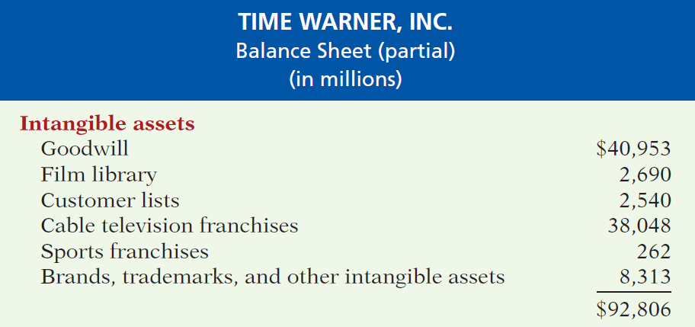
The Classified Balance Sheet
Intangible Assets
Assets that do not have physical substance.
Illustration 4-22
LO 6 Identify the sections of a classified balance sheet.

Slide 38
The Classified Balance Sheet
Question
Patents and copyrights are
Current assets.
Intangible assets.
Long-term investments.
Property, plant, and equipment.
LO 6 Identify the sections of a classified balance sheet.

Slide 39
The Classified Balance Sheet
Current Liabilities
Obligations company is to pay within the coming year or its operating cycle, whichever is longer.
Usually list notes payable first, followed by accounts payable. Other items follow in order of magnitude.
Liquidity - ability to pay obligations expected to be due within the next year.
LO 6 Identify the sections of a classified balance sheet.

Slide 40
The Classified Balance Sheet
Current Liabilities
Illustration 4-23
LO 6 Identify the sections of a classified balance sheet.

Slide 41
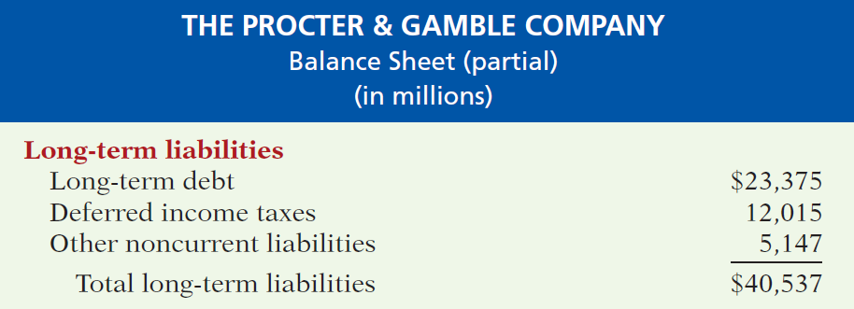
The Classified Balance Sheet
Long-Term Liabilities
Obligations a company expects to pay after one year.
Illustration 4-24
LO 6 Identify the sections of a classified balance sheet.

Slide 42
The Classified Balance Sheet
Question
Which of the following is not a long-term liability?
Bonds payable
Current maturities of long-term obligations
Long-term notes payable
Mortgages payable
LO 6 Identify the sections of a classified balance sheet.

Slide 43
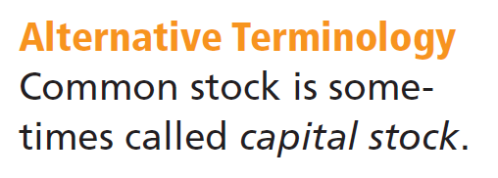
The Classified Balance Sheet
Owner’s Equity
Proprietorship - one capital account.
Partnership - capital account for each partner.
Corporation - Capital Stock and Retained Earnings.
Illustration 4-25
LO 6 Identify the sections of a classified balance sheet.

