Slide 2
5
Accounting for Merchandising Operations
Learning Objectives
After studying this chapter, you should be able to:
[1] Identify the differences between a service and merchandising companies.
[2] Explain the recording of purchases under a perpetual inventory system.
[3] Explain the recording of sales revenues under a perpetual inventory system.
[4] Explain the steps in the accounting cycle for a merchandising company.
[5] Distinguish between a multiple-step and a single-step income statement.

Slide 3
Preview of Chapter 5
Accounting Principles
Eleventh Edition
Weygandt Kimmel Kieso

Slide 4
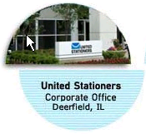
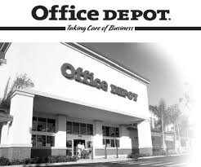
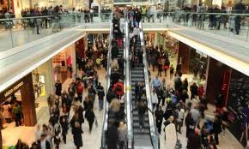
Merchandising Operations
Merchandising Companies
Buy and Sell Goods
Retailer
Wholesaler
Consumer
The primary source of revenues is referred to as sales revenue or sales.
LO 1 Identify the differences between service and merchandising companies.

Slide 5
Merchandising Operations
Income Measurement
Sales
Revenue
Not used in a Service business.
Less
Illustration 5-1
Income measurement process for a merchandising company
Cost of
Goods Sold
Equals
Gross
Profit
Less
Operating
Expenses
Net
Income
(Loss)
Cost of goods sold is the total cost of merchandise sold during the period.
Equals
LO 1 Identify the differences between service and merchandising companies.

Slide 6
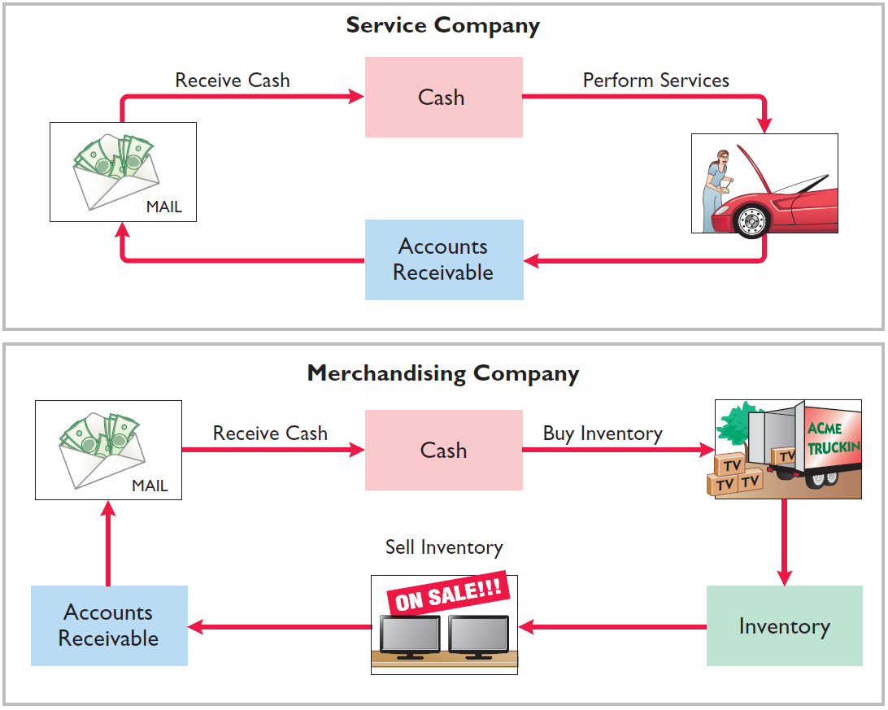
Merchandising Operations
Operating Cycles
Illustration 5-2
The operating cycle of a merchandising company ordinarily is longer than that of a service company.
Illustration 5-3
LO 1 Identify the differences between service and merchandising companies.

Slide 7
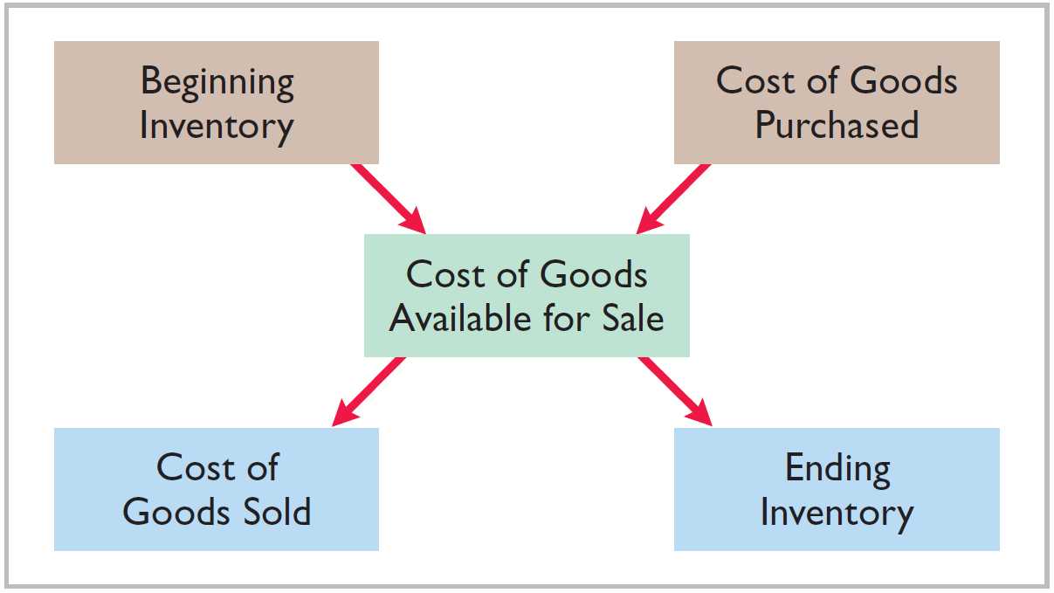
Merchandising Operations
Flow of Costs
Illustration 5-4
Companies use either a perpetual inventory system or a periodic inventory system to account for inventory.
LO 1 Identify the differences between service and merchandising companies.

Slide 8
Merchandising Operations
Flow of Costs
Perpetual System
Maintain detailed records of the cost of each inventory purchase and sale.
Records continuously show inventory that should be on hand for every item.
Company determines cost of goods sold each time a sale occurs.
LO 1 Identify the differences between service and merchandising companies.

Slide 9
Merchandising Operations
Flow of Costs
Periodic System
Do not keep detailed records of the goods on hand.
Cost of goods sold determined by count at the end of the accounting period.
Calculation of Cost of Goods Sold:
Beginning inventory $ 100,000
Add: Purchases, net 800,000
Goods available for sale 900,000
Less: Ending inventory 125,000
Cost of goods sold $ 775,000
LO 1

Slide 10
Merchandising Operations
Flow of Costs
Advantages of the Perpetual System
Traditionally used for merchandise with high unit values.
Shows the quantity and cost of the inventory that should be on hand at any time.
Provides better control over inventories than a periodic system.
LO 1 Identify the differences between service and merchandising companies.

Slide 11
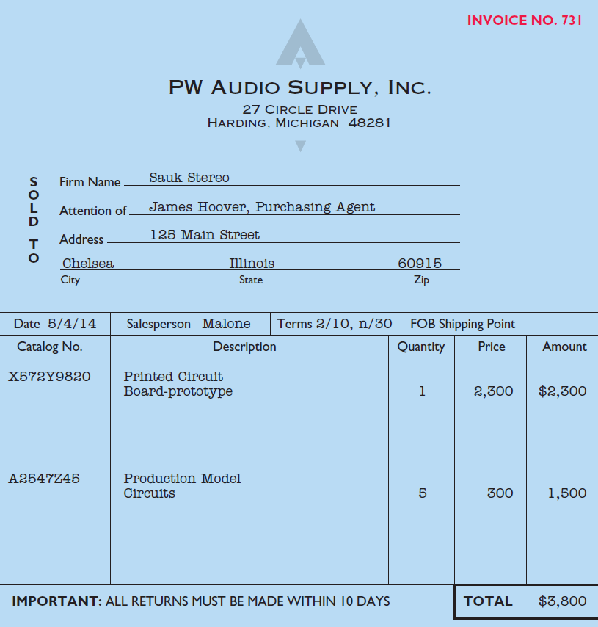
Recording Purchases of Merchandise
Made using cash or credit (on account).
Illustration 5-6
Normally record when goods are received from the seller.
Purchase invoice should support each credit purchase.
LO 2 Explain the recording of purchases under a perpetual inventory system.

Slide 12
Recording Purchases of Merchandise
Illustration: Sauk Stereo (the buyer) uses as a purchase invoice the sales invoice prepared by PW Audio Supply, Inc. (the seller). Prepare the journal entry for Sauk Stereo for the invoice from PW Audio Supply.
Illustration 5-6
May 4
Inventory 3,800
Accounts Payable 3,800
LO 2 Explain the recording of purchases under a perpetual inventory system.

Slide 13
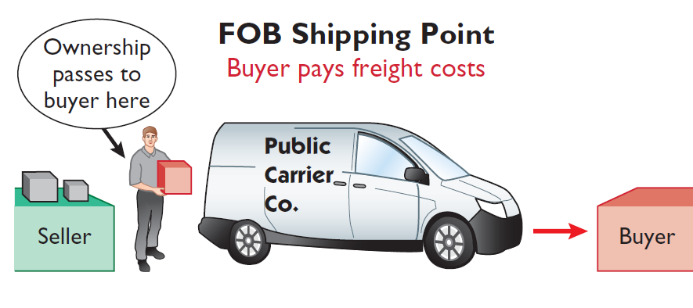
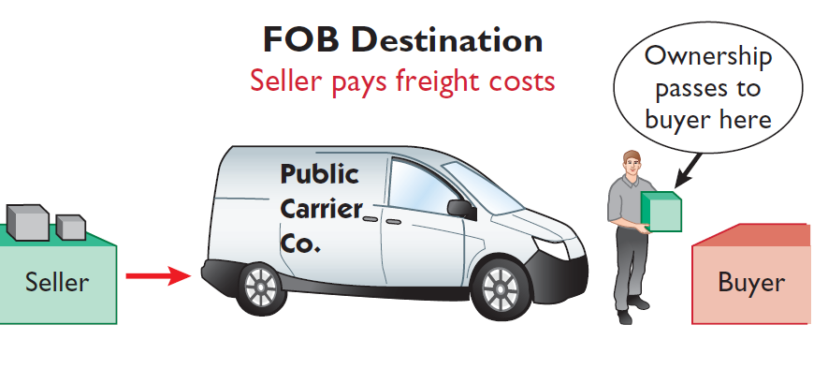
Recording Purchases of Merchandise
Freight Costs – Terms of Sale
Illustration 5-7 Shipping terms
Ownership of the goods passes to the buyer when the public carrier accepts the goods from the seller.
Ownership of the goods remains with the seller until the goods reach the buyer.
Freight costs incurred by the seller are an operating expense.
LO 2

Slide 14
Recording Purchases of Merchandise
Illustration: Assume upon delivery of the goods on May 6, Sauk Stereo pays Public Freight Company $150 for freight charges, the entry on Sauk Stereo’s books is:
May 6
Inventory 150
Cash 150
Assume the freight terms on the invoice in Illustration 5-6 had required PW Audio Supply to pay the freight charges, the entry by PW Audio Supply would have been:
May 4
Freight-Out 150
Cash 150
LO 2 Explain the recording of purchases under a perpetual inventory system.

Slide 15
Recording Purchases of Merchandise
Purchase Returns and Allowances
Purchaser may be dissatisfied because goods are damaged or defective, of inferior quality, or do not meet specifications.
Purchase Return
Purchase Allowance
Return goods for credit if the sale was made on credit, or for a cash refund if the purchase was for cash.
May choose to keep the merchandise if the seller will grant a reduction of the purchase price.
LO 2 Explain the recording of purchases under a perpetual inventory system.

Slide 16
Recording Purchases of Merchandise
Illustration: Assume Sauk Stereo returned goods costing $300 to PW Audio Supply on May 8.
May 8
Accounts Payable 300
Inventory 300
LO 2 Explain the recording of purchases under a perpetual inventory system.

Slide 17
Recording Purchases of Merchandise
Purchase Discounts
Credit terms may permit buyer to claim a cash discount for prompt payment.
Advantages:
Purchaser saves money.
Seller shortens the operating cycle by converting the accounts receivable into cash earlier.
Example: Credit terms may read 2/10, n/30.
LO 2 Explain the recording of purchases under a perpetual inventory system.

Slide 18
Recording Purchases of Merchandise
Purchase Discounts - Terms
2/10, n/30
1/10 EOM
n/10 EOM
2% discount if paid within 10 days, otherwise net amount due within 30 days.
1% discount if paid within first 10 days of next month.
Net amount due within the first 10 days of the next month.
LO 2 Explain the recording of purchases under a perpetual inventory system.

Slide 19
Recording Purchases of Merchandise
Illustration: Assume Sauk Stereo pays the balance due of $3,500 (gross invoice price of $3,800 less purchase returns and allowances of $300) on May 14, the last day of the discount period. Prepare the journal entry Sauk Stereo makes on May 14 to record the payment.
May 14
Accounts Payable 3,500
Inventory 70
Cash 3,430
(Discount = $3,500 x 2% = $70)
LO 2 Explain the recording of purchases under a perpetual inventory system.

Slide 20
Recording Purchases of Merchandise
Illustration: If Sauk Stereo failed to take the discount, and instead made full payment of $3,500 on June 3, the journal entry would be:
June 3
Accounts Payable 3,500
Cash 3,500
LO 2 Explain the recording of purchases under a perpetual inventory system.

Slide 21
Recording Purchases of Merchandise
Purchase Discounts
Should discounts be taken when offered?
LO 2 Explain the recording of purchases under a perpetual inventory system.

Slide 22
Recording Purchases of Merchandise
Summary of Purchasing Transactions
4th - Purchase
3,800
300
8th - Return
6th – Freight-in
150
70
14th - Discount
Balance
3,580
LO 2 Explain the recording of purchases under a perpetual inventory system.

Slide 23
Recording Sales of Merchandise
Made using cash or credit (on account).
Illustration 5-6
Sales revenue, like service revenue, is recorded when the performance obligation is satisfied.
Performance obligation is satisfied when the goods are transferred from the seller to the buyer.
Sales invoice should support each credit sale.
LO 3 Explain the recording of sales revenues under a perpetual inventory system.

Slide 24
Recording Sales of Merchandise
Journal Entries to Record a Sale
#1
Cash or Accounts receivable XXX
Selling Price
Sales revenue XXX
#2
Cost of goods sold XXX
Cost
Inventory XXX
LO 3 Explain the recording of sales revenues under a perpetual inventory system.

Slide 25
Recording Sales of Merchandise
Illustration: PW Audio Supply records the sale of $3,800 on May 4 to Sauk Stereo on account (Illustration 5-6) as follows (assume the merchandise cost PW Audio Supply $2,400).
May 4
Accounts Receivable 3,800
Sales Revenue 3,800
4
Cost of Goods Sold 2,400
Inventory 2,400
LO 3 Explain the recording of sales revenues under a perpetual inventory system.

Slide 26
Recording Sales of Merchandise
Sales Returns and Allowances
“Flip side” of purchase returns and allowances.
Contra-revenue account to Sales Revenue (debit).
Sales not reduced (debited) because:
Would obscure importance of sales returns and allowances as a percentage of sales.
Could distort comparisons.
LO 3 Explain the recording of sales revenues under a perpetual inventory system.

Slide 27
Recording Sales of Merchandise
Illustration: Prepare the entry PW Audio Supply would make to record the credit for returned goods that had a $300 selling price (assume a $140 cost). Assume the goods were not defective.
May 8
Sales Returns and Allowances 300
Accounts Receivable 300
8
Inventory 140
Cost of Goods Sold 140
LO 3 Explain the recording of sales revenues under a perpetual inventory system.

Slide 28
Recording Sales of Merchandise
Illustration: Assume the returned goods were defective and had a scrap value of $50, PW Audio would make the following entries:
May 8
Sales Returns and Allowances 300
Accounts Receivable 300
8
Inventory 50
Cost of Goods Sold 50
LO 3 Explain the recording of sales revenues under a perpetual inventory system.

Slide 29
Recording Sales of Merchandise
Sales Discount
Offered to customers to promote prompt payment of the balance due.
Contra-revenue account (debit) to Sales Revenue.
LO 3 Explain the recording of sales revenues under a perpetual inventory system.

Slide 30
Recording Sales of Merchandise
Illustration: Assume Sauk Stereo pays the balance due of $3,500 (gross invoice price of $3,800 less purchase returns and allowances of $300) on May 14, the last day of the discount period. Prepare the journal entry PW Audio Supply makes to record the receipt on May 14.
May 14
Cash 3,430
Sales Discounts 70
*
Accounts Receivable 3,500
* [($3,800 – $300) X 2%]
LO 3 Explain the recording of sales revenues under a perpetual inventory system.

Slide 31
Completing the Accounting Cycle
Adjusting Entries
Generally the same as a service company.
One additional adjustment to make the records agree with the actual inventory on hand.
Involves adjusting Inventory and Cost of Goods Sold.
LO 4 Explain the steps in the accounting cycle for a merchandising company.

Slide 32
Completing the Accounting Cycle
Illustration: Suppose that PW Audio Supply has an unadjusted balance of $40,500 in Merchandise Inventory. Through a physical count, PW Audio determines that its actual merchandise inventory at year-end is $40,000. The company would make an adjusting entry as follows.
Cost of Goods Sold 500
Inventory 500
LO 4 Explain the steps in the accounting cycle for a merchandising company.

Slide 33
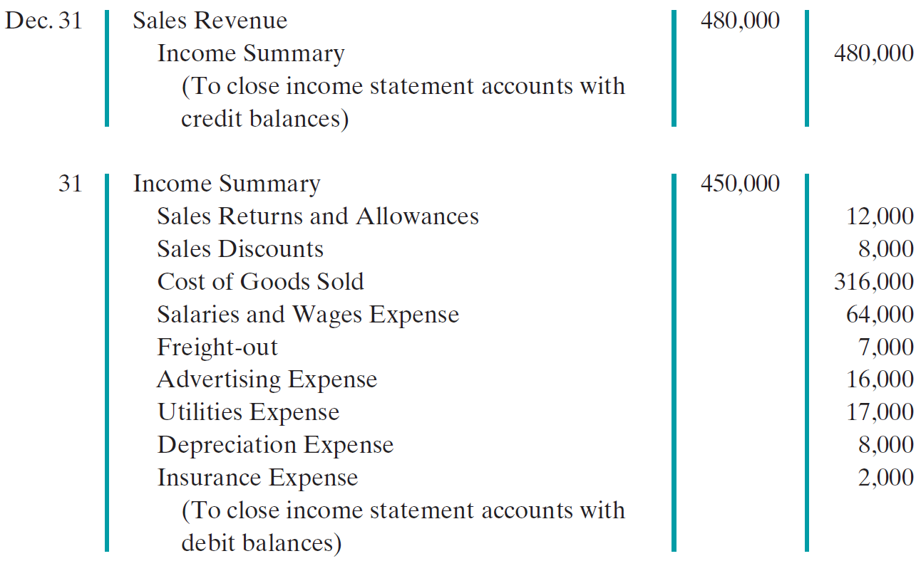
Completing the Accounting Cycle
Closing Entries
LO 4 Explain the steps in the accounting cycle for a merchandising company.

Slide 34
Completing the Accounting Cycle
Closing Entries
LO 4 Explain the steps in the accounting cycle for a merchandising company.

Slide 35
Forms of Financial Statements
Multiple-Step Income Statement
Shows several steps in determining net income.
Two steps relate to principal operating activities.
Distinguishes between operating and non-operating activities.
LO 5 Distinguish between a multiple-step and a single-step income statement.

Slide 36
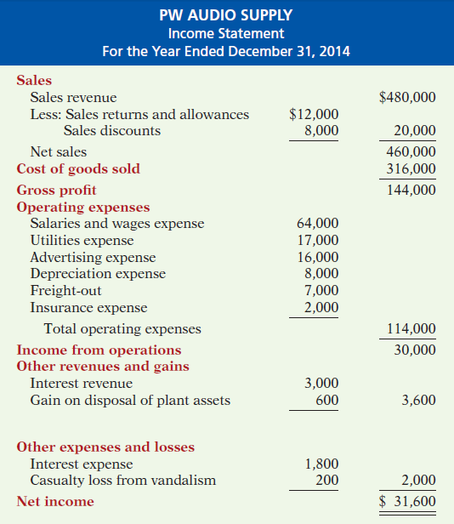
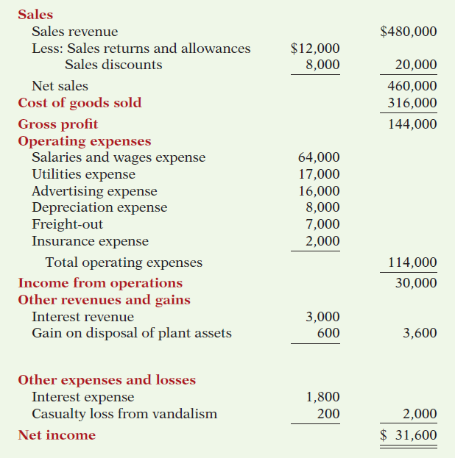
Multiple- Step
Illustration 5-14
Key Items:
Net sales
Illustration 5-14
LO 5

Slide 37
Multiple- Step
Illustration 5-14
Key Items:
Net sales
Gross profit
Illustration 5-14
LO 5

Slide 38
Multiple- Step
Illustration 5-14
Key Items:
Net sales
Gross profit
Operating expenses
Illustration 5-14
LO 5

Slide 39
Multiple- Step
Key Items:
Net sales
Gross profit
Operating expenses
Nonoperating activities
Illustration 5-14
LO 5

Slide 40
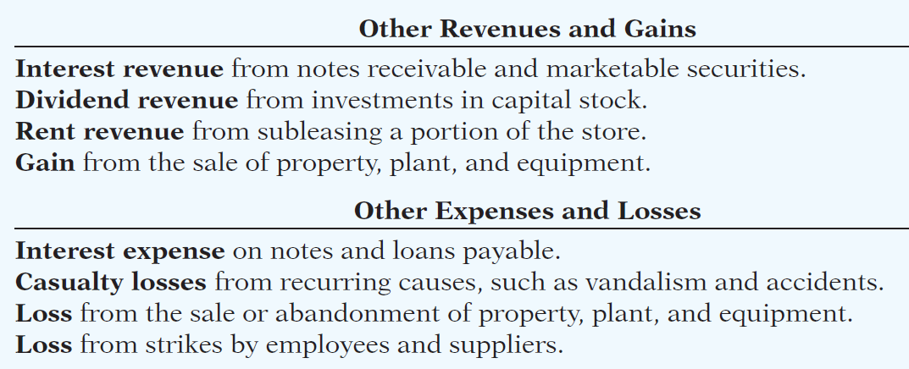
Multiple- Step
Key Items:
Net sales
Gross profit
Operating expenses
Nonoperating activities
Illustration 5-14
LO 5

Slide 41
Multiple- Step
Key Items:
Net sales
Gross profit
Operating expenses
Nonoperating activities
Net income
Illustration 5-14
LO 5

Slide 42
Forms of Financial Statements
Review Question
The multiple-step income statement for a merchandiser shows each of the following features except:
gross profit.
cost of goods sold.
a sales revenue section.
investing activities section.
LO 5 Distinguish between a multiple-step and a single-step income statement.

Slide 43
Forms of Financial Statements
Single-Step Income Statement
Subtract total expenses from total revenues
Two reasons for using the single-step format:
Company does not realize any profit until total revenues exceed total expenses.
Format is simpler and easier to read.
LO 5 Distinguish between a multiple-step and a single-step income statement.

Slide 44
Forms of Financial Statements
Single-Step Income Statement
Illustration 5-15
LO 5 Distinguish between a multiple-step and a single-step income statement.

Slide 45
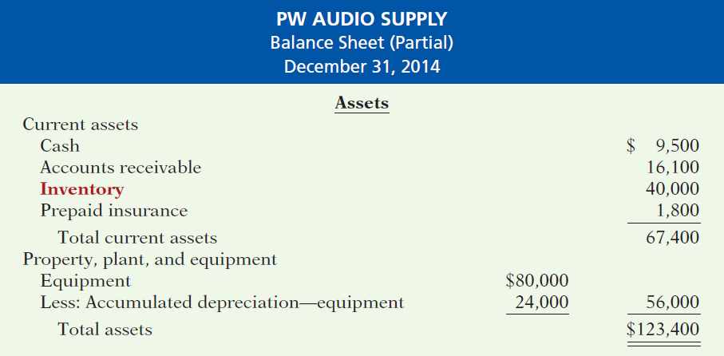
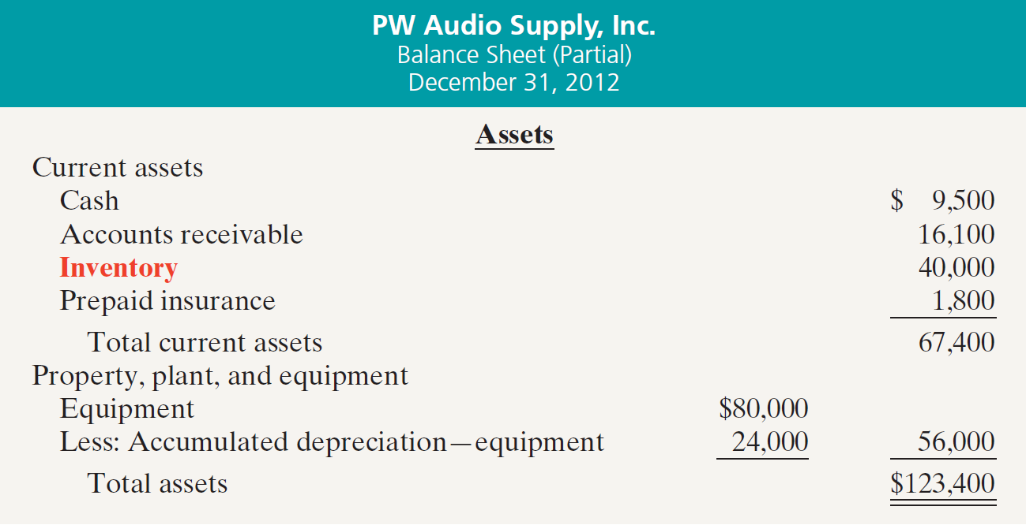
Forms of Financial Statements
Classified Balance Sheet
Illustration 5-16
LO 5 Distinguish between a multiple-step and a single-step income statement.

Slide 46
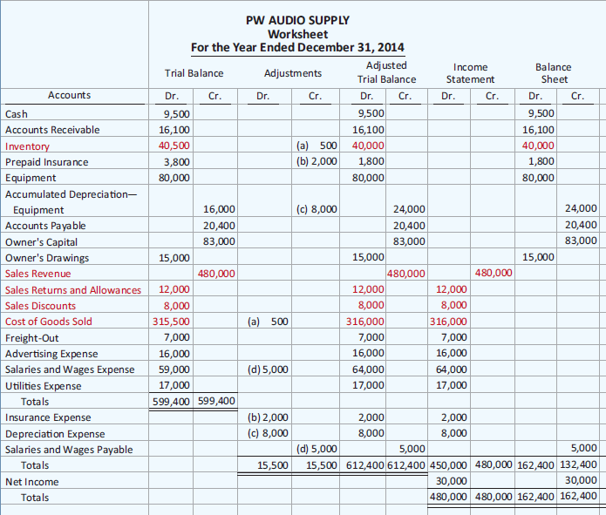
APPENDIX 5A Worksheet for a Merchandising Company
Perpetual Inventory
Illustration 5A-1
LO 6 Prepare a worksheet for a merchandising company.

Slide 47
APPENDIX 5B Periodic Inventory System
Determining Cost of Goods Sold Under a Periodic System
No running account of changes in inventory.
Ending inventory determined by physical count.
Cost of goods sold not determined until the end of the period.
LO 7 Explain the recording of purchases and sales of inventory under a periodic inventory system.

Slide 48
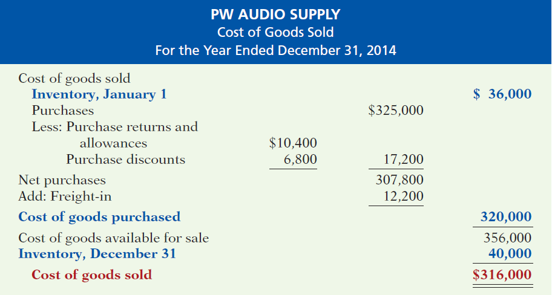
APPENDIX 5B Periodic Inventory System
Determining Cost of Goods Sold Under a Periodic System
Illustration 5B-2
LO 7

Slide 49
APPENDIX 5B Periodic Inventory System
Recording Merchandise Transactions
Record revenues when sales are made.
Do not record cost of merchandise sold on the date of sale.
Physical inventory count determines:
Cost of merchandise on hand and
Cost of merchandise sold during the period.
Record purchases in Purchases account.
Purchase returns and allowances, Purchase discounts, and Freight costs are recorded in separate accounts.
LO 7 Explain the recording of purchases and sales of inventory under a periodic inventory system.

Slide 50
APPENDIX 5B Periodic Inventory System
Recording Purchases of Merchandise
Illustration: On the basis of the sales invoice (Illustration 5-6) and receipt of the merchandise ordered from PW Audio Supply, Sauk Stereo records the $3,800 purchase as follows.
May 4
Purchases 3,800
Accounts Payable 3,800
LO 7 Explain the recording of purchases and sales of inventory under a periodic inventory system.

Slide 51
APPENDIX 5B Periodic Inventory System
Freight Costs
Illustration: If Sauk pays Public Freight Company $150
for freight charges on its purchase from PW Audio Supply on May 6, the entry on Sauk’s books is:
May 6
Freight-in (Transportation-In) 150
Cash 150
LO 7 Explain the recording of purchases and sales of inventory under a periodic inventory system.

Slide 52
APPENDIX 5B Periodic Inventory System
Purchase Returns and Allowances
Illustration: Sauk Stereo returns $300 of goods to PW Audio Supply and prepares the following entry to recognize the return.
May 8
Accounts payable 300
Purchase Returns and Allowances 300
LO 7 Explain the recording of purchases and sales of inventory under a periodic inventory system.

Slide 53
APPENDIX 5B Periodic Inventory System
Purchase Discounts
Illustration: On May 14 Sauk Stereo pays the balance due on account to PW Audio Supply, taking the 2% cash discount allowed by PW Audio for payment within 10 days. Sauk
Stereo records the payment and discount as follows.
May 14
Accounts Payable 3,500
Purchase Discounts 70
Cash 3,430
LO 7 Explain the recording of purchases and sales of inventory under a periodic inventory system.

Slide 54
APPENDIX 5B Periodic Inventory System
Recording Sales of Merchandise
Illustration: PW Audio Supply, records the sale of $3,800 of merchandise to Sauk Stereo on May 4 (sales invoice No. 731, Illustration 5-6) as follows.
May 4
Accounts Receivable 3,800
Sales Revenue 3,800
No entry is recorded for cost of goods sold at the time of the sale under a periodic system.
LO 7 Explain the recording of purchases and sales of inventory under a periodic inventory system.

Slide 55
APPENDIX 5B Periodic Inventory System
Recording Sales of Merchandise
Illustration: PW Audio Supply, records the sale of $3,800 of merchandise to Sauk Stereo on May 4 (sales invoice No. 731, Illustration 5-6) as follows.
May 4
Accounts Receivable 3,800
Sales Revenue 3,800
No entry is recorded for cost of goods sold at the time of the sale under a periodic system.
LO 7 Explain the recording of purchases and sales of inventory under a periodic inventory system.

Slide 56
APPENDIX 5B Periodic Inventory System
Sales Returns and Allowances
Illustration: To record the returned goods received from Sauk Stereo on May 8, PW Audio Supply records the $300 sales return as follows.
May 8
Sales Returns and Allowances 300
Accounts Receivable 300
LO 7 Explain the recording of purchases and sales of inventory under a periodic inventory system.

Slide 57
APPENDIX 5B Periodic Inventory System
Sales Discounts
Illustration: On May 14, PW Audio Supply receives payment of $3,430 on account from Sauk Stereo. PW Audio honors the 2% cash discount and records the payment of Sauk’s account receivable in full as follows.
May 14
Cash 3,430
Sales Discounts 70
Accounts Receivable 3,500
LO 7 Explain the recording of purchases and sales of inventory under a periodic inventory system.

Slide 58
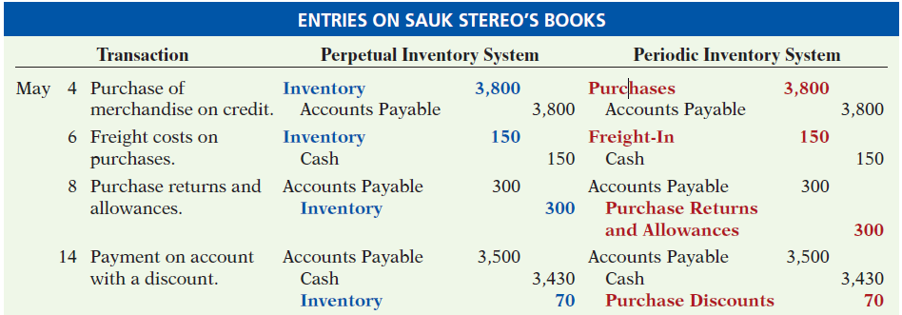
APPENDIX 5B Periodic Inventory System
Comparison of Entries
Illustration 5B-3
LO 7 Explain the recording of purchases and sales of inventory under a periodic inventory system.

Slide 59
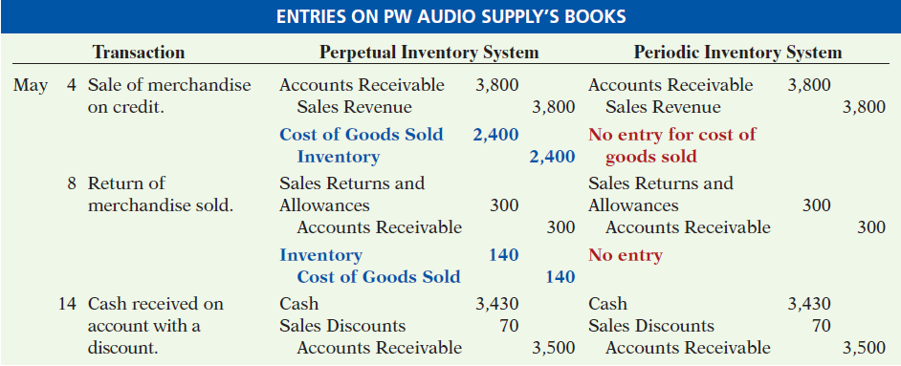
APPENDIX 5B Periodic Inventory System
Comparison of Entries
Illustration 5B-3
LO 7 Explain the recording of purchases and sales of inventory under a periodic inventory system.

Slide 60
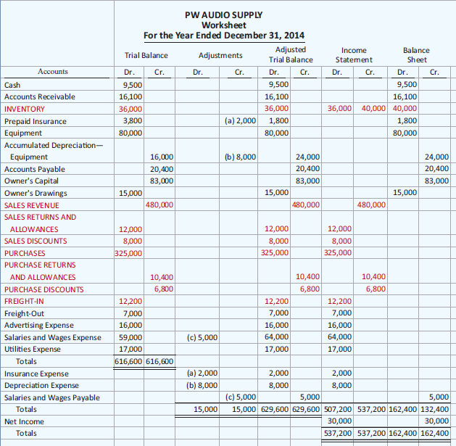
APPENDIX 5B Periodic Inventory System
Illustration 5B-5
Worksheet for merchandising
company—periodic inventory system
LO 7

Slide 61
A Look at IFRS
Key Points
Under both GAAP and IFRS, a company can choose to use either a perpetual or a periodic system.
Presentation of the income statement under GAAP follows either a single-step or multiple-step format. IFRS does not mention a single-step or multiple-step approach.
Under IFRS, revaluation of land, buildings, and intangible assets is permitted. The initial gains and losses resulting from this revaluation are reported as adjustments to equity, often referred to as other comprehensive income.
LO 8 Compare the accounting procedures for merchandising under GAAP and IFRS.

Slide 62
A Look at IFRS
Looking to the Future
The IASB and FASB are working on a project that would rework the structure of financial statements. Specifically, this project will address the issue of how to classify various items in the income statement. A main goal of this new approach is to provide information that better
represents how businesses are run. In addition, this approach draws attention away from just one number—net income. It will adopt major groupings similar to those currently used by the statement of cash flows (operating, investing, and financing), so that numbers can be more readily traced across statements. Finally, this approach would also provide detail, beyond that currently seen in most statements (either GAAP or IFRS), by requiring that line items be presented both by function and by nature. The new financial statement format was heavily influenced by suggestions from financial statement analysts.
LO 8 Compare the accounting procedures for merchandising under GAAP and IFRS.

Slide 63
Copyright
“Copyright © 2013 John Wiley & Sons, Inc. All rights reserved. Reproduction or translation of this work beyond that permitted in Section 117 of the 1976 United States Copyright Act without the express written permission of the copyright owner is unlawful. Request for further information should be addressed to the Permissions Department, John Wiley & Sons, Inc. The purchaser may make back-up copies for his/her own use only and not for distribution or resale. The Publisher assumes no responsibility for errors, omissions, or damages, caused by the use of these programs or from the use of the information contained herein.”

