Slide 2
Learning Goals
LG1 Discuss the role of time value in finance, the use of computational tools, and the basic patterns of cash flow.
LG2 Understand the concepts of future value and present value, their calculation for single amounts, and the relationship between them.
LG3 Find the future value and the present value of both an ordinary annuity and an annuity due, and find the present value of a perpetuity.

Slide 3
Learning Goals (cont.)
LG4 Calculate both the future value and the present value of a mixed stream of cash flows.
LG5 Understand the effect that compounding interest more frequently than annually has on future value and the effective annual rate of interest.
LG6 Describe the procedures involved in (1) determining deposits needed to accumulate a future sum, (2) loan amortization, (3) finding interest or growth rates, and (4) finding an unknown number of periods.

Slide 4
The Role of Time Value in Finance
Most financial decisions involve costs & benefits that are spread out over time.
Time value of money allows comparison of cash flows from different periods.
Question: Your father has offered to give you some money and asks that you choose one of the following two alternatives:
$1,000 today, or
$1,100 one year from now.
What do you do?

Slide 5
The Role of Time Value in Finance (cont.)
The answer depends on what rate of interest you could earn on any money you receive today.
For example, if you could deposit the $1,000 today at 12% per year, you would prefer to be paid today.
Alternatively, if you could only earn 5% on deposited funds, you would be better off if you chose the $1,100 in one year.

Slide 6
Future Value versus Present Value
Suppose a firm has an opportunity to spend $15,000 today on some investment that will produce $17,000 spread out over the next five years as follows:
Is this a wise investment?
To make the right investment decision, managers need to compare the cash flows at a single point in time.
Year | Cash flow
1 | $3,000
2 | $5,000
3 | $4,000
4 | $3,000
5 | $2,000

Slide 7
Figure 5.1 Time Line

Slide 8
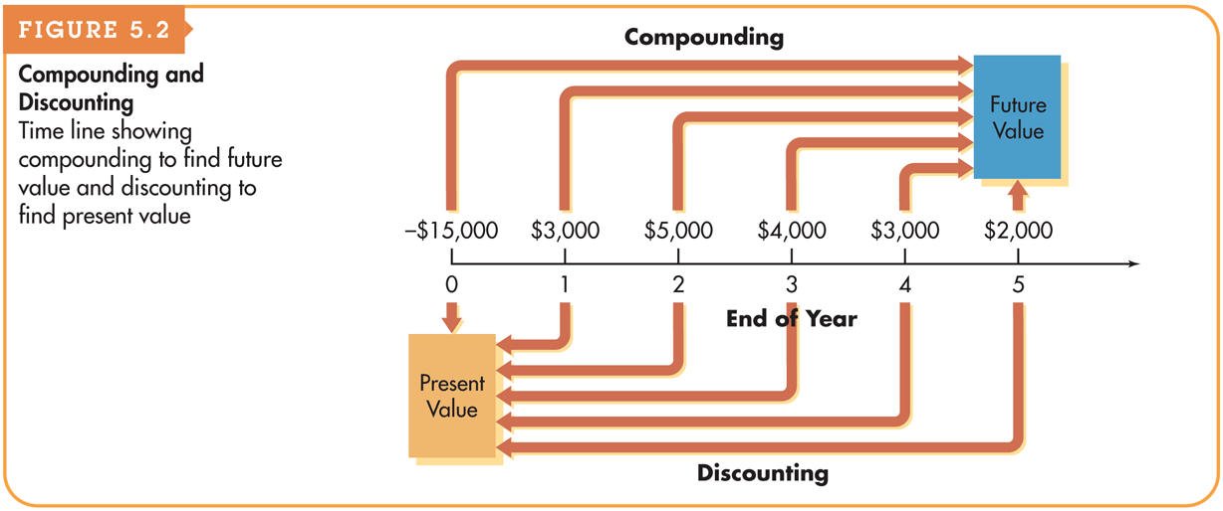
Figure 5.2 Compounding and Discounting

Slide 9
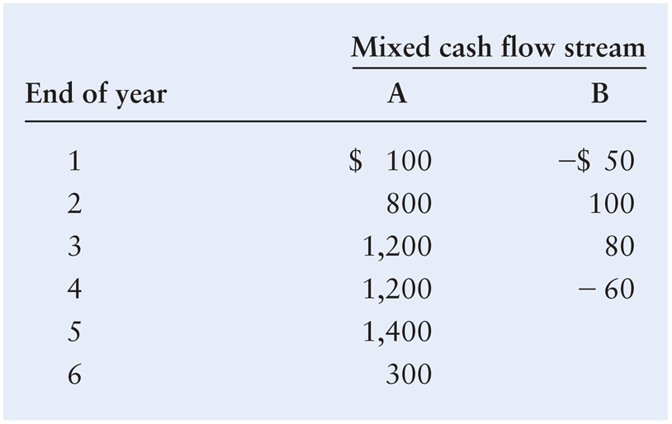
Basic Patterns of Cash Flow
The cash inflows and outflows of a firm can be described by its general pattern.
The three basic patterns include a single amount, an annuity, or a mixed stream:

Slide 10
Future Value of a Single Amount
Future value is the value at a given future date of an amount placed on deposit today and earning interest at a specified rate. Found by applying compound interest over a specified period of time.
Compound interest is interest that is earned on a given deposit and has become part of the principal at the end of a specified period.
Principal is the amount of money on which interest is paid.

Slide 11
Personal Finance Example
If Fred Moreno places $100 in a savings account paying 8% interest compounded annually, how much will he have at the end of 1 year?
Future value at end of year 1 = $100 × (1 + 0.08) = $108
If Fred were to leave this money in the account for another year, how much would he have at the end of the second year?
Future value at end of year 2 = $100 × (1 + 0.08) × (1 + 0.08) = $116.64

Slide 12
Future Value of a Single Amount: The Equation for Future Value
We use the following notation for the various inputs:
FV_{n} = future value at the end of period n
PV = initial principal, or present value
r = annual rate of interest paid. (Note: On financial calculators, I is typically used to represent this rate.)
n = number of periods (typically years) that the money is left on deposit
The general equation for the future value at the end of period n is
FV_{n} = PV × (1 + r)^{n}

Slide 13
Future Value of a Single Amount: The Equation for Future Value
Jane Farber places $800 in a savings account paying 6% interest compounded annually. She wants to know how much money will be in the account at the end of five years.
This analysis can be depicted on a time line as follows:
FV₅ = $800 × (1 + 0.06)⁵ = $800 × (1.33823) = $1,070.58

Slide 14
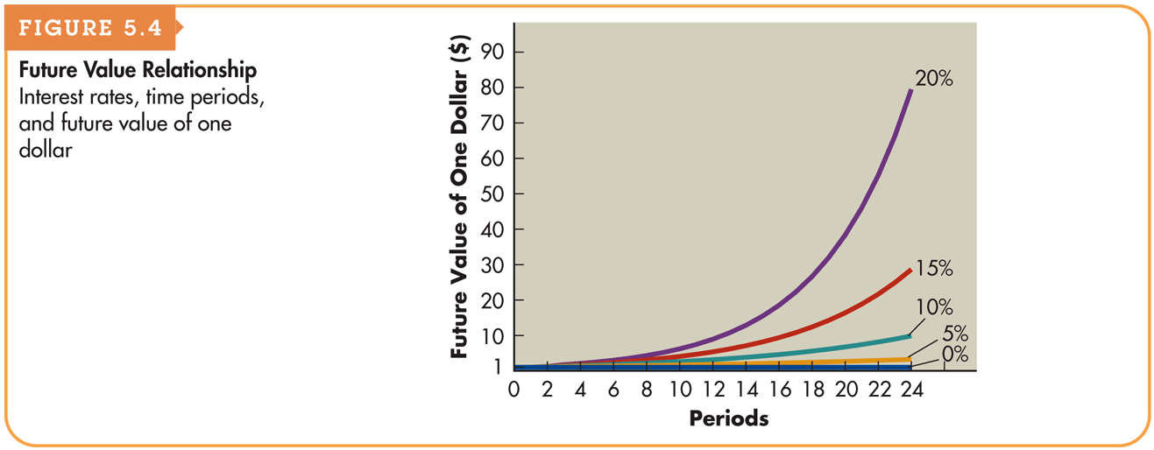
Figure 5.4 Future Value Relationship

Slide 15
Present Value of a Single Amount
Present value is the current dollar value of a future amount—the amount of money that would have to be invested today at a given interest rate over a specified period to equal the future amount.
It is based on the idea that a dollar today is worth more than a dollar tomorrow.
Discounting cash flows is the process of finding present values; the inverse of compounding interest.
The discount rate is often also referred to as the opportunity cost, the discount rate, the required return, or the cost of capital.

Slide 16
Personal Finance Example
Paul Shorter has an opportunity to receive $300 one year from now. If he can earn 6% on his investments, what is the most he should pay now for this opportunity?
PV × (1 + 0.06) = $300
PV = $300/(1 + 0.06) = $283.02

Slide 17
Present Value of a Single Amount: The Equation for Present Value
The present value, PV, of some future amount, FV_{n}, to be received n periods from now, assuming an interest rate (or opportunity cost) of r, is calculated as follows:

Slide 18
Present Value of a Single Amount: The Equation for Future Value
Pam Valenti wishes to find the present value of $1,700 that will be received 8 years from now. Pam’s opportunity cost is 8%.
This analysis can be depicted on a time line as follows:
PV = $1,700/(1 + 0.08)⁸ = $1,700/1.85093 = $918.46

Slide 19
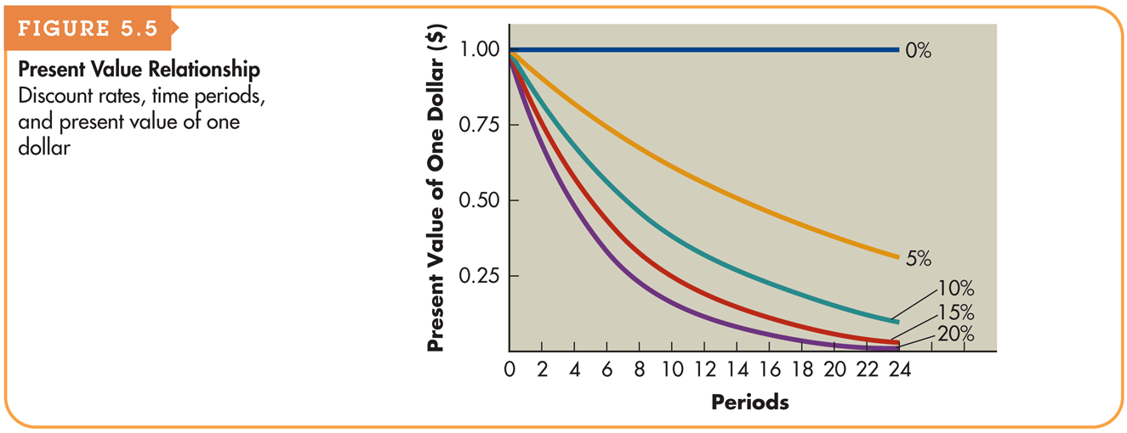
Figure 5.5 Present Value Relationship

Slide 20
Annuities
An annuity is a stream of equal periodic cash flows, over a specified time period. These cash flows can be inflows of returns earned on investments or outflows of funds invested to earn future returns.
An ordinary (deferred) annuity is an annuity for which the cash flow occurs at the end of each period
An annuity due is an annuity for which the cash flow occurs at the beginning of each period.
An annuity due will always be greater than an otherwise equivalent ordinary annuity because interest will compound for an additional period.

Slide 21
Personal Finance Example
Fran Abrams is choosing which of two annuities to receive. Both are 5-year $1,000 annuities; annuity A is an ordinary annuity, and annuity B is an annuity due. Fran has listed the cash flows for both annuities as shown in Table 5.1 on the following slide.
Note that the amount of both annuities total $5,000.

Slide 22
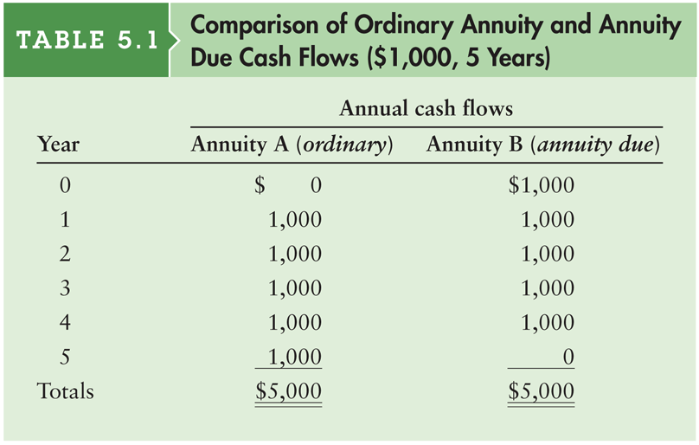
Table 5.1 Comparison of Ordinary Annuity and Annuity Due Cash Flows ($1,000, 5 Years)

Slide 23
Finding the Future Value of an Ordinary Annuity
You can calculate the future value of an ordinary annuity that pays an annual cash flow equal to CF by using the following equation:
As before, in this equation r represents the interest rate and n represents the number of payments in the annuity (or equivalently, the number of years over which the annuity is spread).

Slide 24
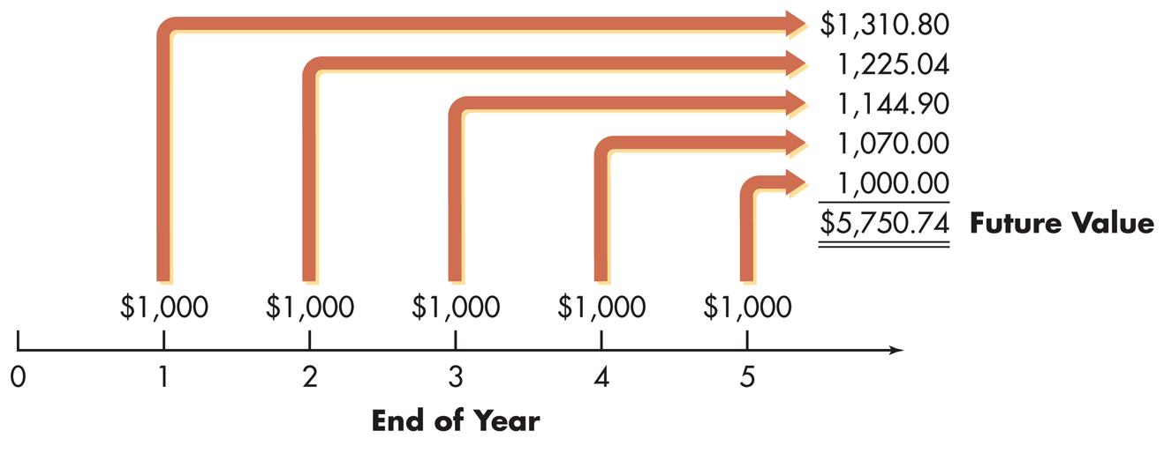
Personal Finance Example
Fran Abrams wishes to determine how much money she will have at the end of 5 years if he chooses annuity A, the ordinary annuity and it earns 7% annually. Annuity A is depicted graphically below:
This analysis can be depicted on a time line as follows:

Slide 25
Finding the Present Value of an Ordinary Annuity
You can calculate the present value of an ordinary annuity that pays an annual cash flow equal to CF by using the following equation:
As before, in this equation r represents the interest rate and n represents the number of payments in the annuity (or equivalently, the number of years over which the annuity is spread).

Slide 26
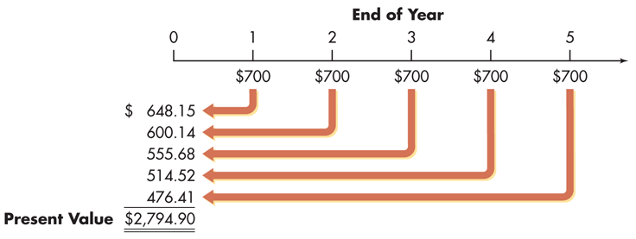
Finding the Present Value of an Ordinary Annuity (cont.)
Braden Company, a small producer of plastic toys, wants to determine the most it should pay to purchase a particular annuity. The annuity consists of cash flows of $700 at the end of each year for 5 years. The required return is 8%.
This analysis can be depicted on a time line as follows:

Slide 27
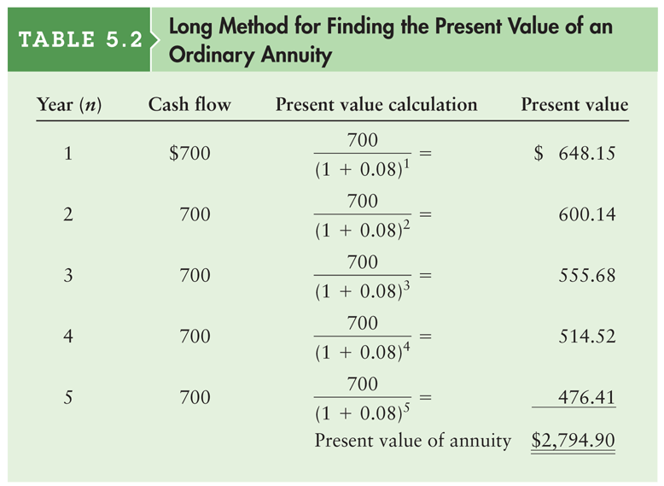
Table 5.2 Long Method for Finding the Present Value of an Ordinary Annuity

Slide 28
Finding the Future Value of an Annuity Due
You can calculate the future value of an annuity due that pays an annual cash flow equal to CF by using the following equation:
As before, in this equation r represents the interest rate and n represents the number of payments in the annuity (or equivalently, the number of years over which the annuity is spread).

Slide 29
Personal Finance Example
Fran Abrams now wishes to calculate the future value of an annuity due for annuity B in Table 5.1. Recall that annuity B was a 5 period annuity with the first annuity beginning immediately.

Slide 30
Finding the Present Value of an Annuity Due
You can calculate the present value of an ordinary annuity that pays an annual cash flow equal to CF by using the following equation:
As before, in this equation r represents the interest rate and n represents the number of payments in the annuity (or equivalently, the number of years over which the annuity is spread).

Slide 31
Finding the Present Value of a Perpetuity
A perpetuity is an annuity with an infinite life, providing continual annual cash flow.
If a perpetuity pays an annual cash flow of CF, starting one year from now, the present value of the cash flow stream is
PV = CF ÷ r

Slide 32
Personal Finance Example
Ross Clark wishes to endow a chair in finance at his alma mater. The university indicated that it requires $200,000 per year to support the chair, and the endowment would earn 10% per year. To determine the amount Ross must give the university to fund the chair, we must determine the present value of a $200,000 perpetuity discounted at 10%.
PV = $200,000 ÷ 0.10 = $2,000,000

Slide 33
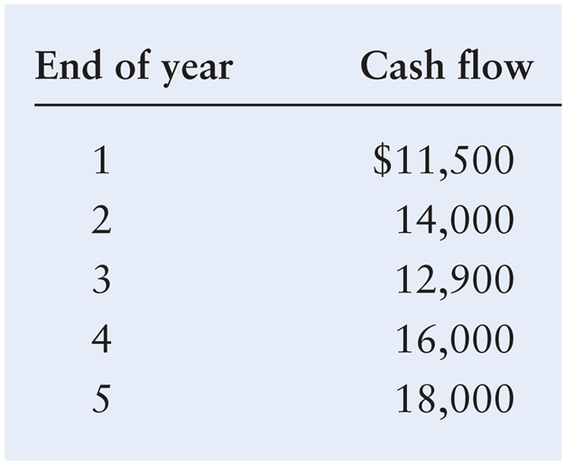
Future Value of a Mixed Stream
Shrell Industries, a cabinet manufacturer, expects to receive the following mixed stream of cash flows over the next 5 years from one of its small customers.

Slide 34
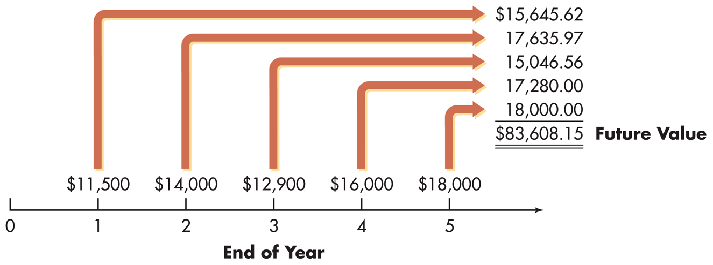
Future Value of a Mixed Stream
If the firm expects to earn at least 8% on its investments, how much will it accumulate by the end of year 5 if it immediately invests these cash flows when they are received?
This situation is depicted on the following time line.

Slide 35
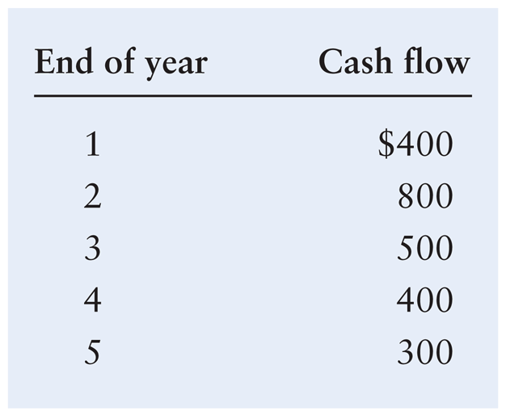
Present Value of a Mixed Stream
Frey Company, a shoe manufacturer, has been offered an opportunity to receive the following mixed stream of cash flows over the next 5 years.

Slide 36
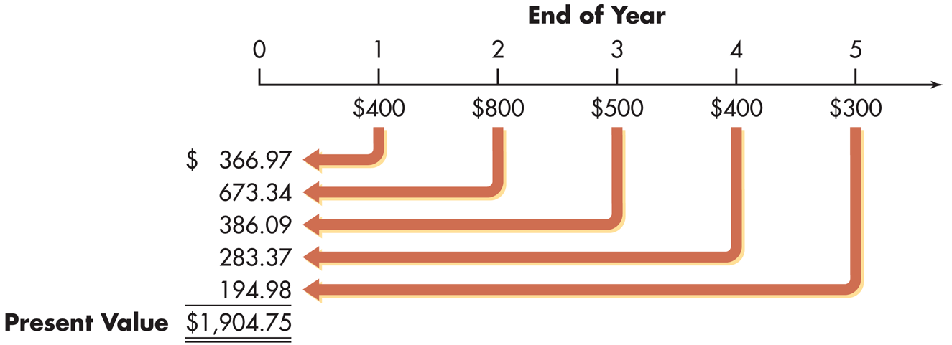
Present Value of a Mixed Stream
If the firm must earn at least 9% on its investments, what is the most it should pay for this opportunity?
This situation is depicted on the following time line.

Slide 37
Compounding Interest More Frequently Than Annually
Compounding more frequently than once a year results in a higher effective interest rate because you are earning on interest on interest more frequently.
As a result, the effective interest rate is greater than the nominal (annual) interest rate.
Furthermore, the effective rate of interest will increase the more frequently interest is compounded.

Slide 38
Table 5.3 Future Value from Investing $100 at 8% Interest Compounded Semiannually over 24 Months (2 Years)

Slide 39
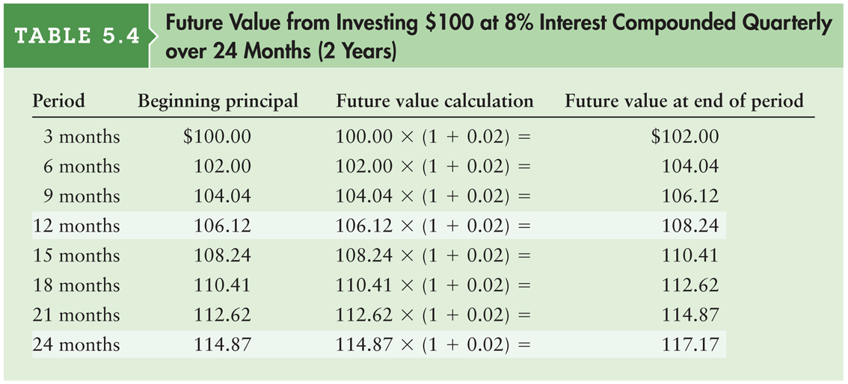
Table 5.4 Future Value from Investing $100 at 8% Interest Compounded Quarterly over 24 Months (2 Years)

Slide 40
Table 5.5 Future Value from Investing $100 at 8% Interest Compounded Quarterly over 24 Months (2 Years)

Slide 41
Compounding Interest More Frequently Than Annually (cont.)
A general equation for compounding more frequently than annually
Recalculate the example for the Fred Moreno example assuming (1) semiannual compounding and (2) quarterly compounding.

Slide 42
Continuous Compounding
Continuous compounding involves the compounding of interest an infinite number of times per year at intervals of microseconds.
A general equation for continuous compounding where e is the exponential function.

Slide 43
Personal Finance Example
Find the value at the end of 2 years (n = 2) of Fred Moreno’s $100 deposit (PV = $100) in an account paying 8% annual interest (r = 0.08) compounded continuously.
FV₂ (continuous compounding) = $100 × e^{0.08 × 2}
= $100 × 2.7183^{0.16}
= $100 × 1.1735 = $117.35

Slide 44
Nominal and Effective Annual Rates of Interest
The nominal (stated) annual rate/annual percentage rate (APR) is the contractual annual rate of interest charged by a lender or promised by a borrower.
The effective (true) annual rate (EAR) is the annual rate of interest actually paid or earned.
In general, the effective rate > nominal rate whenever compounding occurs more than once per year

Slide 45
Personal Finance Example
Fred Moreno wishes to find the effective annual rate associated with an 8% nominal annual rate (r = 0.08) when interest is compounded (1) annually (m = 1); (2) semiannually (m = 2); and (3) quarterly (m = 4).

Slide 46
Special Applications of Time Value: Deposits Needed to Accumulate a Future Sum
The following equation calculates the annual cash payment (CF) that we’d have to save to achieve a future value (FV_{n}):
Suppose you want to buy a house 5 years from now, and you estimate that an initial down payment of $30,000 will be required at that time. To accumulate the $30,000, you will wish to make equal annual end-of-year deposits into an account paying annual interest of 6 percent.

Slide 47
Special Applications of Time Value: Loan Amortization
Loan amortization is the determination of the equal periodic loan payments necessary to provide a lender with a specified interest return and to repay the loan principal over a specified period.
The loan amortization process involves finding the future payments, over the term of the loan, whose present value at the loan interest rate equals the amount of initial principal borrowed.
A loan amortization schedule is a schedule of equal payments to repay a loan. It shows the allocation of each loan payment to interest and principal.

Slide 48
Special Applications of Time Value: Loan Amortization (cont.)
The following equation calculates the equal periodic loan payments (CF) necessary to provide a lender with a specified interest return and to repay the loan principal (PV) over a specified period:
Say you borrow $6,000 at 10 percent and agree to make equal annual end-of-year payments over 4 years. To find the size of the payments, the lender determines the amount of a 4-year annuity discounted at 10 percent that has a present value of $6,000.

Slide 49
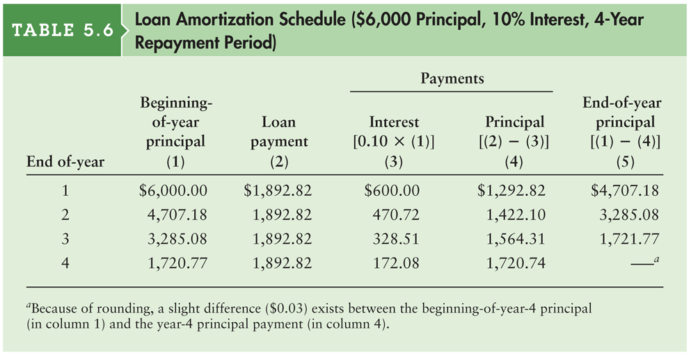
Table 5.6 Loan Amortization Schedule ($6,000 Principal, 10% Interest, 4-Year Repayment Period)

Slide 50
Review of Learning Goals
LG1 Discuss the role of time value in finance, the use of computational tools, and the basic patterns of cash flow.
Financial managers and investors use time-value-of-money techniques when assessing the value of expected cash flow streams. Alternatives can be assessed by either compounding to find future value or discounting to find present value. Financial managers rely primarily on present value techniques. The cash flow of a firm can be described by its pattern—single amount, annuity, or mixed stream.

Slide 51
Review of Learning Goals (cont.)
LG2 Understand the concepts of future value and present value, their calculation for single amounts, and the relationship between them.
Future value (FV) relies on compound interest to measure future amounts: The initial principal or deposit in one period, along with the interest earned on it, becomes the beginning principal of the following period.
The present value (PV) of a future amount is the amount of money today that is equivalent to the given future amount, considering the return that can be earned. Present value is the inverse of future value.

Slide 52
Review of Learning Goals (cont.)
LG3 Find the future value and the present value of both an ordinary annuity and an annuity due, and find the present value of a perpetuity.
The future or present value of an ordinary annuity can be found by using algebraic equations, a financial calculator, or a spreadsheet program. The value of an annuity due is always r% greater than the value of an identical annuity. The present value of a perpetuity—an infinite-lived annuity—is found using 1 divided by the discount rate to represent the present value interest factor.

Slide 53
Review of Learning Goals (cont.)
LG4 Calculate both the future value and the present value of a mixed stream of cash flows.
A mixed stream of cash flows is a stream of unequal periodic cash flows that reflect no particular pattern. The future value of a mixed stream of cash flows is the sum of the future values of each individual cash flow. Similarly, the present value of a mixed stream of cash flows is the sum of the present values of the individual cash flows.

Slide 54
Review of Learning Goals (cont.)
LG5 Understand the effect that compounding interest more frequently than annually has on future value and the effective annual rate of interest.
Interest can be compounded at intervals ranging from annually to daily, and even continuously. The more often interest is compounded, the larger the future amount that will be accumulated, and the higher the effective, or true, annual rate (EAR).

Slide 55
Review of Learning Goals (cont.)
LG6 Describe the procedures involved in (1) determining deposits needed to accumulate a future sum, (2) loan amortization
(1) The periodic deposit to accumulate a given future sum can be found by solving the equation for the future value of an annuity for the annual payment. (2) A loan can be amortized into equal periodic payments by solving the equation for the present value of an annuity for the periodic payment.

