Slide 2
Overview of the Cost of Capital
The cost of capital represents the firm’s cost of financing, and is the minimum rate of return that a project must earn to increase firm value.
Financial managers are ethically bound to only invest in projects that they expect to exceed the cost of capital.
The cost of capital reflects the entirety of the firm’s financing activities.
Most firms attempt to maintain an optimal mix of debt and equity financing.
To capture all of the relevant financing costs, assuming some desired mix of financing, we need to look at the overall cost of capital rather than just the cost of any single source of financing.

Slide 3
Overview of the Cost of Capital (cont.)
A firm is currently faced with an investment opportunity. Assume the following:
Best project available today
Cost = $100,000
Life = 20 years
Expected Return = 7%
Least costly financing source available
Debt = 6%
Because it can earn 7% on the investment of funds costing only 6%, the firm undertakes the opportunity.

Slide 4
Overview of the Cost of Capital (cont.)
Imagine that 1 week later a new investment opportunity is available:
Best project available 1 week later
Cost = $100,000
Life = 20 years
Expected Return = 12%
Least costly financing source available
Equity = 14%
In this instance, the firm rejects the opportunity, because the 14% financing cost is greater than the 12% expected return.

Slide 5
Overview of the Cost of Capital (cont.)
What if instead the firm used a combined cost of financing?
Assuming that a 50–50 mix of debt and equity is targeted, the weighted average cost here would be:
(0.50 × 6% debt) + (0.50 × 14% equity) = 10%
With this average cost of financing, the first opportunity would have been rejected (7% expected return < 10% weighted average cost), and the second would have been accepted (12% expected return > 10% weighted average cost).

Slide 6
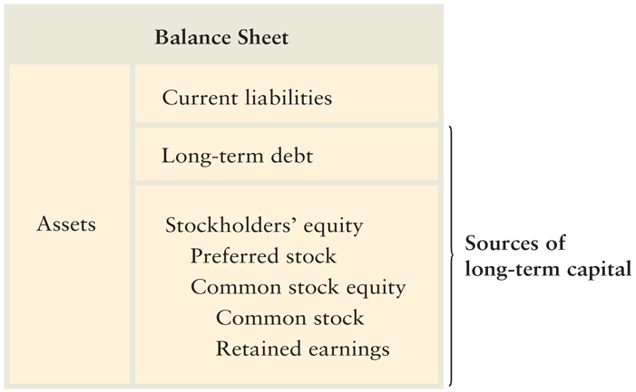
Overview of the Cost of Capital: Sources of Long-Term Capital

Slide 7
Cost of Long-Term Debt
Net proceeds are the funds actually received by the firm from the sale of a security.
Flotation costs are the total costs of issuing and selling a security. They include two components:
Underwriting costs—compensation earned by investment bankers for selling the security.
Administrative costs—issuer expenses such as legal, accounting, and printing.
Floatation costs reduce the net proceeds.

Slide 8
Cost of Long-Term Debt (cont.)
Duchess Corporation, a major hardware manufacturer, is contemplating selling $10 million worth of 20-year, 9% coupon bonds with a par value of $1,000. Because current market interest rates are greater than 9%, the firm must sell the bonds at $980. Flotation costs are 2% or $20. The net proceeds to the firm for each bond is therefore $960 ($980 – $20).

Slide 9
Cost of Long-Term Debt (cont.)
The before-tax cost of debt, r_{d}, is simply the rate of return the firm must pay on new borrowing.
The before-tax cost of debt can be calculated in any one of three ways:
Using market quotations: observe the yield to maturity (YTM) on the firm’s existing bonds or bonds of similar risk issued by other companies
Calculating the cost: find the before-tax cost of debt by calculating the YTM generated by the bond cash flows
Approximating the cost

Slide 10
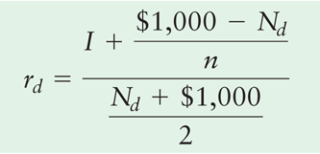
Cost of Long-Term Debt (cont.)
Approximating the cost
where
I | = | annual interest in dollars
N_{d} | = | net proceeds from the sale of debt (bond)
n | = | number of years to the bond’s maturity

Slide 11
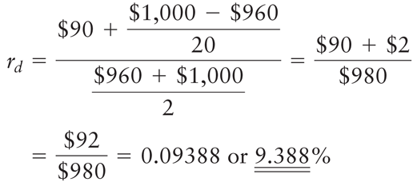
Cost of Long-Term Debt (cont.)
Approximating the cost

Slide 12
Cost of Long-Term Debt: After-Tax Cost of Debt
The interest payments paid to bondholders are tax deductable for the firm, so the interest expense on debt reduces the firm’s taxable income and, therefore, the firm’s tax liability.
The after-tax cost of debt, r_{i}, can be found by multiplying the before-tax cost, r_{d}, by 1 minus the tax rate, T, as stated in the following equation:
r_{i} = r_{d} × (1 – T)

Slide 13
Cost of Long-Term Debt: After-Tax Cost of Debt (cont.)
Duchess Corporation has a 40% tax rate. Using the 9.452% before-tax debt cost calculated above, we find an after-tax cost of debt of 5.6% [9.4% × (1 – 0.40)].
Typically, the cost of long-term debt for a given firm is less than the cost of preferred or common stock, partly because of the tax deductibility of interest.

Slide 14
Personal Finance Example
Kait and Kasim Sullivan, a married couple in the 28% federal income-tax bracket, wish to borrow $60,000 for a new car.
They can either borrow the $60,000 through the auto dealer at an annual interest rate of 6.0%, or they can take a $60,000 second mortgage on their home at an annual interest rate of 7.2%.
If they borrow from the auto dealer, the interest on this “consumer loan” will not be deductible for federal tax purposes. However, the interest on the second mortgage would be tax-deductible because the tax law allows individuals to deduct interest paid on a home mortgage.
Because interest on the auto loan is not tax-deductible, its after-tax cost equals its stated cost of 6.0%.
Because interest on the second mortgage is tax-deductible, its after-tax cost equals its stated cost of 7.2% × (1 – 0.28) = 5.2%.

Slide 15
Cost of Preferred Stock
Preferred stock gives preferred stockholders the right to receive their stated dividends before the firm can distribute any earnings to common stockholders.
Most preferred stock dividends are stated as a dollar amount.
Sometimes preferred stock dividends are stated as an annual percentage rate, which represents the percentage of the stock’s par, or face, value that equals the annual dividend.
The cost of preferred stock, r_{p}, is the ratio of the preferred stock dividend to the firm’s net proceeds from the sale of preferred stock.

Slide 16
Cost of Preferred Stock (cont.)
Duchess Corporation is contemplating the issuance of a 10% preferred stock that is expected to sell for its $87-per share value. The cost of issuing and selling the stock is expected to be $5 per share. The dividend is $8.70 (10% × $87). The net proceeds price (N_{p}) is $82 ($87 – $5).
r_{P} = D_{P}/N_{p} = $8.70/$82 = 10.6%

Slide 17
Cost of Common Stock
The cost of common stock is the return required on the stock by investors in the marketplace.
There are two forms of common stock financing:
retained earnings
new issues of common stock
The cost of common stock equity, r_{s}, is the rate at which investors discount the expected dividends of the firm to determine its share value.

Slide 18
Cost of Common Stock (cont.)
The constant-growth valuation (Gordon) model assumes that the value of a share of stock equals the present value of all future dividends (assumed to grow at a constant rate) that it is expected to provide over an infinite time horizon.
where
P₀ | = | value of common stock
D₁ | = | per-share dividend expected at the end of year 1
r_{s} | = | required return on common stock
g | = | constant rate of growth in dividends

Slide 19
Cost of Common Stock (cont.)
Solving for r_{s} results in the following expression for the cost of common stock equity:
The equation indicates that the cost of common stock equity can be found by dividing the dividend expected at the end of year 1 by the current market price of the stock (the “dividend yield”) and adding the expected growth rate (the “capital gains yield”).

Slide 20
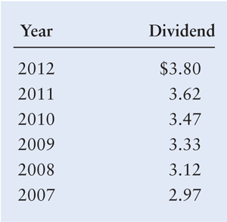
Cost of Common Stock (cont.)
Duchess Corporation wishes to determine its cost of common stock equity, r_{s}. The market price, P₀, of its common stock is $50 per share. The firm expects to pay a dividend, D₁, of $4 at the end of the coming year, 2013. The dividends paid on the outstanding stock over the past 6 years (2007–2012) were as follows:

Slide 21
Cost of Common Stock (cont.)
We can calculate the annual rate at which dividends have grown, g, from 2007 to 2012. It turns out to be approximately 5% (more precisely, it is 5.05%).
Substituting D₁ = $4, P₀ = $50, and g = 5% into the previous equation yields the cost of common stock equity:
r_{s} = ($4/$50) + 0.05 = 0.08 + 0.05 = 0.130, or 13.0%

Slide 22
Cost of Common Stock (cont.)
The capital asset pricing model (CAPM) describes the relationship between the required return, r_{s}, and the nondiversifiable risk of the firm as measured by the beta coefficient, b.
r_{s} = R_{F} + [b × (r_{m} – R_{F})]
where
R_{F} = risk-free rate of return
r_{m} = market return; return on the market portfolio of assets

Slide 23
Cost of Common Stock (cont.)
Duchess Corporation now wishes to calculate its cost of common stock equity, r_{s}, by using the capital asset pricing model. The firm’s investment advisors and its own analysts indicate that the risk-free rate, R_{F}, equals 7%; the firm’s beta, b, equals 1.5; and the market return, r_{m}, equals 11%.
Substituting these values into the CAPM, the company estimates the cost of common stock equity, r_{s}, to be:
r_{s} = 7.0% + [1.5 × (11.0% – 7.0%)] = 7.0% + 6.0% = 13.0%

Slide 24
Cost of Common Stock (cont.)
The CAPM technique differs from the constant-growth valuation model in that it directly considers the firm’s risk, as reflected by beta, in determining the required return or cost of common stock equity.
The constant-growth model does not look at risk; it uses the market price, P₀, as a reflection of the expected risk–return preference of investors in the marketplace.
The constant-growth valuation and CAPM techniques for finding r_{s} are theoretically equivalent, though in practice estimates from the two methods do not always agree.

Slide 25
Cost of Common Stock (cont.)
Another difference is that when the constant-growth valuation model is used to find the cost of common stock equity, it can easily be adjusted for flotation costs to find the cost of new common stock; the CAPM does not provide a simple adjustment mechanism.
The difficulty in adjusting the cost of common stock equity calculated by using CAPM occurs because in its common form the model does not include the market price, P₀, a variable needed to make such an adjustment.

Slide 26
Cost of Common Stock: Cost of Retained Earnings
The cost of retained earnings, r_{r}, is the same as the cost of an equivalent fully subscribed issue of additional common stock, which is equal to the cost of common stock equity, r_{s}.
r_{r} = r_{s}
The cost of retained earnings for Duchess Corporation was actually calculated in the preceding examples: It is equal to the cost of common stock equity. Thus r_{r} equals 13.0%.

Slide 27
Matter of Fact
Retained Earnings vs. Reinvesting Earnings
Technically, if a stockholder received dividends and wished to invest them in additional shares of the firm’s stock, he or she would first have to pay personal taxes on the dividends and then pay brokerage fees before acquiring additional shares.
By using p_{t} as the average stockholder’s personal tax rate and b_{f} as the average brokerage fees stated as a percentage, we can specify the cost of retained earnings, r_{r}, as r_{r} = r_{s} × (1 – p_{t}) × (1 – b_{f}).

Slide 28
Cost of Common Stock: Cost of New Issues of Common Stock
The cost of a new issue of common stock, r_{n}, is the cost of common stock, net of underpricing and associated flotation costs.
New shares are underpriced if the stock is sold at a price below its current market price, P₀.

Slide 29
Cost of Common Stock: Cost of New Issues of Common Stock (cont.)
We can use the constant-growth valuation model expression for the cost of existing common stock, r_{s}, as a starting point. If we let N_{n} represent the net proceeds from the sale of new common stock after subtracting underpricing and flotation costs, the cost of the new issue, r_{n}, can be expressed as follows:

Slide 30
Cost of Common Stock: Cost of New Issues of Common Stock (cont.)
The net proceeds from sale of new common stock, N_{n}, will be less than the current market price, P₀.
Therefore, the cost of new issues, r_{n}, will always be greater than the cost of existing issues, r_{s}, which is equal to the cost of retained earnings, r_{r}.
The cost of new common stock is normally greater than any other long-term financing cost.

Slide 31
Cost of Common Stock: Cost of New Issues of Common Stock (cont.)
To determine its cost of new common stock, r_{n}, Duchess Corporation has estimated that on average, new shares can be sold for $47. The $3-per-share underpricing is due to the competitive nature of the market. A second cost associated with a new issue is flotation costs of $2.50 per share that would be paid to issue and sell the new shares. The total underpricing and flotation costs per share are therefore $5.50.
r_{n} = ($4.00/$44.50) + 0.05 = 0.09 + 0.05 = 0.140, or 14.0%

Slide 32
Weighted Average Cost of Capital
The weighted average cost of capital (WACC), r_{a}, reflects the expected average future cost of capital over the long run; found by weighting the cost of each specific type of capital by its proportion in the firm’s capital structure.
r_{a} = (w_{i} × r_{i}) + (w_{p} × r_{p}) + (w_{s} × r_{r} _{or n})
where
w_{i} | = | proportion of long-term debt in capital structure
w_{p} | = | proportion of preferred stock in capital structure
w_{s} | = | proportion of common stock equity in capital structure
w_{i} + w_{p} + w_{s} | = | 1.0

Slide 33
Weighted Average Cost of Capital (cont.)
Three important points should be noted in the equation for r_{a}:
For computational convenience, it is best to convert the weights into decimal form and leave the individual costs in percentage terms.
The weights must be non-negative and sum to 1.0. Simply stated, WACC must account for all financing costs within the firm’s capital structure.
The firm’s common stock equity weight, w_{s}, is multiplied by either the cost of retained earnings, r_{r}, or the cost of new common stock, r_{n}. Which cost is used depends on whether the firm’s common stock equity will be financed using retained earnings, r_{r}, or new common stock, r_{n}.

Slide 34
Weighted Average Cost of Capital (cont.)
In earlier examples, we found the costs of the various types of capital for Duchess Corporation to be as follows:
Cost of debt, r_{i} = 5.6%
Cost of preferred stock, r_{p} = 10.6%
Cost of retained earnings, r_{r} = 13.0%
Cost of new common stock, r_{n} = 14.0%
The company uses the following weights in calculating its weighted average cost of capital:
Long-term debt = 40%
Preferred stock = 10%
Common stock equity = 50%

Slide 35
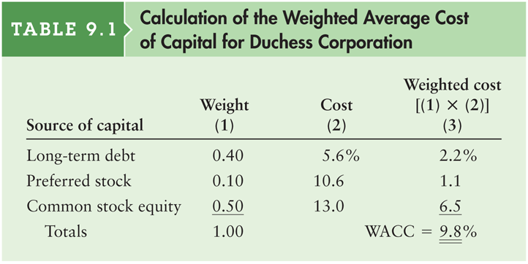
Table 9.1 Calculation of the Weighted Average Cost of Capital for Dutchess Corporation

Slide 36
Weighted Average Cost of Capital: Weighting Schemes
Book Value versus Market Value:
Book value weights are weights that use accounting values to measure the proportion of each type of capital in the firm’s financial structure.
Market value weights are weights that use market values to measure the proportion of each type of capital in the firm’s financial structure.
Historical versus Target:
Historical weights are either book or market value weights based on actual capital structure proportions.
Target weights are either book or market value weights based on desired capital structure proportions.
From a strictly theoretical point of view, the preferred weighting scheme is target market value proportions.

