Slide 1
Chapter 4
Inventory Management

Slide 2
INVENTORY MANAGEMENT
2
Stockpile of the product, a firm is offering for sale and the components that make up the product. The management of inventory is different from management of any other asset.
Why???

Slide 3
INVENTORY
3
Keep small inventory less idle investment, requires more orders of inventory more order cost
Keep minimal inventory Inventory shortages
Supply chain management-the process by which companies move materials from suppliers through the production process and on to the consumers

Slide 4
CONCEPT OF INVENTORY
4
A major problem with managing inventory is that the demand for a corporation’s product is uncertain.
The supply of Raw materials is also uncertain.
Production schedule contain some degree of uncertainty because of equipment failure.
Inventory acts as a shock absorber.
Three types
raw materials
work-in-process
finished goods

Slide 5
RAW MATERIAL INVENTORY
5
Initial input to the production process
Why we need raw materials inventory?
Available stock of raw materials makes production schedule easier
Avoid price changes for these goods
To hedge against supply shortages
To take advantage of quantity discount

Slide 6
WIP INVENTORY
In manufacturing firms, a certain amount of WIP occurs as product moves from one production process to another.
A major reason firms keep WIP inventory beyond minimum level is to buffer production.
Panel A (production line with no buffer)
Panel B (production line with buffer)
Process A
Process B
Process C
Process A
Buffer stock
Process B
Buffer stock
Process C
6

Slide 7
FINISHED GOODS INVENTORY
7
Finished goods consist of completed goods.
Uncertain consumer demand and firm’s desire not to run out of inventory for sale

Slide 8
MOTIVES TO HOLD INVENTORY
8
Transaction motive- Need to maintain inventories to facilitate smooth production and sales operation.
Precautionary motive- To guard against the risk of unpredictable changes in demand and supply and other factors.
Speculative motive- The decision to increase or reduce inventory level to take advantage of price fluctuation.

Slide 9
BASICS OF MANAGING THE AVERAGE INVENTORY BALANCE
9
Demand for product
Cost of carrying (holding) inventory
insurance
storage
cost of capital
Cost of ordering inventory
Total cost = total cost of ordering inventory + total cost of carrying inventory
= Order Cost + Holding Cost = F x (T/Q) + H x (Q/2)

Slide 10
ORDERING COSTS & CARRYING COST
10
Ordering cost is used in case of RM and includes the entire cost of acquiring RM.
Ordering cost increases with the number of orders, thus more frequently inventory is acquired the higher the firm’s ordering cost.
Carrying cost for maintaining a given level of inventory varies with the inventory size. The behavior contradicts with ordering cost which decline with the increase in inventory size.
The economic size of inventory would thus depend on trade off between carrying cost and ordering cost.

Slide 11
ORDERING COSTS & CARRYING COST
Ordering cost | Carrying cost
Requisitioning | Warehousing
Order placing | Handling
Transportation | Insurance
Receiving, inspecting & storing | Deterioration & obsolescence
Clerical and staff
11

Slide 12
COST OF MANAGING INVENTORY
12
The goal is to choose that order quantity that results in a optimal tradeoff between ordering cost and holding cost so that the total cost of managing inventory will be minimized.

Slide 13
COST OF MANAGING INVENTORY
13
Total inventory units demanded = T
Order quantity = Q
Fixed order cost per order= F
Holding cost per unit of inventory= H
Total cost, TC = (T/Q X F) + (H × Q/2)

Slide 14
ORDER COST AND HOLDING COST TRADE-OFF
$
Total cost = Holding + Order
Holding cost = H x (Q/2)
Order costs = F x (T/Q)
14
Order quantity, Q

Slide 15
ECONOMIC ORDER QUANTITY
EOQ solution: √(2TF/H)
Number of orders: T/Q
Average inventory: Q/2
Usage rate/Average Usage: T/D
(D= days in period)
15

Slide 16
ASSUMPTIONS
16
Requires a near perfect forecast of inventory units demanded
Constant rate of inventory usage
Constant fixed order cost
Constant cost of inventory holding cost

Slide 17
REORDER POINT
Is the inventory level at which an order should be placed to replenish the inventory. To determine the reorder point under certainty we should know the lead time, average usage and EOQ.
Lead time is the time normally taken to replenish inventory after the order has been placed. By certainty we mean usage and lead time do not fluctuate.
Reorder point will be the inventory level which will be maintained for consumption during the lead time.
Reorder point = Lead Time × Average Usage
= Delivery Time × (T/D)
17

Slide 18
SAFETY STOCK
18
It is difficult to predict usage and lead time.
If actual usage increases or delivery of inventory delayed firm can face stock out which is costly.
To guard against stock-out firms maintain a safety stock some minimum or buffer inventory as cushion.

Slide 19
WHY WE NEED SAFETY STOCK
19
Two major uncertain variables
Demand for the goods
Lead time from the order to arrival of goods
If neither of these variables uncertain, the firm can plan perfectly: Inventory will arrive just as it is needed and firm will never face unplanned stockout of goods

Slide 20
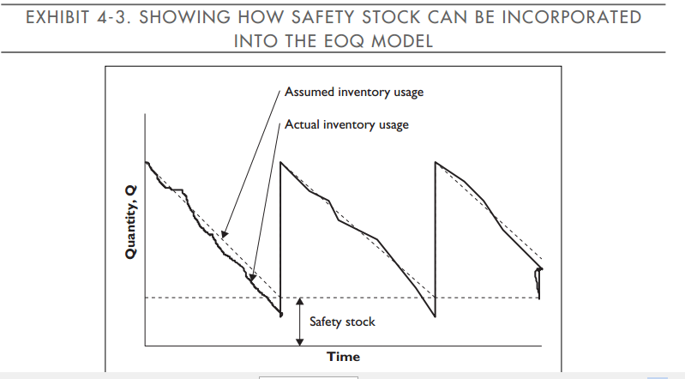

Slide 21
FACTORS DETERMINING THE AMOUNT OF SAFETY STOCK
The greater the uncertainty associated with forecasted demand, the greater the amount of safety stock.
The greater the uncertainty of lead time to replenish stock, the greater the risk of stockout and the greater the amount of safety stock.
Cost of running out of inventory.
For RM and WIP- delay in production
For finished goods- lost sales and customer dissatisfaction and it also affects future sales How??
Cost of carrying additional inventory- the greater the cost, more costly it is to maintain safety stock.
21

Slide 22
JUST IN TIME (JIT)
22
Newest and most interesting alternative to holding inventory
Developed by Japanese firms
Inventories are minimized and holding inventories are considered uneconomical
To minimize inventory goods are produced and delivered only when they are needed
JIT can be used within the firm to reduce WIP inventories and in conjunction with suppliers to reduce raw materials inventories

Slide 23
JUST IN TIME (JIT)
23
Production planning
Signaling system is used among the production process
The last process provide signals
The next to last provide signals
Kanban travels through the processes indicating the need for goods
In response to these kanbans employees set up production process and produce the goods
WIP buffer stocks are minimized

Slide 24
JUST IN TIME
24
Differs in respect of lot size and quality of production run
Set up cost should be small
Small lot size requires workers should be flexible
Quality control performed by the worker
Output must be of very high quality in JIT Why??

Slide 25
JIT
25
Suppliers are treated as another step in production process
They are required to produce small lots of high quality goods for frequent delivery. This minimizes buyer’s RM inventory.
Need to work closely with supplier to ensure the quality of RM.

Slide 26
COSTS IN JIT
26
JIT substitutes worker’s education cost and capital cost for inventory cost.
Workers must be highly skilled and flexible
Machinery should be capable of producing high quality product while being cheap and quick to set up.

Slide 27
INVENTORY AND THE CASH FLOW TIMELINE
Inventory ordered Inventory ordered
and received and received
< Inventory Held> <Inventory Held>
Time=>
Cash paid Cash paid Cash paid
for inventory for inventory for holding &
ordering costs
27

Slide 28
MONITOR THE INVENTORY BALANCE
28
Inventory control systems
Inventory turnover ratio
Sales or COGS / Inventory balance
Days COGS in inventory
Inventory balance / Daily COGS or Sales
Balance fraction approach
Develop monthly balance fractions based on the proportion of items remaining in inventory from a given month’s purchase.

Slide 30
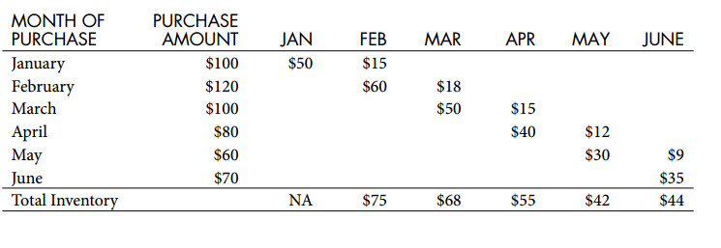

Slide 32
SUMMARY
32
Inventory decisions should be based on:
cost of holding inventory
cost or ordering inventory
opportunity cost of funds
quantity discounts
is quantity workable within inventory management system?
Inventory, if properly managed can be a major contributor to cash flow...
if mismanaged, it can be a significant drain on cash.
Some traditional inventory monitoring tools can be biased by sales and production trends

