Slide 1
Chapter 16
Financial Leverage
and
Capital Structure Policy

Slide 2
Key Concepts and Skills
Understand the effect of financial leverage on cash flows and the cost of equity
Understand the impact of taxes and bankruptcy on capital structure choice
Understand the basic components of the bankruptcy process

Slide 3
Chapter Outline
The Capital Structure Question
The Effect of Financial Leverage
Capital Structure and the Cost of Equity Capital
M&M Propositions I and II with Corporate Taxes
Bankruptcy Costs
Optimal Capital Structure
The Pie Again
Observed Capital Structures
A Quick Look at the Bankruptcy Process

Slide 4
Capital Restructuring
We are going to look at how changes in capital structure affect the value of the firm, all else equal
Capital restructuring involves changing the amount of leverage a firm has without changing the firm’s assets
The firm can increase leverage by issuing debt and repurchasing outstanding shares
The firm can decrease leverage by issuing new shares and retiring outstanding debt

Slide 5
Choosing a Capital Structure
What is the primary goal of financial managers?
Maximize stockholder wealth
We want to choose the capital structure that will maximize stockholder wealth
We can maximize stockholder wealth by maximizing the value of the firm or minimizing the WACC
Notes:
Remind students that the WACC is the appropriate discount rate for the risk of the firm’s assets. We can find the value of the firm by discounting the firm’s expected future cash flows at the discount rate – the process is the same as finding the value of anything else. Since value and discount rate move in opposite directions, firm value will be maximized when WACC is minimized.

Slide 6
The Effect of Leverage
How does leverage affect the EPS and ROE of a firm?
When we increase the amount of debt financing, we increase the fixed interest expense
If we have a really good year, then we pay our fixed cost and we have more left over for our stockholders
If we have a really bad year, we still have to pay our fixed costs and we have less left over for our stockholders
Leverage amplifies the variation in both EPS and ROE
Notes:
Remind the students that if we increase the amount of debt in a restructuring, we are decreasing the amount of outstanding shares.

Slide 7
Break-Even EBIT
Find EBIT where EPS is the same under both the current and proposed capital structures
If we expect EBIT to be greater than the break-even point, then leverage is beneficial to our stockholders
If we expect EBIT to be less than the break-even point, then leverage is detrimental to our stockholders

Slide 8
Example: Break-Even EBIT
Notes:
Click on the Excel icon to see the graph of the break-even analysis

Slide 9
Capital Structure Theory
Modigliani and Miller Theory of Capital Structure
Proposition I – firm value
Proposition II – WACC
The value of the firm is determined by the cash flows to the firm and the risk of the assets
Changing firm value
Change the risk of the cash flows
Change the cash flows

Slide 10
Capital Structure Theory Under Three Special Cases
Case I – Assumptions
No corporate or personal taxes
No bankruptcy costs
Case II – Assumptions
Corporate taxes, but no personal taxes
No bankruptcy costs
Case III – Assumptions
Corporate taxes, but no personal taxes
Bankruptcy costs

Slide 11
Case I – Propositions I and II
Proposition I
The value of the firm is NOT affected by changes in the capital structure
The cash flows of the firm do not change; therefore, value doesn’t change
Proposition II
The WACC of the firm is NOT affected by capital structure
Notes:
The main point with case I is that it doesn’t matter how we divide our cash flows between our stockholders and bondholders, the cash flow of the firm doesn’t change. Since the cash flows don’t change; and we haven’t changed the risk of existing cash flows, the value of the firm won’t change.

Slide 12
Case I - Equations
WACC = R_{A} = (E/V)R_{E} + (D/V)R_{D}
R_{E} = R_{A} + (R_{A} – R_{D})(D/E)
R_{A} is the “cost” of the firm’s business risk, i.e., the risk of the firm’s assets
(R_{A} – R_{D})(D/E) is the “cost” of the firm’s financial risk, i.e., the additional return required by stockholders to compensate for the risk of leverage
Notes:
Remind students that case I is a world without taxes. That is why the term (1 – T_{C}) is not included in the WACC equation.

Slide 13
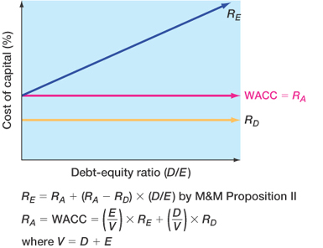
Figure 17.3

Slide 14
Case I - Example
Data
Required return on assets = 16%, cost of debt = 10%; percent of debt = 45%
What is the cost of equity?
R_{E} = 16 + (16 - 10)(.45/.55) = 20.91%
Suppose instead that the cost of equity is 25%, what is the debt-to-equity ratio?
25 = 16 + (16 - 10)(D/E)
D/E = (25 - 16) / (16 - 10) = 1.5
Based on this information, what is the percent of equity in the firm?
E/V = 1 / 2.5 = 40%
Notes:
Remind students that if the firm is financed with 45% debt, then it is financed with 55% equity.
At this point, you may need to remind them that one way to compute the D/E ratio is %debt / (1-%debt)
The second question is used to reinforce that R_{A} does not change when the capital structure changes
Many students will not immediately see how to get the % of equity from the D/E ratio. Remind them that D+E = V. We are looking at ratios, so the actual $ amount of D and E is not important. All that matters is the relationship between them. So, let E = 1. Then D/1 = 1.5; Solve for D; D = 1.5. Then V = 1 + 1.5 = 2.5 and the percent equity is 1 / 2.5 = 40%. They often don’t understand that the choice of E = 1 is for simplicity. If they are confused about the process, then show them that it doesn’t matter what you set E equal to, as long as you keep the relationships intact. So, let E = 5; then D/5 = 1.5 and D = 5(1.5) = 7.5; V = 5 + 7.5 = 12.5 and E/V = 5 / 12.5 = 40%.

Slide 15
Case II – Proposition I
Interest is tax deductible
Therefore, when a firm adds debt, it reduces taxes, all else equal
The reduction in taxes increases the cash flow of the firm
How should an increase in cash flows affect the value of the firm?
Notes:
Point out that the government effectively pays part of our interest expense for us; it is subsidizing a portion of the interest payment.

Slide 16
Case II - Example
 | Unlevered Firm | Levered Firm
EBIT | 5,000 | 5,000
Interest | 0 | 500
Taxable Income | 5,000 | 4,500
Taxes (34%) | 1,700 | 1,530
Net Income | 3,300 | 2,970
CFFA | 3,300 | 3,470
Notes:
The levered firm has 6,250 in 8% debt, so the interest expense = .08(6,250) = 500
CFFA = EBIT – taxes (depreciation expense is the same in either case, so it will not affect CFFA on an incremental basis)

Slide 17
Interest Tax Shield
Annual interest tax shield
Tax rate times interest payment
6,250 in 8% debt = 500 in interest expense
Annual tax shield = .34(500) = 170
Present value of annual interest tax shield
Assume perpetual debt for simplicity
PV = 170 / .08 = 2,125
PV = D(R_{D})(T_{C}) / R_{D} = DT_{C} = 6,250(.34) = 2,125
Notes:
Point out that the increase in cash flow in the example is exactly equal to the interest tax shield
The assumption of perpetual debt makes the equations easier to work with, but it is useful to ask the students what would happen if we did not assume perpetual debt.

Slide 18
Case II – Proposition I
The value of the firm increases by the present value of the annual interest tax shield
Value of a levered firm = value of an unlevered firm + PV of interest tax shield
Value of equity = Value of the firm – Value of debt
Assuming perpetual cash flows
V_{U} = EBIT(1-T) / R_{U}
V_{L} = V_{U} + DT_{C}
Notes:
R_{U} is the cost of capital for an unlevered firm = R_{A} for an unlevered firm
V_{U} is jus the PV of the expected future cash flow from assets for an unlevered firm.

Slide 19
Example: Case II – Proposition I
Data
EBIT = 25 million; Tax rate = 35%; Debt = $75 million; Cost of debt = 9%; Unlevered cost of capital = 12%
V_{U} = 25(1-.35) / .12 = $135.42 million
V_{L} = 135.42 + 75(.35) = $161.67 million
E = 161.67 – 75 = $86.67 million

Slide 20
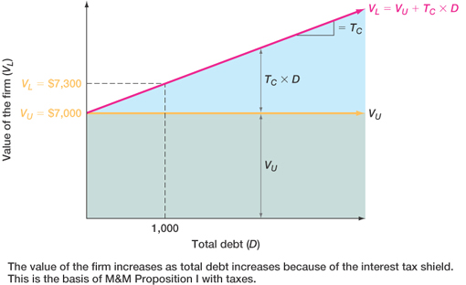
Figure 17.4

Slide 21
Case II – Proposition II
The WACC decreases as D/E increases because of the government subsidy on interest payments
R_{A} = (E/V)R_{E} + (D/V)(R_{D})(1-T_{C})
R_{E} = R_{U} + (R_{U} – R_{D})(D/E)(1-T_{C})
Example
R_{E} = 12 + (12-9)(75/86.67)(1-.35) = 13.69%
R_{A} = (86.67/161.67)(13.69) + (75/161.67)(9)(1-.35) R_{A} = 10.05%

Slide 22
Example: Case II – Proposition II
Suppose that the firm changes its capital structure so that the debt-to-equity ratio becomes 1.
What will happen to the cost of equity under the new capital structure?
R_{E} = 12 + (12 - 9)(1)(1-.35) = 13.95%
What will happen to the weighted average cost of capital?
R_{A} = .5(13.95) + .5(9)(1-.35) = 9.9%
Notes:
Remind students that a D/E ratio = 1 implies 50% equity and 50% debt.
The amount of leverage in the firm increased, the cost of equity increased, but the overall cost of capital decreased.

Slide 23
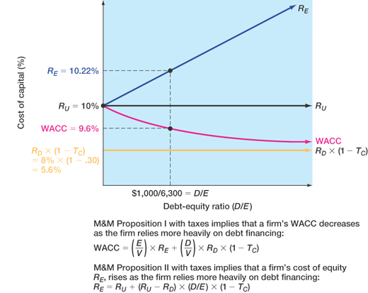
Figure 17.5

Slide 24
Case III
Now we add bankruptcy costs
As the D/E ratio increases, the probability of bankruptcy increases
This increased probability will increase the expected bankruptcy costs
At some point, the additional value of the interest tax shield will be offset by the increase in expected bankruptcy cost
At this point, the value of the firm will start to decrease and the WACC will start to increase as more debt is added
Notes:
Note that we are talking about “expected” in a statistical sense. If the firm goes bankrupt – it will have a certain level of costs it will incur. If the firm is all equity, then the expected bankruptcy cost is 0 since the probability of bankruptcy is 0. As the firm adds debt, the probability of incurring the bankruptcy costs increases, and thus the expected bankruptcy cost increases.

Slide 25
Bankruptcy Costs
Direct costs
Legal and administrative costs
Ultimately cause bondholders to incur additional losses
Disincentive to debt financing
Financial distress
Significant problems in meeting debt obligations
Most firms that experience financial distress do not ultimately file for bankruptcy

Slide 26
More Bankruptcy Costs
Indirect bankruptcy costs
Larger than direct costs, but more difficult to measure and estimate
Stockholders want to avoid a formal bankruptcy filing
Bondholders want to keep existing assets intact so they can at least receive that money
Assets lose value as management spends time worrying about avoiding bankruptcy instead of running the business
The firm may also lose sales, experience interrupted operations and lose valuable employees

Slide 27
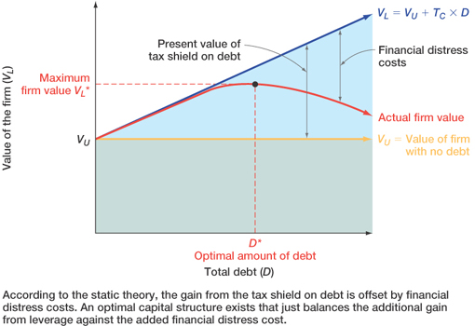
Figure 17.6

Slide 28
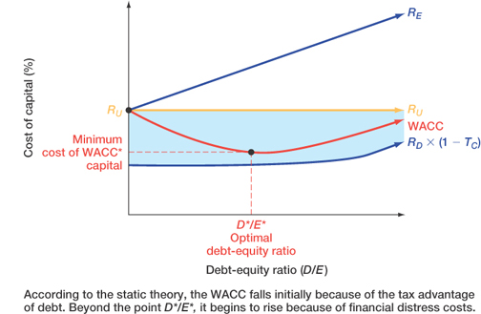
Figure 17.7

Slide 29
Conclusions
Case I – no taxes or bankruptcy costs
No optimal capital structure
Case II – corporate taxes but no bankruptcy costs
Optimal capital structure is almost 100% debt
Each additional dollar of debt increases the cash flow of the firm
Case III – corporate taxes and bankruptcy costs
Optimal capital structure is part debt and part equity
Occurs where the benefit from an additional dollar of debt is just offset by the increase in expected bankruptcy costs

Slide 30
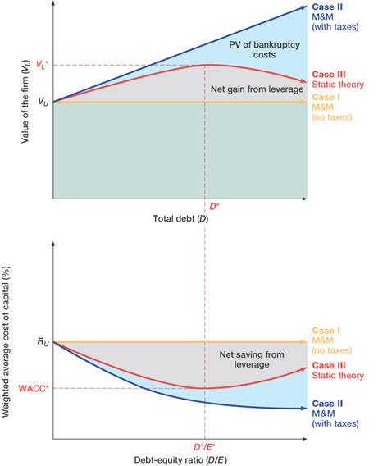
Figure 17.8

Slide 31
Managerial Recommendations
The tax benefit is only important if the firm has a large tax liability
Risk of financial distress
The greater the risk of financial distress, the less debt will be optimal for the firm
The cost of financial distress varies across firms and industries and as a manager you need to understand the cost for your industry

Slide 32
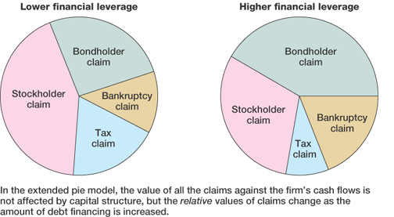
Figure 17.9

Slide 33
The Value of the Firm
Value of the firm = marketed claims + nonmarketed claims
Marketed claims are the claims of stockholders and bondholders
Nonmarketed claims are the claims of the government and other potential stakeholders
The overall value of the firm is unaffected by changes in capital structure
The division of value between marketed claims and nonmarketed claims may be impacted by capital structure decisions

Slide 34
Quick Quiz
Explain the effect of leverage on EPS and ROE
What is the break-even EBIT and how do we compute it?
How do we determine the optimal capital structure?
What is the optimal capital structure in the three cases that were discussed in this chapter?
What is the difference between liquidation and reorganization?

Slide 35
End of Chapter

Slide 36
Comprehensive Problem
Assuming perpetual cash flows in Case II Proposition I, what is the value of equity for a firm with EBIT = $50 million, Tax rate = 40%, Debt = $100 million, cost of debt = 9%, and unlevered cost of capital = 12%?
Notes:
V_{U} = $50 million (1 - .4) / .12 = $250 million
V_{L} = $250 million + $100 million (.4) = $290 million
E = V_{L} – Debt = $290 million - $100 million = $190 million

