Slide 2
Differences Between Debt and Equity
Debt includes all borrowing incurred by a firm, including bonds, and is repaid according to a fixed schedule of payments.
Equity consists of funds provided by the firm’s owners (investors or stockholders) that are repaid subject to the firm’s performance.
Debt financing is obtained from creditors and equity financing is obtained from investors who then become part owners of the firm.
Creditors (lenders or debtholders) have a legal right to be repaid, whereas investors only have an expectation of being repaid.

Slide 3
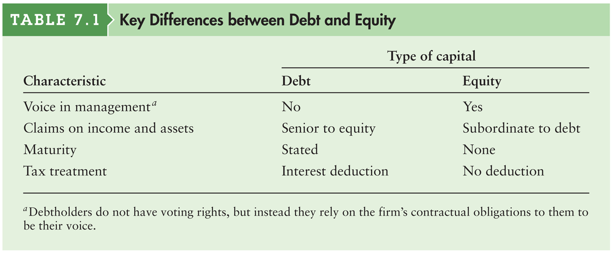
Table 7.1 Key Differences between Debt and Equity Capital

Slide 4
Differences Between Debt and Equity: Tax Treatment
Interest payments to debtholders are treated as tax-deductible expenses by the issuing firm.
Dividend payments to a firm’s stockholders are not tax-deductible.
The tax deductibility of interest lowers the corporation’s cost of debt financing, further causing it to be lower than the cost of equity financing.

Slide 5
Common Stock: Par Value
The par value of common stock is an arbitrary value established for legal purposes in the firm’s corporate charter, and can be used to find the total number of shares outstanding by dividing it into the book value of common stock.
When a firm sells new shares of common stock, the par value of the shares sold is recorded in the capital section of the balance sheet as part of common stock.
At any time the total number of shares of common stock outstanding can be found by dividing the book value of common stock by the par value.

Slide 6
Common Stock: Authorized, Outstanding, and Issued Shares
Authorized shares are the shares of common stock that a firm’s corporate charter allows it to issue.
Outstanding shares are issued shares of common stock held by investors, this includes private and public investors.
Treasury stock are issued shares of common stock held by the firm; often these shares have been repurchased by the firm.
Issued shares are shares of common stock that have been put into circulation.
Issued shares = outstanding shares + treasury stock

Slide 7
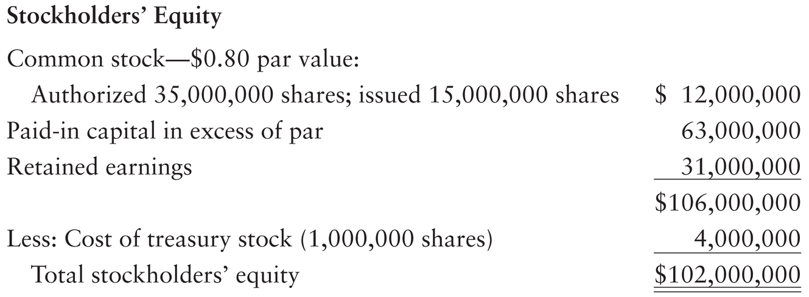
Common Stock: Authorized, Outstanding, and Issued Shares (cont.)
Golden Enterprises, a producer of medical pumps, has the following stockholder’s equity account on December 31st.

Slide 8
Common Stock: Dividends
The payment of dividends to the firm’s shareholders is at the discretion of the company’s board of directors.
Dividends may be paid in cash, stock, or merchandise.
Common stockholders are not promised a dividend, but they come to expect certain payments on the basis of the historical dividend pattern of the firm.
Before dividends are paid to common stockholders any past due dividends owed to preferred stockholders must be paid.

Slide 9
Preferred Stock
Preferred stock gives its holders certain privileges that make them senior to common stockholders.
Preferred stockholders are promised a fixed periodic dividend, which is stated either as a percentage or as a dollar amount.
Par-value preferred stock is preferred stock with a stated face value that is used with the specified dividend percentage to determine the annual dollar dividend.
No-par preferred stock is preferred stock with no stated face value but with a stated annual dollar dividend.

Slide 10
Preferred Stock: Basic Rights of Preferred Stockholders
Preferred stock is often considered quasi-debt because, much like interest on debt, it specifies a fixed periodic payment (dividend).
Preferred stock is unlike debt in that it has no maturity date.
Because they have a fixed claim on the firm’s income that takes precedence over the claim of common stockholders, preferred stockholders are exposed to less risk.
Preferred stockholders are not normally given a voting right, although preferred stockholders are sometimes allowed to elect one member of the board of directors.

Slide 11
Preferred Stock: Features of Preferred Stock
Restrictive covenants including provisions about passing dividends, the sale of senior securities, mergers, sales of assets, minimum liquidity requirements, and repurchases of common stock.
Cumulative preferred stock is preferred stock for which all passed (unpaid) dividends in arrears, along with the current dividend, must be paid before dividends can be paid to common stockholders.
Noncumulative preferred stock is preferred stock for which passed (unpaid) dividends do not accumulate.

Slide 12
Issuing Common Stock
Initial financing for most firms typically comes from a firm’s original founders in the form of a common stock investment.
Early stage debt or equity investors are unlikely to make an investment in a firm unless the founders also have a personal stake in the business.
Initial non-founder financing usually comes first from private equity investors.
After establishing itself, a firm will often “go public” by issuing shares of stock to a much broader group.

Slide 13
Going Public
When a firm wishes to sell its stock in the primary market, it has three alternatives.
A public offering, in which it offers its shares for sale to the general public.
A rights offering, in which new shares are sold to existing shareholders.
A private placement, in which the firm sells new securities directly to an investor or a group of investors.
Here we focus on the initial public offering (IPO), which is the first public sale of a firm’s stock.

Slide 14
Going Public (cont.)
IPOs are typically made by small, fast-growing companies that either:
require additional capital to continue expanding, or
have met a milestone for going public that was established in a contract to obtain VC funding.
The firm must obtain approval of current shareholders, and hire an investment bank to underwrite the offering.
The investment banker is responsible for promoting the stock and facilitating the sale of the company’s IPO shares.

Slide 15
Going Public (cont.)
Investment bankers and company officials promote the company through a road show, a series of presentations to potential investors around the country and sometimes overseas.
This helps investment bankers gauge the demand for the offering which helps them to set the initial offer price.
After the underwriter sets the terms, the SEC must approve the offering.

Slide 16
Going Public: The Investment Banker’s Role
An investment banker is a financial intermediary that specializes in selling new security issues and advising firms with regard to major financial transactions.
Underwriting is the role of the investment banker in bearing the risk of reselling, at a profit, the securities purchased from an issuing corporation at an agreed-on price.
This process involves purchasing the security issue from the issuing corporation at an agreed-on price and bearing the risk of reselling it to the public at a profit.
The investment banker also provides the issuer with advice about pricing and other important aspects of the issue.

Slide 17
Going Public: The Investment Banker’s Role (cont.)
Compensation for underwriting and selling services typically comes in the form of a discount on the sale price of the securities.
For example, an investment banker may pay the issuing firm $24 per share for stock that will be sold for $26 per share.

Slide 18
Common Stock Valuation: Basic Common Stock Valuation Equation
The value of a share of common stock is equal to the present value of all future cash flows (dividends) that it is expected to provide.
where
P₀ | = | value of common stock
D_{t} | = | per-share dividend expected at the end of year t
R_{s} | = | required return on common stock

Slide 19
Common Stock Valuation: The Zero Growth Model
The zero dividend growth model assumes that the stock will pay the same dividend each year, year after year.
The equation shows that with zero growth, the value of a share of stock would equal the present value of a perpetuity of D₁ dollars discounted at a rate r_{s}.

Slide 20
Personal Finance Example
Chuck Swimmer estimates that the dividend of Denham Company, an established textile producer, is expected to remain constant at $3 per share indefinitely.
If his required return on its stock is 15%, the stock’s value is:
$20 ($3 ÷ 0.15) per share

Slide 21
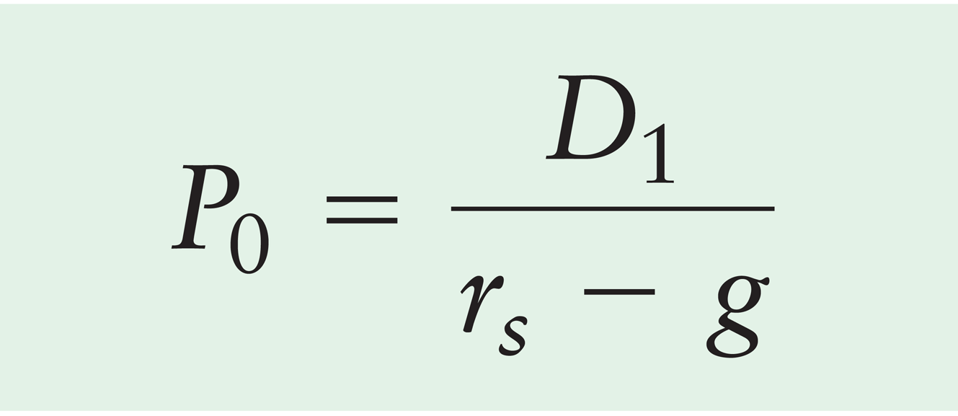
Common Stock Valuation: Constant-Growth Model
The constant-growth model is a widely cited dividend valuation approach that assumes that dividends will grow at a constant rate, but a rate that is less than the required return.
The Gordon model is a common name for the constant-growth model that is widely cited in dividend valuation.

Slide 22
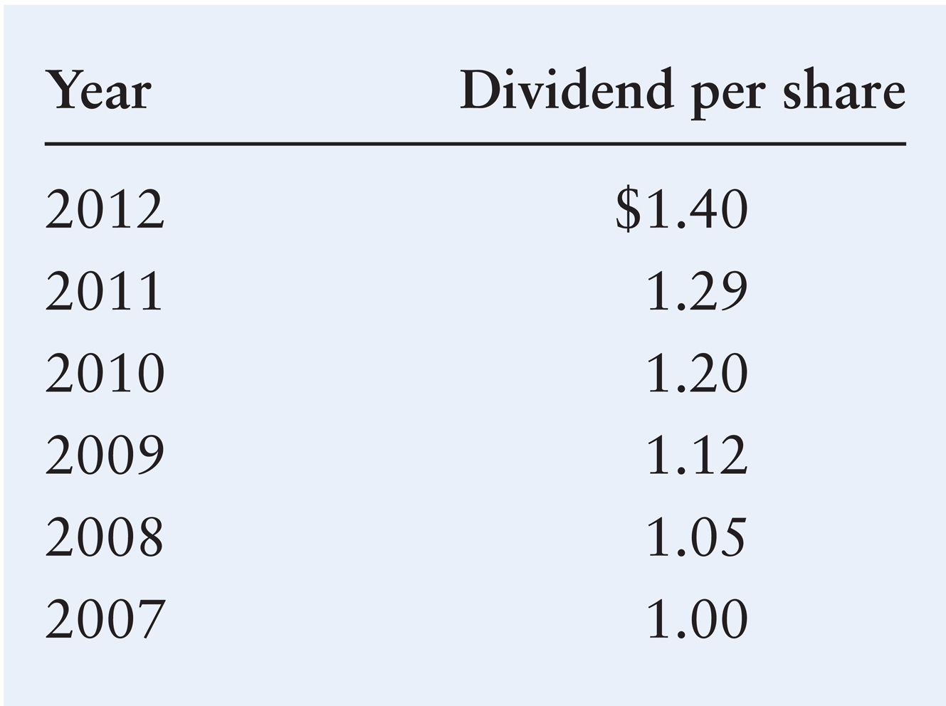
Common Stock Valuation: Constant-Growth Model (cont.)
Lamar Company, a small cosmetics company, paid the following per share dividends:

Slide 23
Common Stock Valuation: Constant-Growth Model (cont.)
Using a financial calculator or a spreadsheet, we find that the historical annual growth rate of Lamar Company dividends equals 7%.

Slide 24
Common Stock Valuation: Variable-Growth Model
The zero- and constant-growth common stock models do not allow for any shift in expected growth rates.
The variable-growth model is a dividend valuation approach that allows for a change in the dividend growth rate.
To determine the value of a share of stock in the case of variable growth, we use a four-step procedure.

Slide 25
Common Stock Valuation: Variable-Growth Model (cont.)
Step 1. Find the value of the cash dividends at the end of each year, D_{t}, during the initial growth period, years 1 though N.
D_{t} = D₀ × (1 + g₁)^{t}

Slide 26
Common Stock Valuation: Variable-Growth Model (cont.)
Step 2. Find the present value of the dividends expected during the initial growth period.

Slide 27
Common Stock Valuation: Variable-Growth Model (cont.)
Step 3. Find the value of the stock at the end of the initial growth period, P_{N} = (D_{N+1})/(r_{s} – g₂), which is the present value of all dividends expected from year N + 1 to infinity, assuming a constant dividend growth rate, g₂.

Slide 28
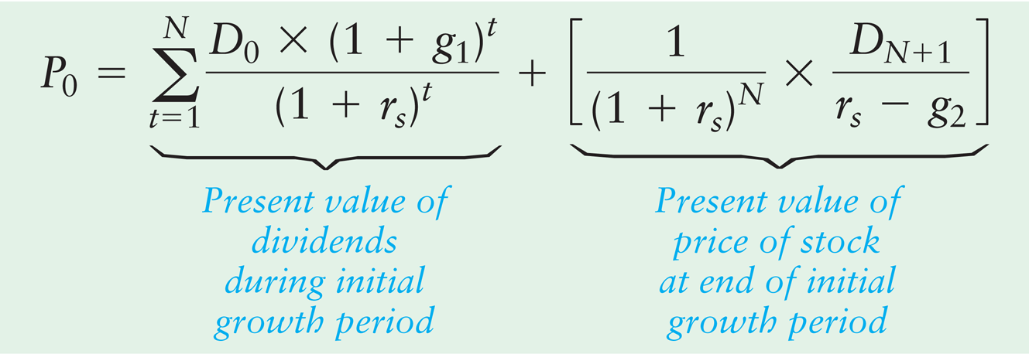
Common Stock Valuation: Variable-Growth Model (cont.)
Step 4. Add the present value components found in Steps 2 and 3 to find the value of the stock, P₀.

Slide 29
Common Stock Valuation: Variable-Growth Model (cont.)
The most recent annual (2012) dividend payment of Warren Industries, a rapidly growing boat manufacturer, was $1.50 per share. The firm’s financial manager expects that these dividends will increase at a 10% annual rate, g₁, over the next three years. At the end of three years (the end of 2015), the firm’s mature product line is expected to result in a slowing of the dividend growth rate to 5% per year, g₂, for the foreseeable future. The firm’s required return, r_{s}, is 15%.
Steps 1 and 2 are detailed in Table 7.3 on the following slide.

Slide 30
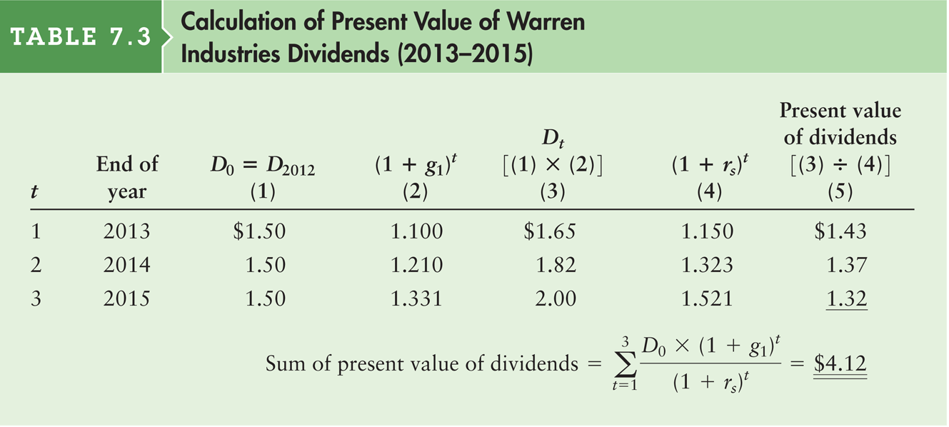
Table 7.3 Calculation of Present Value of Warren Industries Dividends (2013–2015)

Slide 31
Common Stock Valuation: Variable-Growth Model (cont.)
Step 3. The value of the stock at the end of the initial growth period (N = 2015) can be found by first calculating D_{N+1} = D₂₀₁₆.
D₂₀₁₆ = D₂₀₁₅ × (1 + 0.05) = $2.00 × (1.05) = $2.10
By using D₂₀₁₆ = $2.10, a 15% required return, and a 5% dividend growth rate, we can calculate the value of the stock at the end of 2015 as follows:
P₂₀₁₅ = D₂₀₁₆ / (r_{s} – g₂) = $2.10 / (.15 – .05) = $21.00

Slide 32
Common Stock Valuation: Variable-Growth Model (cont.)
Step 3 (cont.) Finally, the share value of $21 at the end of 2015 must be converted into a present (end of 2012) value.
P₂₀₁₅ / (1 + r_{s})³ = $21 / (1 + 0.15)³ = $13.81
Step 4. Adding the PV of the initial dividend stream (found in Step 2) to the PV of the stock at the end of the initial growth period (found in Step 3), we get:
P₂₀₁₂ = $4.14 + $13.82 = $17.93 per share

Slide 33
Common Stock Valuation: Free Cash Flow Valuation Model
A free cash flow valuation model determines the value of an entire company as the present value of its expected free cash flows discounted at the firm’s weighted average cost of capital, which is its expected average future cost of funds over the long run.
where
V_{C} | = | value of the entire company
FCF_{t} | = | free cash flow expected at the end of year t end of year t
r_{a} | = | the firm’s weighted average cost of capital

Slide 34
Common Stock Valuation: Free Cash Flow Valuation Model (cont.)
Because the value of the entire company, V_{C}, is the market value of the entire enterprise (that is, of all assets), to find common stock value, V_{S}, we must subtract the market value of all of the firm’s debt, V_{D}, and the market value of preferred stock, V_{P,} from V_{C}.
V_{S} = V_{C} – V_{D} – V_{P}

Slide 35
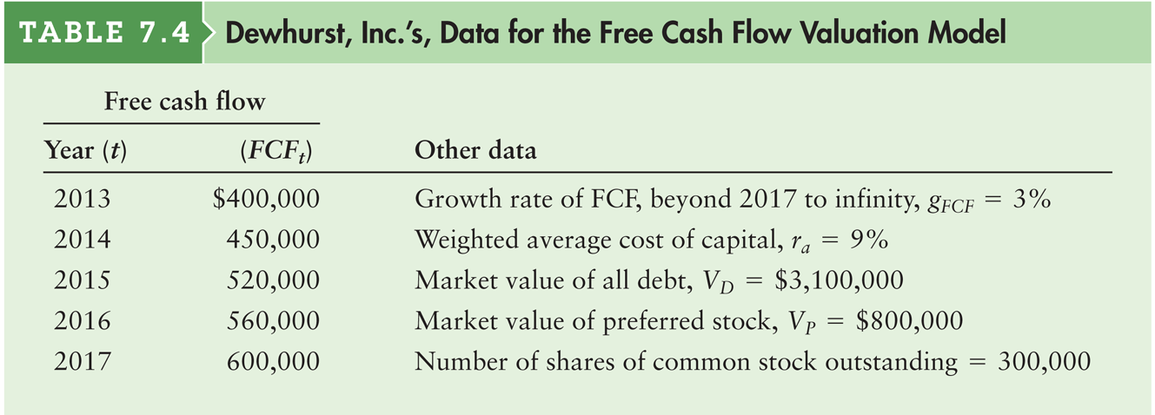
Table 7.4 Dewhurst, Inc.’s Data for the Free Cash Flow Valuation Model

Slide 36
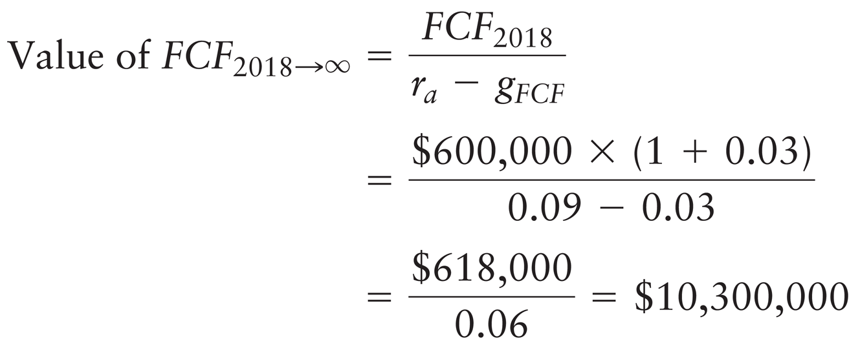
Common Stock Valuation: Free Cash Flow Valuation Model (cont.)
Step 1. Calculate the present value of the free cash flow occurring from the end of 2018 to infinity, measured at the beginning of 2018.

Slide 37
Common Stock Valuation: Free Cash Flow Valuation Model (cont.)
Step 2. Add the present value of the FCF from 2018 to infinity, which is measured at the end of 2017, to the 2017 FCF value to get the total FCF in 2017.
Total FCF₂₀₁₇ = $600,000 + $10,300,000 = $10,900,000
Step 3. Find the sum of the present values of the FCFs for 2013 through 2017 to determine the value of the entire company, V_{C}. This step is detailed in Table 7.5 on the following slide.

Slide 38
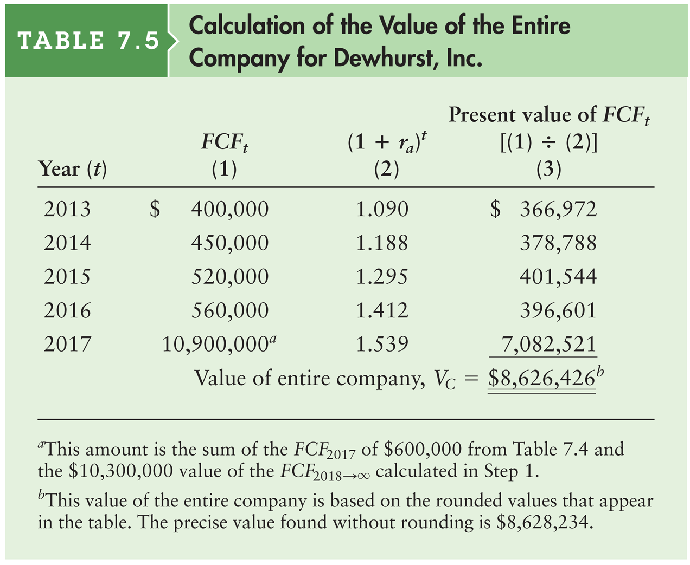
Table 7.5 Calculation of the Value of the Entire Company for Dewhurst, Inc.

Slide 39
Common Stock Valuation: Free Cash Flow Valuation Model (cont.)
Step 4. Calculate the value of the common stock.
V_{S} = $8,626,426 – $3,100,000 – $800,000 = $4,726,426
The value of Dewhurst’s common stock is therefore estimated to be $4,726,426. By dividing this total by the 300,000 shares of common stock that the firm has outstanding, we get a common stock value of $15.76 per share ($4,726,426 ÷ 300,000).

Slide 40
Decision Making and Common Stock Value: Changes in Risk (cont.)
Assume that Lamar Company manager makes a decision that, without changing expected dividends, causes the firm’s risk premium to increase to 7%. Assuming that the risk-free rate remains at 9%, the new required return on Lamar stock will be 16% (9% + 7%).

Slide 41
Decision Making and Common Stock Value: Combined Effect
If we assume that the two changes illustrated for Lamar Company in the preceding examples occur simultaneously, the key variable values would be D₁ = $1.50, r_{s} = 0.16, and g = 0.09.

