Slide 1
MGT-210

Slide 2
Explain why managers are important to an organization
Tell who managers are, and where they work
Describe the function roles and skill of managers
Describe the factors that are reshaping and redefining a managers job
Explain the value of studying management
1
2
3
4
5

Slide 3
Why managers are important???
Organizations need their managerial skills and abilities more than ever in these uncertain, complex, and chaotic times.
Managerial skills and abilities are critical in getting things done.
The quality of the employee/supervisor relationship is the most important variable in productivity and loyalty.
Notes:
Managers are needed to organize and motivate employees, to reach towards the common Organizational Goal. Their abilities help an organizations to reach the goal more effectively and efficiently. Research have found that the employee-manager relation is a major contribution factor for employee productivity.
Example: A branch manager in a Bank how he/she organizes the branch, mobilizes resources, in order to deliver service to its’ clients and help the organization reach its’ goal. Now think what would the situation of a branch be without a designated MANAGE?

Slide 4
Who are managers?
Are YOU a Manager???
Manger- Someone who coordinates and oversees the work of other people so that organizational goals can be accomplished.
Notes:
Managers, help achieving organizational goals. The can be of any age and any gender. Its not necessary that managers only exist in business organizations,
Managers can be found in a Government Agency, Not for Profit Organization, Hospitals, Small Businesses, Large Multi National Corporations. Managers job is not personal achievement it is important for managers to help/ facilitate others to do their work for achieving a common organizational goal.

Slide 5
Classifying Managers
First-line Managers - Individuals who manage the work of non-managerial employees. Example- Office manager, district manager, shift manager, department managers, etc.
Middle Managers - Individuals who manage the work of first-line managers. Example- Division manager, regional manager, brand manager, etc.
Top Managers - Individuals who are responsible for making organization-wide decisions and establishing plans and goals that affect the entire organization. Example- CEO, COO, President, Executive vice president, Managing Director, etc.

Slide 6
Management Levels

Slide 7
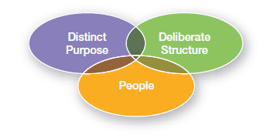
Where do managers work?
Organization - A deliberate arrangement of people assembled to accomplish some specific purpose (that individuals independently could not accomplish alone).
Common Characteristics of Organizations:
Have a distinct purpose (goal)
Are composed of people
Have a deliberate structure
Notes:
Our University, different banks, MNCs, a local departmental store, Grameen Phone, Robi, Asset Developments, ASA, Brac, these are some of the examples of an organization, and each organization must have the three common characteristics:
1) Distinct Purpose: Every organization has a purpose for their existence, and these purposes are usually expressed through the goals which an organization want to achieve. Different organizations may have different goals.
2) People: The second thing which every organizations have are People. As it takes people to accomplish the tasks which are needed to be performed in order to achieve an organizational goal. Imagine an organization without people how will it accomplish it’s tasks even?
3) Deliberate Structure: An organization develops their own structure, and employees of the organization work with in that specified, developed structure. There are two types of organizational structure, and they are open/flexible, where the job duties are not defined. The other type of organizational structure is the traditional structure, where specified job duties, descriptions, are given.

Slide 8
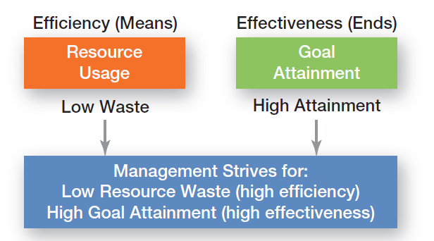
What do Managers do?
Management: Involves coordinating and overseeing the work activities of others so that their activities are completed efficiently and effectively.
Notes:
As we now know the difference between managerial and non managerial employee. Therefore it is important for managers to manage his/her subordinates/employees in such a way that the organizational goal is achieved with highest efficiency and effectiveness.
Efficiency: Working efficiency means to get the highest output through giving in the least amount of input, as managers have scarce resources inputs (money, people, and equipment), therefore the efficient use of resources are vital. Efficiency can be considered as “ Doing Things Right” . Therefore efficiency is considered with the means of getting things done.
Effectiveness: Being efficient is not enough for achieving an organizational goal, it is important to be effective, in order to attain the goals. Effectiveness can be considered as “Doing The Right Things’ . Therefore effectiveness can be considered with the end, or how much an organization has been able to attain its goal.

Slide 9
Functions of Management
Planning - Defining goals, establishing strategies to achieve goals, and developing plans to integrate and coordinate activities.
Organizing - Arranging and structuring work to accomplish organizational goals.
Leading - Working with and through people to accomplish goals.
Controlling - Monitoring, comparing, and correcting work.
Initially it was: Planning, organizing, commanding,
coordinating, and controlling (Henry Fayol, 20th Century)

Slide 10
Functions of Management Cont

Slide 11
Mintzberg’s Managerial Roles & Contemporary Model of Management
Mintzberg identified 10 roles grouped around interpersonal relationships, the transfer of information, and decision making.

Slide 12
10 Managerial Roles

Slide 13
Management Skills
Technical skills
Job specific knowledge which are needed to proficiently perform the task
Human skills
The ability to work well with other people both individually and in a group
Conceptual skills
The ability to think and conceptualize about abstract and complex situations concerning the organization
Notes:
Technical skill: These skills are needed for first line-manager, as they are usually managing employees who are non managerial and the employees who use tools and techniques to produce the organization's good/service to cater to their customers. Usually employees having excellent technical skills are promoted to first line-managers on the their performance basis.
Human skill: A manager having technical skill, should also posses human skills, as this is the ability of the manager to work efficiently in a group and individually also. As all managers from first line to top deal with people, therefore these skills are equally important, as a manager with good human skill would be able to communicate, motivate, lead, create enthusiasm and trust within his/her subordinates.
Conceptual skills: These are the skills needed by top level managers, as they need to conceptualize the abstract and complex situations which an organization may experience. Using these skills the managers see the organization as a whole and tries to understand the relationship between each departments/subunits. As these top-level managers provide strategic leadership, and direction to an organization.

Slide 14
Skills Needed at Different Managerial Levels
Notes:
Top managers: Conceptual skills
Middle Managers: Human Skills
Lower-Level Managers: Technical Skills

Slide 15
Important Managerial Skills
Managing human capital
Inspiring commitment
Managing change
Structuring work and getting things done
Facilitating the psychological and social contexts of work
Using purposeful networking
Managing decision-making processes
Managing strategy and innovation
Managing logistics and technology

Slide 16
Importance of Customers
Customers: the reason that organizations exist
Managing customer relationships is the responsibility of all managers and employees.
Consistent high quality customer service is essential for survival.

Slide 17
Changes Faced by Managers

Slide 18
Importance of Innovation and Sustainability
Innovation
Doing things differently, exploring new territory, and taking risks.
Managers should encourage employees to be aware of and act on opportunities for innovation.
One of the biggest innovative CEO Ratan
Tata, Steve Jobs!!!
Sustainability:
Achieve business goals through increasing long-term shareholder value.
Acting responsibility towards the environment and societal issues, and integrating economic, environmental and social opportunities within business strategies.

Slide 19
Why Study Management?
Notes:
The reality that management is needed
In all types and sizes of organizations
At all organizational levels
An all organizational areas

Slide 20
Terminologies you should know!!!
Manager
First-line managers
Middle managers
Top Managers
Management
Efficiency
Effectiveness
Planning
Organizing
Leading
Controlling
Interpersonal roles
Informational roles
Decisional roles
Technical skills
Human skills
Conceptual skills
Organization

