Slide 1
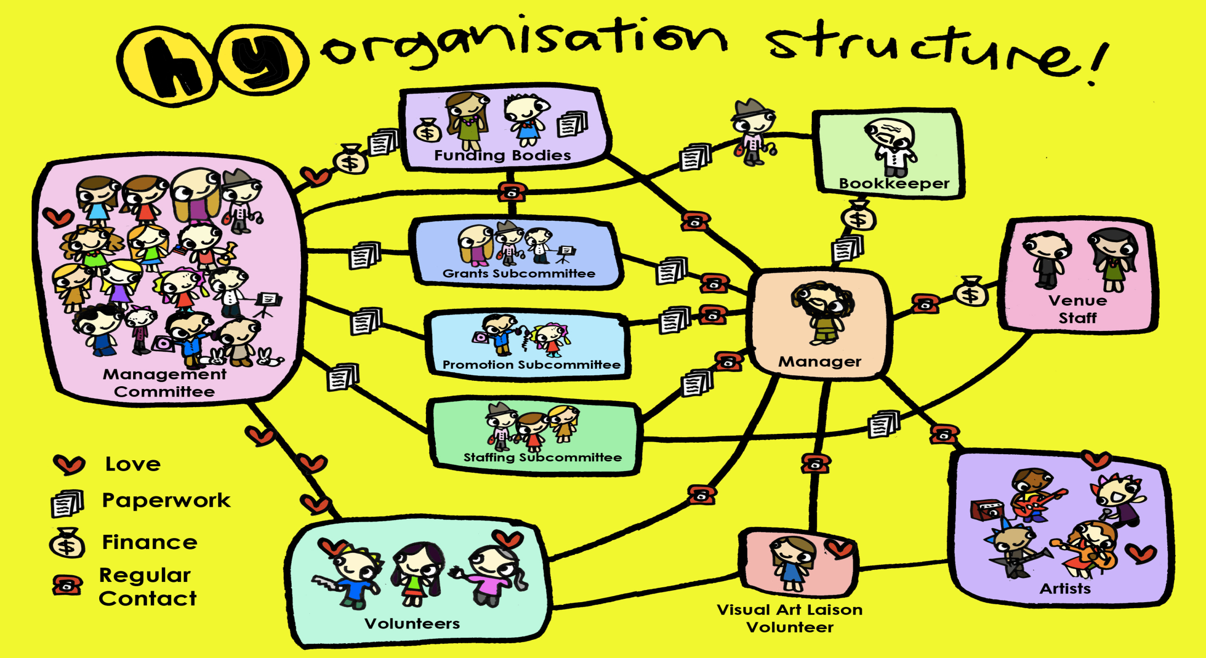
MGT 210 Chapter 10: Basic Organizational Design

Slide 2
Designing Organizational Structure
Organizing: arranging and structuring work to accomplish organizational goals
Organizational structure: the formal arrangement of jobs within an organization.
Organizational Design: managers creating or changing the structure. Involves six key elements:
Work Specialization
Departmentalization
Chain of command
Span of control
Centralization
Decentralization

Slide 3
Work Specialization
Dividing work activities into separate job tasks (Division of Labor). Individual employees specialize in doing part of an activity rather than the entire activity in order to increase output
Work specialization makes efficient use of the diversity of skills that workers have

Slide 4
Departmentalization
How jobs are grouped together

Slide 5
Functional Departmentalization
group jobs according to function
Strengths
Efficiencies from putting people of similar specialties together
Coordination within functional areas
In-depth specialization
Weaknesses
Poor communication across functional areas
Limited view of organizational goals

Slide 6
Geographical Departmentalization
group jobs according to location
Strengths
More effective and efficient handling of specific regional issues
Serve needs of unique geographic markets better
Weakness
Duplication of function
Can feel isolated from other organizational areas

Slide 7
Product Specialization
group jobs by product
Strengths
Allows specialization in particular products and services
Managers can become experts in their industry
Closer to customers
Weakness
Duplication of functions
Limited view of organizational goals

Slide 8
Customer Departmentalization
groups jobs on the basis of specific and unique customers who have common needs
Strengths
Customer’s needs and problems can be met by specialists
Weakness
Duplication of functions
Limited view of organizational goals

Slide 9
Process Departmentalization
group jobs on the basis of product or customer flow
More efficient flow of work activities
Can only be used with certain types of products

Slide 10
Chain of Command
line of authority extending from upper organizational levels to lower levels, which clarifies who reports to whom . It has three aspects to it

Slide 11
Authority
Rights belonging to managerial position to tell people what to do and expect them to do it
Managers in the chain of command had authority to their job of coordinating and overseeing the work of others
The acceptance theory of authority says that authority comes form the willingness of subordinates to accept it
They understand the order
They feel the order is consistent with the organization’s purpose
The order does not conflict with their personal beliefs
They are able to perform the task as directed

Slide 12
Line Vs. Staff Authority
Line authority
The right to command immediate subordinates in the chain of command
An activity that contributes directly to profit generation
Staff authority
The right to advise but not command others
An activity that supports profit generation

Slide 13
Responsibility
The obligation or expectation to perform

Slide 14
Unity of command
a person should report only to one manager. Without it, conflicting demands from multiple bosses may create problems.

Slide 15
The span of control
The number of employees a manager can effectively and efficiently manage/supervise

Slide 16
Span of control
The span of control determines the number of levels and managers in an organization, the wider or larger the span, the more efficient an organization will be.
The skills and abilities of the manger and the employees
the characteristics of the work being done
similarity and complexity of employee tasks
the physical proximity of subordinates
the degree to which standardized procedures are in place
the information system
the organization culture and preferred style of management.

Slide 17
Centralization Vs. Decentralization

Slide 18
Formalization
how standardized organization’s job are and the extent to which employee behavior is guided by rules and procedures.
In highly formalized organization:
there are explicit job description
numerous organization rules and clearly defined procedures covering work processes
Employees have little discretion in what they want to do.

Slide 19
Mechanistic Vs. Organic Model

Slide 20
Contingency factors affecting structural choice
There are four variables that go into designing an appropriate organizational structure

Slide 21
Strategy
An organization’s structure should help goal achievement
Flexibility and free-flowing information of the organic structure works well when an organization is pursuing meaningful and unique innovations
The mechanistic organization with efficiency, stability and tight control works best for companies wanting to tightly control costs.

Slide 22
Additional variables
Technology
Unit production: the production of items in units or small batches
Mass production: described large batch manufacturing
Process production: continuous process production
Size
Larger organizations tend to have more specialization, departmentalization, centralization and rules and regulations than do small organizations.
Environmental uncertainty
In stable and simple environments, mechanistic designs can be more effective. The greater the uncertainty, the more an organization needs the flexibility of an organic design.

Slide 23
Traditional Organizational Designs

Slide 24
Simple structures
An organization with low departmentalization, wide spans of control , authority centralized in a single person and little formalization
Strength:
Fast, flexible, inexpensive to maintain; clear accountability
Weaknesses:
Not apporpirate as organization grows, reliance on one person is risky

Slide 25
Functional structure
groups similar or related occupational specialties together. Functional departmentalization applied to the entire organization
Strengths:
Cost saving advantages from specialization, employees are grouped with others who have similar tasks
Weakness:
Pursuit of functional goals can cause managers to lose sight of what’s bets for the overall organization;
functional specialists become insulated and have little understanding of what other units are doing

Slide 26
Divisional structure
This business structure is made of separate business units or divisions.
Strengths:
Focuses on results – divisions mangers are responsible for what happens to their products and services
Weaknesses
Duplication of activities and resources increases cots and reduces efficiency.

Slide 27
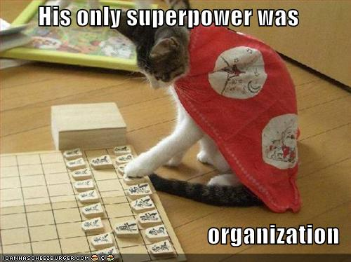
THANK YOU EVERYONE & TAKE CARE

