Slide 1
Chapter-11, Adaptive Organizational Design

Slide 2
Describe contemporary organizational designs
Discuss how organizations organize for collaboration
Explain flexible work arrangements used by organizations
Discuss organizing issues associated with a contingent workforce
Describe today’s organizational design challenges

Slide 3
Contemporary Organizational Designs
Team Structure - an organizational structure in which the entire organization is made up of work teams. Example- Motorola, HP, Xerox, Louis Vuitton, etc.
Matrix Structure - an organizational structure that assigns specialists from different functional departments to work on one or more projects. Surprisingly this structure defies the principle of ‘Unity of Command’.

Slide 4
Contemporary Organizational Designs (cont.)
Project Structure - an organizational structure in which employees continuously work on projects.
Boundary-less Organization - an organization whose design is not defined by, or limited to, the horizontal, vertical, or external boundaries imposed by a predefined structure, example- General Electronics.
Notes:
Boundary-less organization an association where management has largely succeeded in breaking down barriers between internal levels, job functions and departments, as well as reducing external barriers between the association and those with whom it does business. Developing a business into a boundary-less organization might include creating a more horizontal management structure, encouraging interdepartmental projects, and empowering staff members.

Slide 5
Contemporary Organizational Designs (cont.)
Virtual Organization - an organization that consists of a small core of full-time employees and outside specialists temporarily hired as needed to work on projects.
Network Organization - an organization that uses its own employees to do some work activities and networks of outside suppliers to provide other needed product components or work processes.

Slide 6
Contemporary Organizational Designs (cont.)
Learning Organization - an organization that has developed the capacity to continuously learn, adapt, and change
Organizations need to be lean, flexible, and innovative; that is, they need to be more organic. So managers are finding creative ways to structure and organize work. These contemporary designs include team structures, matrix and project structures, boundary less organizations, and learning organizations.

Slide 7
Contemporary Organizational Designs (cont.)

Slide 8
Contemporary Organizational Designs (cont.)

Slide 9
Internal Collaboration
Cross-functional team - a work team composed of individuals from various functional specialties.
Task force (or ad hoc committee) - a temporary committee or team formed to tackle a specific short-term problem affecting several departments.
Notes:
An organization’s collaboration efforts can be internal—that is, among employees within the organization. Or those efforts can be external collaborations with any stakeholders

Slide 10
Flexible Work Arrangements
Telecommuting - a work arrangement in which employees work at home and are linked to the workplace by computer.
Notes:
Example- These telecommuters are connected to their employers via the Internet, voice and video conferencing, and mobile devices. Working from home generally appeals to employees who want freedom, but also to persons with disabilities, older workers, and parents. Companies benefit from telework arrangements because they can expand their pool of talent and increase productivity without increasing costs.29 Telecommuters need to be self-disciplined and reliable employees. They also need managers who are comfortable with setting goals and managing from afar. Forrester Research predicts that telecommuting will grow from its current 34 million workers to 63 million by the year 2016 (IN USA).

Slide 11
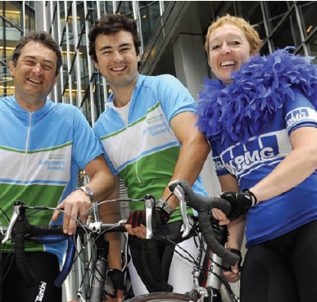
Flexible Work Arrangements (cont.)
Compressed workweek - a workweek where employees work longer hours per day but fewer days per week. Example- Macy’s
Notes:
Example- About 40 percent of Macy’s employees opt for a compressed workweek. According to the retailer’s human resource department, this benefit is valued second only to pay and medical insurance. “We’ve invested a lot in our people,” notes Ed Cooney, senior vice president of human resources. “When we offer work options, it’s not totally unselfish. We know it results in more loyalty and less absenteeism.

Slide 12
Flexible Work Arrangements (cont.)
Flextime (or flexible work hours) - a scheduling system in which employees are required to work a specific number of hours a week but are free to vary those hours within certain limits. Example- BidShift’s online posting of work schedule
Job sharing - the practice of having two or more people split a full-time job.
Notes:
Example of flexi time: With the help of programs from BidShift, a San Diego company that specializes in Internet based scheduling software, the logistic problems of flexible scheduling are solved for users such as the San Angelo Community Medical Center. BidShift’s programs allow managers to post schedules online, where employees log in and request certain shifts or schedule changes.

Slide 13
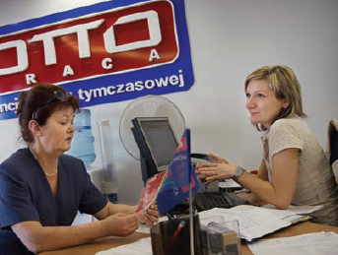
Contingent Workforce
Contingent workers - temporary, freelance, or contract workers whose employment is contingent upon demand for their services.

Slide 14
Terms to Know
Team structure
Matrix structure
Project structure
Boundaryless organization
Virtual organization
Network organization
Learning organization
Cross-functional team
Task force (or ad hoc committee)
Communities of practice
Open innovation
Strategic partnerships
Telecommuting
Compressed workweek
Flextime (or flexible work hours)
Job sharing
Contingent workers
Notes:
14

Slide 15
Thank You ☺

