Slide 1
MGT 210
CHAPTER 13: MANAGING TEAMS

Slide 2

Group
two or more interacting and interdependent individuals who come together to achieve specific goals

Slide 3
Formal Groups
work groups that are defined by the organization’s structure and have designated work assignments and specific tasks directed at accomplishing organizational goals
Command groups: groups that are determined by the organization and composed of individuals who report directly to a given manager
Task groups: groups composed of individuals brought together to complete a specific job task
  group disbands when job is done
Cross-functional groups: groups that bring together the knowledge and skills of individuals from various work areas
Self managed teams: groups that are essentially independent do their own tasks and take on traditional managerial responsibilities.

Slide 4
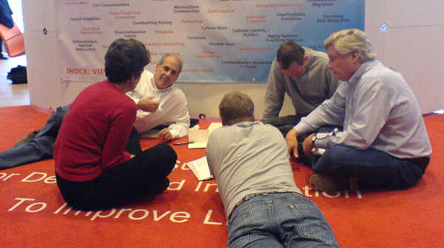
Informal Groups
social groups. These groups occur naturally in the workplace and tend to form around friendships and common interests

Slide 5
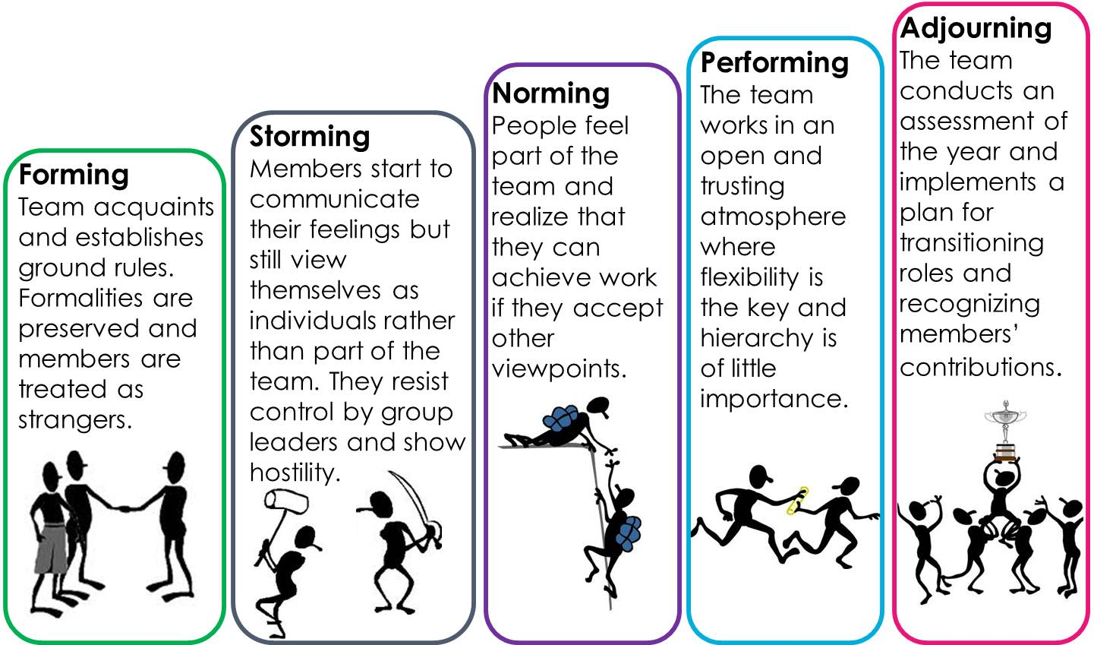
Stages of Group Development

Slide 6
Work Group Performance & Satisfaction

Slide 7
Factors that determine group performance satisfaction
External Conditions Imposed on the group
Group member resources
Group structure
Group tasks

Slide 8
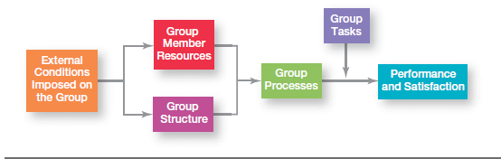
Factors that determine group performance satisfaction

Slide 9
External Conditions Imposed on the Group
Work groups are affected by the external conditions imposed on it:
the organization’s strategy
authority
reporting relationships
formal rules and regulations
availability of resources
employee selection criteria

Slide 10
Group Member Resources
A group’s performance potential depends to a large extent on the resources each individual brings to the group
Abilities, skills and personality traits
These determine what members can do and how effectively they will perform in a group
Skills deemed as essential are:
  Conflict management and resolution
  Collaborative problem solving
  Communication
Personality traits also affect group performance because they strongly influence how they individual will interact

Slide 11
Group Structure
Groups have an internal structure that shapes member behaviors and influences group performance
Roles
Norms
Conformity
Status systems
Group size
Group cohesiveness
Group decision making
Conflict management

Slide 12
Roles
A role refers to behavior patterns expected of someone occupying a given position in a social unit
Individuals are expected to do certain things because of their position in the group.
These roles are generally oriented toward:
  either getting work done
  keeping members happy.

Slide 13
Norms
These are standards or expectation that are accepted and shared by a group’s members
Norms dictate things such as:
  work output levels
  absenteeism
  Promptness
  amount of socialization on the job.
The most widespread norms are related to work effort and performance.

Slide 14
Conformity
Because individuals want to be accepted by groups to which they belong, they are susceptible to pressures to conform.
Group members often want to be seen as one of the group and avoid being visibly different
When individual’s opinion differs greatly from the group, the group often exerts intense pressure on the individual to align his or her opinion to conform to others opinion. This is known as groupthink.

Slide 15
Status Systems
Status is prestige grading position or rank within a group
Status can be a significant motivator with behavioral consequences
Status may be informally conferred by characteristics such as education, age , skill or experience.
Group members have no problem placing people into status categories and usually agree about who has high or low status.

Slide 16
Group Size
Group size affects performance and satisfaction
Small groups are faster at completing tasks than larger one.
Larger groups are good at getting diverse inputs.
Social loafing is the tendency for an individual to expend less effort when working collectively than working individually.
Social loafing may occur because people believe that others in the group aren’t doing their fair share

Slide 17
Group Cohesiveness
degree to which members are attracted to a group and share the group’s goals.
A key moderating variable is the degree to which the group’s attitude aligns with its goals or the goals of the organization.
The more cohesive the groups, the more its members will follow its goals.
Highly cohesive groups are more effective than less cohesive ones.
If the goals are desirable, a cohesive group is more productive than a less cohesive group.

Slide 18
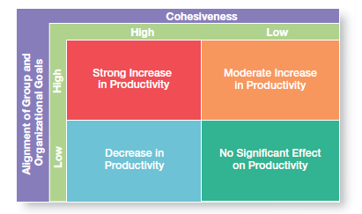
Group Cohesiveness and Productivity

Slide 19

Group Decision making

Slide 20
Group Versus Individual Decision Making
Criteria of Effectiveness Groups Individuals
Accuracy ✓
Speed ✓
Creativity ✓
Degree of acceptance ✓
Efficiency ✓

Slide 21
Conflict Management
perceived incompatible differences resulting in some form of interference or opposition
The traditional view: conflict must be avoided
Human view: conflict is a natural and inevitable outcome in any group and need not be negative
  it has potential to be positive force in contributing to a group’s performance.
Interactionist view: not only conflict be a positive force in a group but that some conflict is absolutely necessary for a group to perform effectively

Slide 22
Interactionist View
Functional Conflict
Dysfunctional conflict
constructive and support the goals & improve performance
    Task conflict: relates to the content and goals of the work
    Process conflict: refers to how the work gets done
destructive and prevent a group from achieving its goals.
    Relationship conflict: focuses on interpersonal relationships.

Slide 23
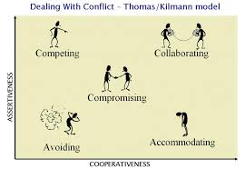
Conflict Management Options

Slide 24
Conflict Management Options
Resolving conflicts by
Resolving conflicts by
satisfying one’s own
seeking an advantageous
needs at the expense
solution for all parties.
of another’s.
Resolving conflicts by
each party's giving up
something of value.
Compromising
Resolving conflicts by
Resolving conflicts by
withdrawing from or
placing another’s needs
suppressing them.
and concerns above
your own.
Avoiding
Accommodating
Uncooperative
Cooperative

Slide 25
Group Tasks
Tasks are either simple or complex
Simple tasks are routine and standardized.
Complex tasks tend to be novel or nonroutine.
The more complex the task is, the more a group benefits from group discussions about alternative work methods.

Slide 26
Types of Work Teams

Slide 27
Difference Between Groups and Teams
Groups
  Interact primarily to share information and to make decisions to help each member do his or her job more efficiently and effectively
Teams
  Work intensely on a specific, common goal using their positive synergy, individual and mutual accountability, and complementary skills

Slide 28
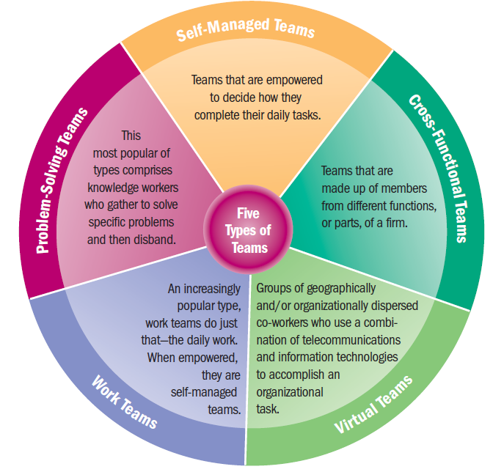
Types of Work Teams

Slide 29
Creating Effective Work Teams
Clear goals
Relevant skills
Mutual trust
Unified commitment
Good communication
Negotiating skills
Appropriate leadership
Internal and external support

