Slide 1
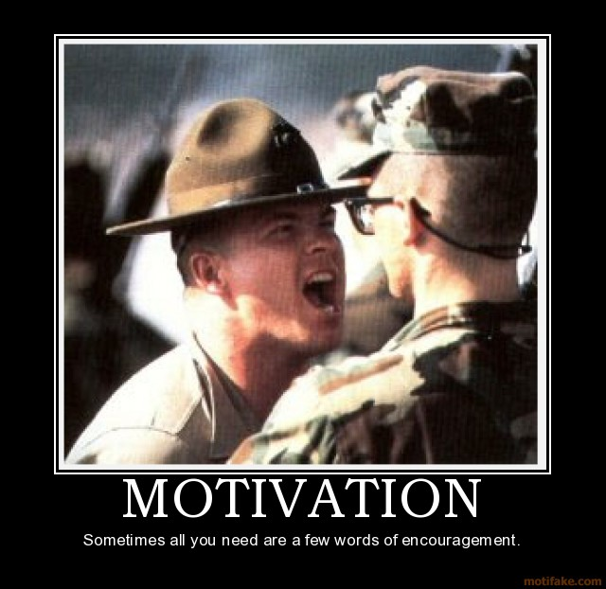
MGT 210: PRINCIPLES OF MANAGEMENT CHAPTER 16: MOTIVATION

Slide 2
Motivation
the process by which efforts are energized, directed and sustained toward attaining a goal

Slide 3
Motivation
the process by which efforts are energized, directed and sustained toward attaining a goal
Energy: measure of intensity, drive and vigor. A motivated person puts forth effort and work hard.
Effort that's directed toward, and consistent with organizational goals is the kind of effort we want from employees.
Motivation includes a persistence dimension. We want employees to persist in putting forth effort to achieve those goals.

Slide 4
Early Theories of Motivation

Slide 5
Maslow’s Hierarchy of Need Theory
people have five levels of needs that they seek to satisfy
Physiological
Safety
Social
Esteem
Self-actualization

Slide 6
Maslow’s Hierarchy of Need Theory

Slide 7
Hertzberg’s Motivating Factors
The two factor theory of motivation holds that two sets of factors influence jobs satisfaction
Hygiene factors: salary, technical supervision, company policies and administration, interpersonal relations and working conditions
Motivators: achievement, recognition, responsibility, advancement and the work itself.
If hygiene factors are not taken care of, they will create dissatisfaction.
If hygiene factors are taken care of, there may be no dissatisfaction but there may also be no satisfaction
Only motivators lead to satisfaction

Slide 8
McGregor’s Theory X & Theory Y

Slide 9
McClelland’s Need Theory
there are three acquired needs that are major motives in work.
The need for achievement (nAch)
The drive to succeed and excel in relation to a set of standards
The need for power (nPow)
The need to make others behave in a way that they would not have behaved otherwise
The need for affiliation (nAff)
The desire for friendly and close interpersonal relationships.

Slide 10
Contemporary Theories of Motivation

Slide 11
Goal Setting Theory & Management
Setting ambitious but attainable goals can motivate workers and improve performance as if the goals are accepted and accomplished by feedback and if conditions in the organization pave the way for achievement.
All organization should have some basic agreement about both overall goals and specific objective for each department and individual.

Slide 12
Goal Setting Theory & Management
Goals need to be:
- Specific
- Difficult
- Participatively set
Goals Motivate by:
-Directing attention
- Encouraging Persistence
- Fostering goal attainment strategies & action Plan
Improved Performance

Slide 13
Reinforcement Theory
Behavior is a function of its consequences. This theory focuses on what happens to a person when he or she does something

Slide 14
Designing Motivating Jobs
Managers should design jobs deliberately and thoughtfully to reflect the demands of the changing environment, the organization’s technology and employees skills, abilities and preferences
Job Design and Motivation
Job enlargement—job design that expands an employee’s responsibilities by increasing the number and variety of tasks they entail.
Job enrichment—change in job duties to increase employee’s authority in planning their work, deciding how it should be done, and learning new skills.

Slide 15
Job Characteristics Model
This identifies five core job dimensions, their interrelationships and their impact on employee productivity, motivation and satisfaction
Skill variety: the degree to which a job requires a variety of activities so that an employee can use a number of different skills and talents
Task identity: the degree to which a job requires a completion of a whole and identifiable piece of work
Task significance: the degree to which a job has a substantial impact on the lives or work of other people
Autonomy: the degree to which a job provides substantial freedom, independence and discretion to the individual in scheduling the work and determining the procedures to be used in carrying it out
Feedback: the degree to which doing work activities required by a job results in an individual obtaining direct and clear information about the effectiveness of his or her performance.

Slide 16
Job Characteristics Model
This identifies five core job dimensions, their interrelationships and their impact on employee productivity, motivation and satisfaction

Slide 17
Equity Theory
Employees compare what they get from a job in relation to what they put into it and then they compare their inputs- outcomes ratio with the inputs – outcomes ratios of relevant others

Slide 18
Equity Theory
The referent - the other persons, systems or selves individuals compare themselves against in order to assess equity
The persons category includes other individuals with similar jobs in the same organization but also includes friends, neighbors or professional associates.
The systems category includes organizational pay policies, procedures and allocation
The self category refers to inputs – outcomes ratios that are unique to the individual. It reflects past personal experiences and contacts.

Slide 19
Expectancy Theory
Individuals act in a certain way based on the expectation that the act will be followed by a given outcome and on the attractiveness of that outcomes to the individual.

Slide 20
Expectancy Theory
Expectancy or effort performance lineage: exerting a given amount of effort will lead to a certain level of performance.
Instrumental or performance-reward linkage: performing at a particular level is instrumental in attaining the desired outcome
Valence or attractiveness of reward: on the potential outcomes or reward that can be achieved on the job.

Slide 21
Designing Appropriate Reward Programs

Slide 22
Open Book Management
Many organizations of various sizes involve their employees in workplace decisions by opening up the financial statement.
share the information so that employees will be motivated to make better decisions about their work
better able to understand the implications of:
what they do
how they do it
ultimate impact on the bottom line
The goal is to get employees to think like an owner by seeing the impact their decisions have on financial results
Employees begin to see the link between their efforts, level of performance and operational results

Slide 23
Employee Recognition Programs
personal attention and expressing interest, approval and appreciation for a job well done

Slide 24
Employee Recognition Program
Personally congratulate an employee for a job well done
Send a handwritten note or email messages acknowledging something positive that the employee has done.
For employees with a strong need for social acceptance, you can publicly recognize accomplishment.
To enhance group cohesiveness and motivation, you can celebrate team successes.

Slide 25
Pay for Performance
This is compensation that pay employees on the basis of some performance measure.

