Slide 1
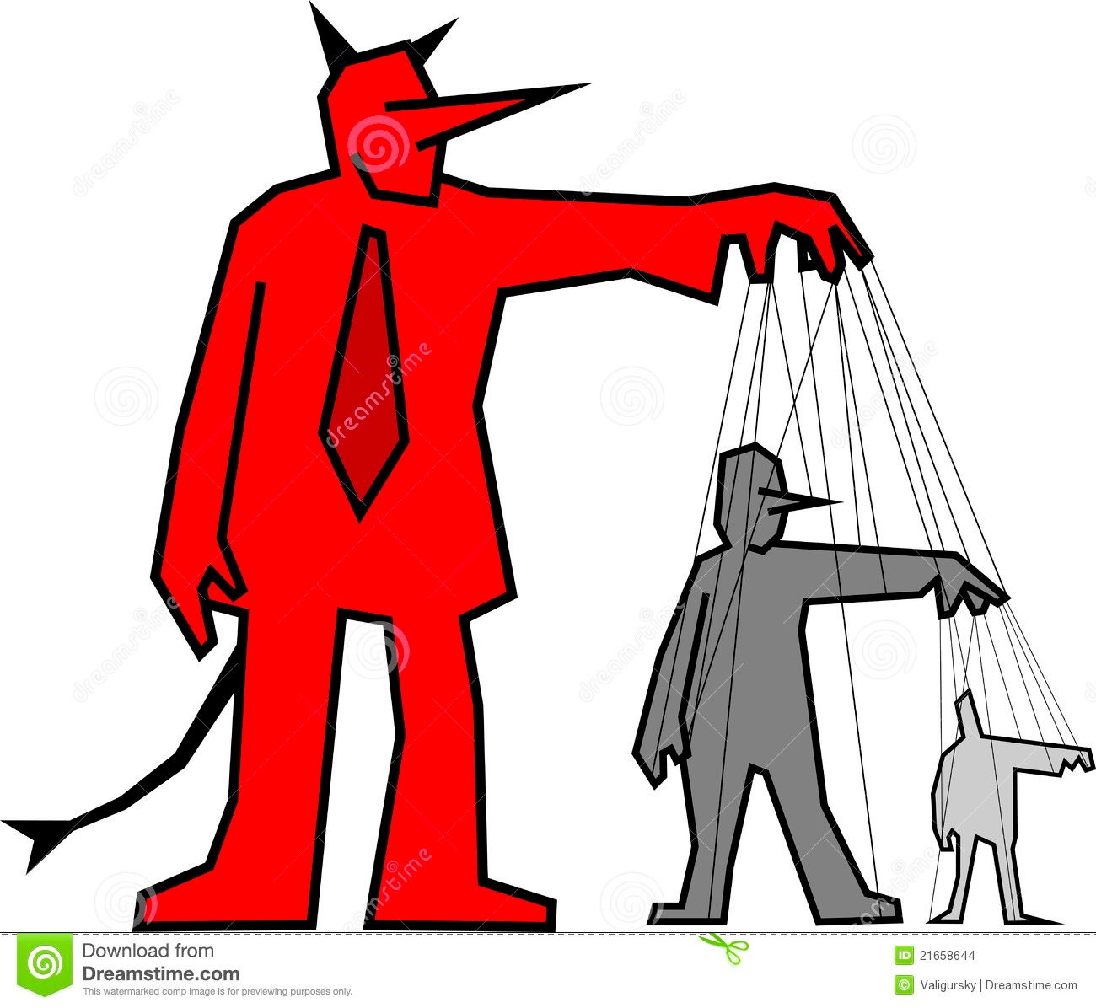
MGT 210 Chapter 18: Controlling

Slide 2
Controlling
The process of monitoring, comparing and correcting work performance

Slide 3
Importance of Controlling
Control is important because it is the only way that managers know whether organizational goals are being met and if not the reasons why
The importance of control functions can be seen in three specific areas:
Planning
Empowering employees
Protecting the workplace

Slide 4
Importance of Controlling
Planning: Goals provide specific direction to employees and managers as the foundation of planning.
The effective managers follows up to ensure that what employees are supposed to do and goals are being achieved
Empowerment: An effective control system can provide information and feedback on employee performance and minimize the chance of potential problems.
Protecting the workplace: Managers must protect organizational assets in the event that any abnormalities should happen. Comprehensive controls and backup plans will help assure minimal work disruptions

Slide 5
The Control Process
a three step process of measuring actual performance, comparing actual performance against standard, and taking managerial action to correct deviations or to address inadequate standards

Slide 6
The Control Process
Step 1: measuring actual performance
The first step in control is measuring.
How we measure
Four approaches used by managers are:
Personal observation
Statistical reports
Oral reports
Written reports
What we measure
Some control criteria can be used for any management situation. Most work activities can be expressed in quantifiable terms.
Step 2: comparing actual performance against the standard
This step determines the deviation between actual performance and the standard.
Although some variation is acceptable and is expected in all activities, it is critical to determine an acceptable range of variation.
Deviation outside this range needs attention.

Slide 8
The Control Process
Step 3: taking managerial action
Managers can choose among three possible course of actions:
Do nothing
Correct the actual performance
Revise the standards

Slide 9
Taking Managerial Actions
Correct actual performance
Depending on what the problem is, a manager could take different corrective actions:
Take immediate corrective action, which corrects problems at once to get performance back on track
Use basic corrective action, which looks at how and why performance deviated before correcting the source of deviation.
Revise the standard
It’s possible the variance was because of unrealistic standard – too high or low a goal.
In this case, the standard needs the corrective action, not the performance.
If performance consistently exceeds the goal then a manager should look at whether the goal is too easy and needs to be raised.
On the other hand, managers must be cautious about revising a standard downward.

Slide 10
Controlling for Organizational Performance

Slide 11
Organizational Performance
the accumulated results of all the organizational activities
All managers must know which measures will help them with the information they need about organizational performance.
Commonly used ones include:
organizational productivity
organizational effectiveness
industry rankings.

Slide 12
Measures of Organizational Performance
Organizational productivity
Productivity is the amount of G&S produced divided by the inputs needed to generate that output.
Organizations and individuals want to produce the most goods and services using the least amount of inputs.
Output is measured by the sales revenue an organization receives when goods are sold
(selling price x number sold).
Input is measured by the costs of acquiring and transforming resources into outputs.
Organizational effectiveness
Organizational effectiveness is a measure of how appropriate organizational goals are and how well those goals are being met.
That is what guides managerial decisions in designing strategies and work activities in coordinating the work of employees.
Industry & company ranking
Rankings are popular way for managers to measure their organization’s performance.

Slide 13
Tools for Measuring Organizational Performance

Slide 14
Feedforward – Concurrent – Feedback (FCF) Control
Managers can implement control before an activity begins, during the time the activity is going and after the activity has been completed.
1.Feedfroward Control
Taking managerial action before a problem occurs.
Helps to prevent problems before they happen
2. Concurrent Control
Taking action while work activity is in progress
Direct Supervision or management by walking around
3. Feedback Control
Taking action after the activity is done
Provide meaningful information about plan effectiveness
Can enhance motivation

Slide 15
Financial Controls
Managers might use traditional financial measures such as ratio analysis and budget analysis
Budgets are planning tools
A budget indicate which work activities are important
What & How much resources would be allocated
Budgets are used for controlling
Provides quantitative standards to measure against

Slide 16
The Balance Scorecard
Evaluate the company’s performance from four perspectives:
Financial
Customer
Internal processes
People/innovation/growth
Managers will focus on areas that drive their organization’s success and use scorecards that reflect those strategies.

Slide 17
Information Controls
Managers deal with information controls in two ways:
Information Used in Controlling
Manager need the right information at the right time in the right amount to monitor and measure organizational activities and performance.
Controlling Information
Managers must have comprehensive and secure control in place to protect that information

Slide 18
Benchmarking of Best Practices
Benchmarking is the search for the best practices among competitors or non-competitors that lead to their superiors performance
Benchmarking should identify the standards of excellence against which to measure and compare.
Benchmarking can be used to identify specific performance gaps and potential areas of improvement.

Slide 19
Contemporary Issues in Control

Slide 20
Adjusting for Cross-Cultural Differences
The differences are primarily in the measurement and corrective actions steps of the control process
Distance becomes an issue
Have to rely on formal reports
Laws & regulations
Comparability

Slide 21
Workplace Privacy
Managers monitor employee email and computer usage is that they don't want to risk being sued for creating a hostile workplace environment
Concerns about racial or sexual harassment
Managers want to ensure that company secrets are not being leaked
Employee theft
any unauthorized taking of company property by employees for their personal use

Slide 22
Workplace Violence

Slide 23
Customer Interaction
There is no better area to see the link between planning and controlling than in customer service

Slide 24
Corporate Governance

Slide 25
