Slide 1
Contrast the actions of managers according to the omnipotent and symbolic views
Describe the constraints and challenges facing managers in today’s external environment
Discuss the characteristics and importance of organizational culture
Describe current issues in organizational culture

Slide 2
Manager- Omnipotent or Symbolic
Omnipotent View of Management - the view that managers are directly responsible for an organization’s success or failure.
Symbolic view of Management - the view that much of an organization’s success or failure is due to external forces outside managers’ control.

Slide 3
Constraints on Managerial Decision

Slide 4
The External Environment: Constraints and Challenges
External Environment – Are those factors and forces outside the organization that affect its performance.
Components of the External Environment:
Broad economic, socio-cultural, political/legal, demographic, technological, and global conditions that may affect the organization

Slide 5
Components of External Environment

Slide 6
Environmental Uncertainty and Complexity
Environmental Uncertainty - the degree of change and complexity in an organization’s environment.
Environmental Complexity - the number of components in an organization’s environment and the extent of the organization’s knowledge about those components.

Slide 7
Environmental Uncertainty Matrix

Slide 8
Stakeholders'- Who are they?
Stakeholders - Any constituencies in the organization’s environment that are affected by an organization’s decisions and actions.

Slide 9
Organizational Steak Holders

Slide 10
Managing Stakeholder Relationships
Identify the organization’s external stakeholders.
Determine the particular interests and concerns of external stakeholders.
Decide how critical each external stakeholder is to the organization.
Determine how to manage each individual external stakeholder relationship.

Slide 11
Organizational Culture
Organizational Culture - The shared values, principles, traditions, and ways of doing things that influence the way organizational members act. Three components of culture- perception, descriptive and shared.
Strong Cultures - Organizational cultures in which key values are intensely held and widely shared.

Slide 12
Cultural Dimensions

Slide 13
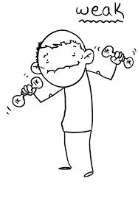
Organizational Culture
vs

Slide 14
An example

Slide 15
Benefits of Strong Cultures
Creates a stronger employee commitment to the organization
Aids in the recruitment and socialization of new employees
Fosters higher organizational performance by instilling and promoting employee initiative

Slide 16
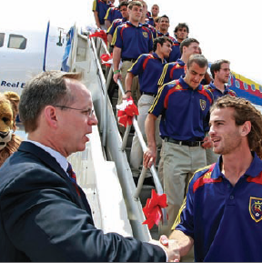
Does a culture just jumps in?
Organization founder
Vision and mission
Past practices
Top management behavior
Socialization - The process that helps employees adapt to the organization’s culture

Slide 17
Not only make but MAINTAIN Culture

Slide 18
Learning Cultures
Stories - Narratives of significant events or people, e.g. organization founders, rule breaking, reaction to past mistakes etc.
Rituals - Sequences of activities that express and reinforce the important values and goals of the organization

Slide 19
Learning Cultures (cont.)
Material Artifacts and Symbols - Convey the kinds of behavior that are expected, e.g. risk taking, participation, authority, etc.
Language - Acts as a common denominator that bonds members

Slide 20
Criteria's for Customer Responsive Culture

Slide 21
Spirituality and Culture
Workplace Spirituality - a culture where organizational values promote a sense of purpose through meaningful work that takes place in the context of community
Characteristics of a Spiritual Organization
Strong sense of purpose
Focus on individual development
Trust and openness
Employee empowerment
Toleration of employees’ expression

Slide 22
Terms You Should Know
omnipotent view of management
symbolic view of management
organizational culture
strong cultures
socialization
workplace spirituality
external environment
specific environment
general environment
environmental uncertainty
environmental complexity
stakeholders

