Slide 1

Let’s Learn to Manage Them!!!

Slide 2

Define workplace diversity and explain why managing it is so important
Describe the changing workplaces in the United States and around the world
Explain the different types of diversity found in workplaces
Discuss the challenges managers face in managing diversity
Describe various workplace diversity management initiatives

Slide 3
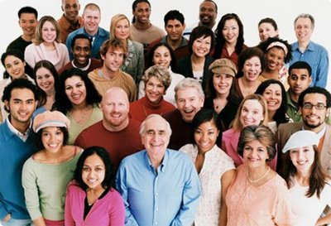
What is Workforce Diversity?
Workforce Diversity - the ways in which people in an organization are different from and similar to one another.

Slide 4
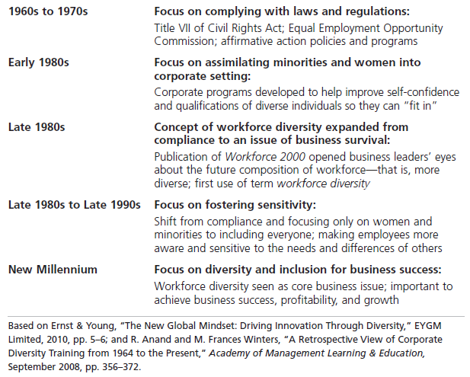
Timeline of the Evolution of Workforce Diversity

Slide 5
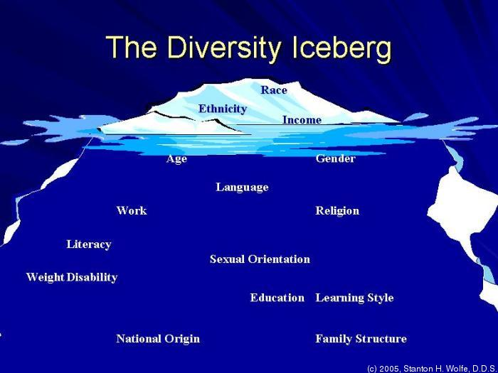
Levels of Diversity
Surface-level diversity- Easily perceived differences that may trigger certain stereotypes, but do not necessarily reflect the ways people think or feel.
Deep-level diversity - Differences in values, personality, and work preferences.

Slide 6
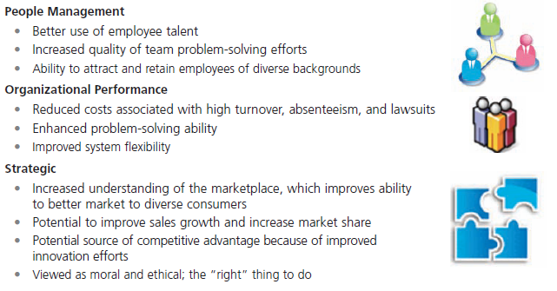
Benefits of Workforce Diversity

Slide 7
Examples of Poor Diversity Management
Abercrombie & Fitch paid $50 million to people who alleged in a lawsuit and two class-action suits that it discriminated against minorities and women.
A Muslim female employee of Hollister, was asked to remove her HIJAB, as her look and attire did not go well with the company’s “Look Policy” ( as their policy instructs employee’s clothing and hairstyle, make up and what to wear to work). As the Muslim lady refused she was fired. However after complaining to law authorities, the spokesperson of the company tried to re-accommodate her in a different role.
Quest Diagnostics and AmeriPath, a subsidiary have been sued in federal court for widespread and systematic discriminatory practices against women. Without admitting guilt, the company agreed to pay $152 million to more than 5,000 current and former female employees. The company also agreed to spend $22.5 million to institute new human resources policies and procedures.
Ventura Corporation, a wholesaler of beauty products, was sued by the EEOC for discriminating against men -- the company refused to hire men as sales reps. Talk show host Jimmy Fallon and his network, NBC, was also sued for discriminatory practices against men.

Slide 8
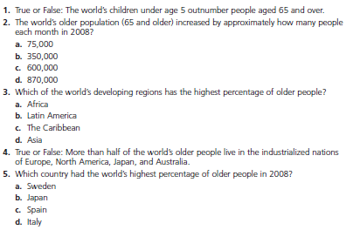
Example: Global Aging:
How Much do You Know?

Slide 9
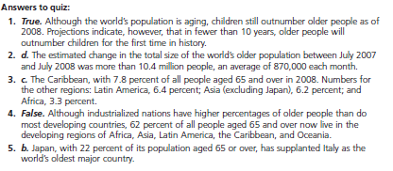
Global Aging (cont.)

Slide 10
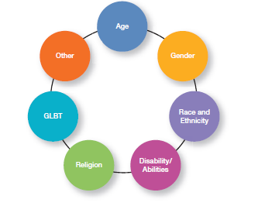
Types of Diversity Found in Workplaces

Slide 11
Types of Diversity
Age - Both Title VII of the Civil Rights Act of 1964 and the Age Discrimination in Employment Act of 1967 prohibit age discrimination.
Gender - Women (49.8%) and men (50.2%) now each make up almost half of the workforce. Gender discrimination has decreased, and women are not only a part of workforce but they are working collaboratively and competing with men. Research says, the percentage of women in top managerial roles have increased all over the world.

Slide 12

Types of Diversity (cont,)
‘Women tend to be more agreeable and willing to conform to authority while men are more aggressive and more likely to have expectations of success’.

Slide 13

Types of Diversity (cont,)
Race - the biological heritage (including skin color and associated traits) that people use to identify themselves.
Ethnicity - social traits (such as cultural background or allegiance) that are shared by a human population. Example: 56 Ethnic different ethnic groups have been identified in China, and recognized by the government of China.

Slide 14
Types of Diversity (cont,)
Disability/Abilities - The Americans With Disabilities Act of 1990 prohibits discrimination against persons with disabilities.
Religion - Title VII of the Civil Rights Act prohibits discrimination on the basis of religion.
GLBT: Sexual Orientation and Gender Identity - U.S. federal law does not prohibit discrimination against employees on the basis of sexual orientation.

Slide 15
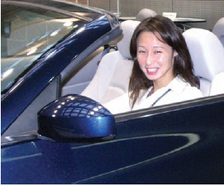
Challenges in Managing Diversity
Bias - a tendency or preference toward a particular perspective or ideology.
Prejudice - a pre-conceived belief, opinion, or judgment toward a person or a group of people.

Slide 16
Challenges in Diversity (cont.)
Stereotyping - judging a person based on a prejudicial perception of a group to which that person belongs. Example- Married persons are more stable employees than single persons.
Discrimination - when someone acts out their prejudicial attitudes toward people who are the targets of their prejudice.
Glass Ceiling - the invisible barrier that separates women and minorities from reaching top management positions.

Slide 17
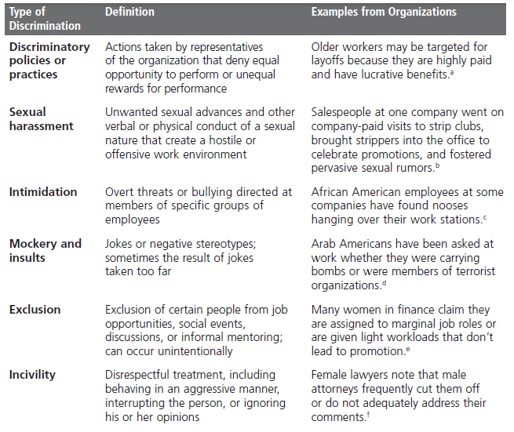
Forms of Discrimination

Slide 18
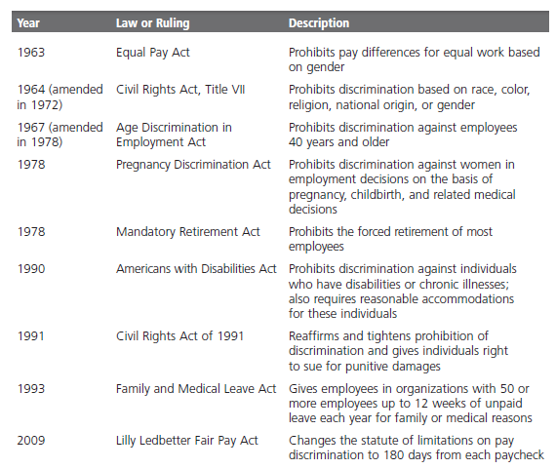
Major Equal Employment
Opportunity Laws

Slide 19
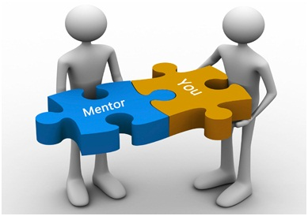
Top Management’s Commitment to Diversity
Mentoring - a process whereby an experienced organizational member (a mentor) provides advice and guidance to a less-experienced member (a protégé)

Slide 20
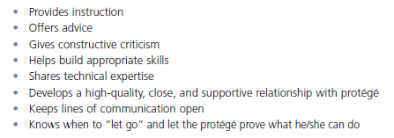
What a Good Mentor Does

Slide 21
Top Management’s Commitment to Diversity (cont,)
Diversity Skills Training - specialized training to educate employees about the importance of diversity and to teach them skills for working in a diverse workplace.
  First make employees aware of the diversity issue and its aspects, through awareness training.
  Secondly train employees how to manage diversity in the work environment, through developing their skills.

Slide 22
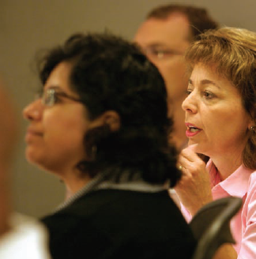
Commitment to Diversity (cont.)
Employee Resource Groups - groups made up of employees connected by some common dimension of diversity.

Slide 23
Terms to Know
Workforce diversity
Surface-level diversity
Deep-level diversity
Race
Ethnicity
Bias
Prejudice
Stereotyping
Discrimination
Glass ceiling
Mentoring
Diversity Skills Training
Employee resource groups
Notes:
23

Slide 24
Thank You All ☺!!!!

