Slide 1
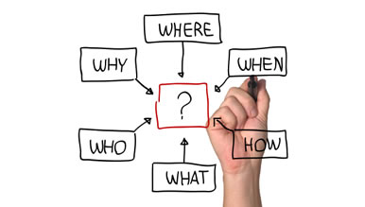
MGT 210 Chapter 8: Foundations of Planning

Slide 2
Planning: A primary managerial function
Defining the organization goals
Establishing an overall strategy for achieving those goals
Developing plans to organize work activities
concerned with both ends (what) and means (how).
Most plans are formal plans covering specific goals over a time period
Goals are shared with organizational members to create a common understanding

Slide 3
Why do managers plan?
Provides a sense of direction
Reduces Uncertainty
Reduces waste & redundancy
Setting standards for Controlling

Slide 4
Planning & Performance
Formal Planning is associated with the following
Higher profits and returns on assets
Positive financial results
The quality of planning and implementation affects performance more than the extent of planning
The external environment can reduce the impact of planning on performance

Slide 5
Goals & Plans
Two of the important aspects in business

Slide 6
Goals (objectives)
Desired outcomes or targets for individuals, groups, or entire organizations
Provide direction and evaluation performance criteria
often described as the essential elements of planning.
Most company’s goals are either strategic or financial.
Financial Goals - related to the expected internal financial performance of the organization.
Strategic Goals - related to the performance of the firm relative to all other factors in its external environment
Stated Goals - Official statements of what an organization says, and what it wants its various stakeholders to believe, its goals are.
Real Goals - Goals that an organization actually pursues, as defined by the actions of its members

Slide 7
Types of Plans

Slide 8
Types of Plans
Plans are documents that details how goals are going to be met. They usually include resource allocations, schedules and other necessary actions to accomplish the goals.

Slide 9
Types of Plans
Strategic Plans
Operational Goals
Applies to the whole organization
Establish the organization overall goals
Cover extended periods of time
Strategic plans are broad
Specify the details of how the overall goals are to be achieved
Cover a short time period
Operational plans are narrow

Slide 10
Types of Plans
Long-Term Plans
Time frames extending beyond three years.
Short-Term Plans
Time frames of one year or less.
Specific Plans
Plans that are clearly defined and leave no room for interpretation.
eliminates ambiguity and problems with misunderstanding.
Single-Use Plan
A one-time plan specifically designed to meet the need of a unique situation.
Standing Plans
Ongoing plans that provide guidance for activities performed repeatedly.
Directional Plans
Flexible plans that set out general guidelines and provide focus, yet allow discretion in implementation.

Slide 11
Setting Goals & Developing Plans

Slide 12
Traditional Approach to Goal Setting
Broad goals are set at the top of the organization.
Goals are then broken into sub-goals for each organizational level.
Goals are intended to direct, guide, and constrain from above.
Goals lose clarity and focus as lower-level managers attempt to interpret and define the goals for their areas of responsibility.

Slide 13
Maintaining the Hierarchy of Goals
Means End Chain
The integrated network of goals that results from establishing a clearly-defined hierarchy of organizational goals.
Achievement of lower-level goals is the means by which to reach higher-level goals (ends).

Slide 14
Management by Objectives
Specific performance goals are jointly determined by employees and managers
Goal specificity
Participative decision making
An explicit performance/evaluation period (Time Period)
Performance feedback
MBO uses goals to motivate employees rather than forcing them

Slide 15
Setting Well Written goals
Mangers should follow five steps when setting goals:
Review the organization’s mission or purpose
Evaluate available resources
Determine goals individually or with input from others.
Write down the goals and communicate them to all those who need to know
Review results and whether goals are being met.
Characteristics of well written goals:
Written in terms of outcomes rather than actions
Measurable and quantifiable
Clear as to a time frame
Challenging yet attainable
Written down
Communicated to all necessary organizational members

Slide 16
Contingency Factors in Planning
Manager’s level in the organization
Strategic plans at higher levels
Operational plans at lower levels
Degree of environmental uncertainty
Stable environment: specific plans
Dynamic environment: specific but flexible plans

Slide 17
Approaches to Planning
Establishing a formal planning department
Involving organizational members in the process
a group of planning specialists that help managers write organizational plans.
Planning is a function of management; it should never become the sole responsibility of planners.
Plans are developed by members of organizational units at various levels
coordinated with other units across the organization.

Slide 18
Planning in Dynamic Environment
Develop plans that are specific but flexible.
Understand that planning is an ongoing process.
Change plans when conditions warrant alterations.
Persistence in planning eventually pays off.
Flatten the organizational hierarchy to foster the development of planning skills at all organizational levels.

Slide 19
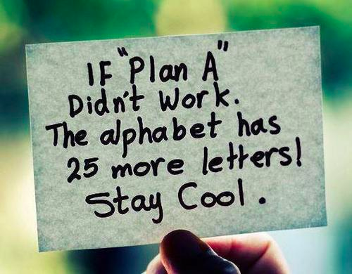
THANK YOU EVERYONE & TAKE CARE….

